Slide 1
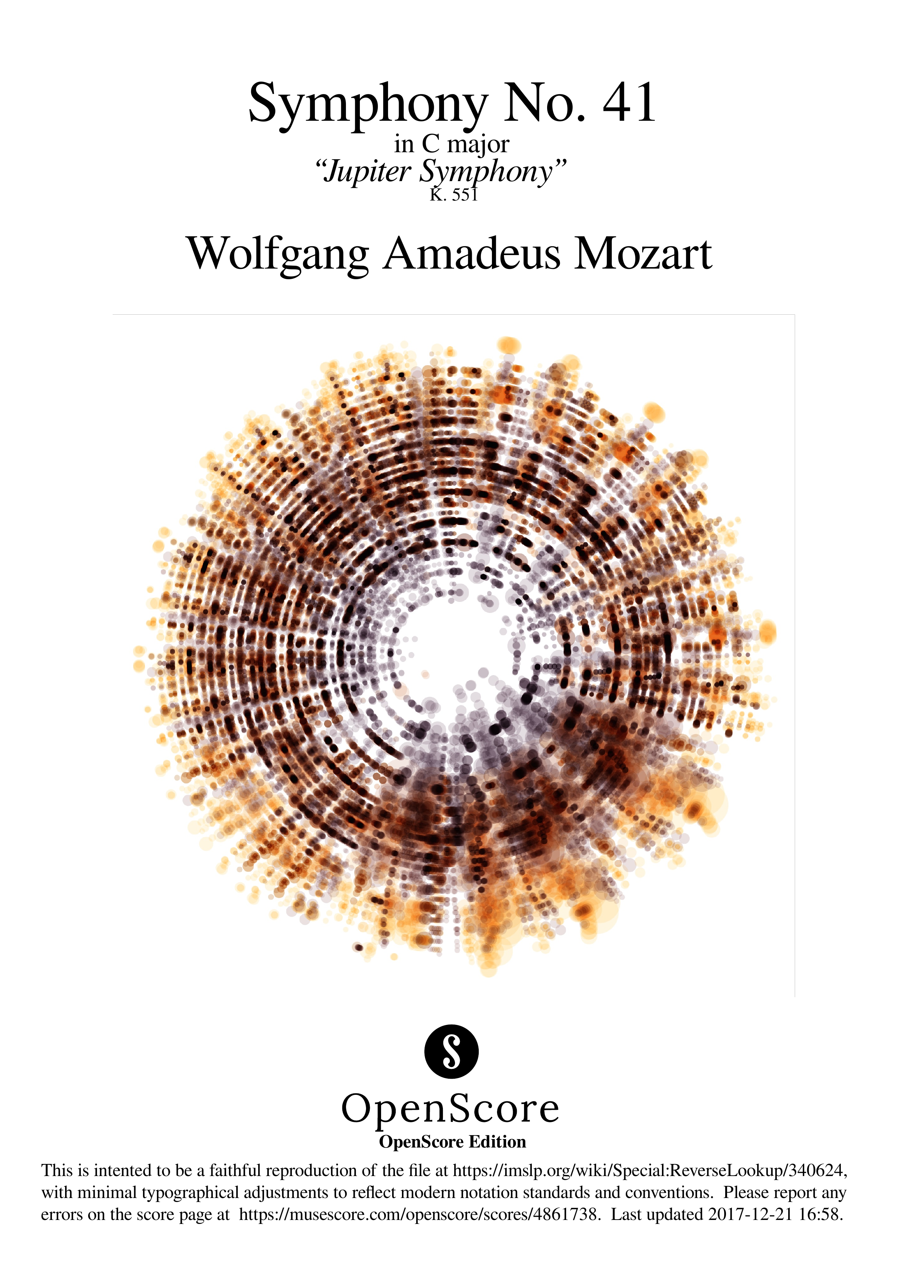

Slide 2
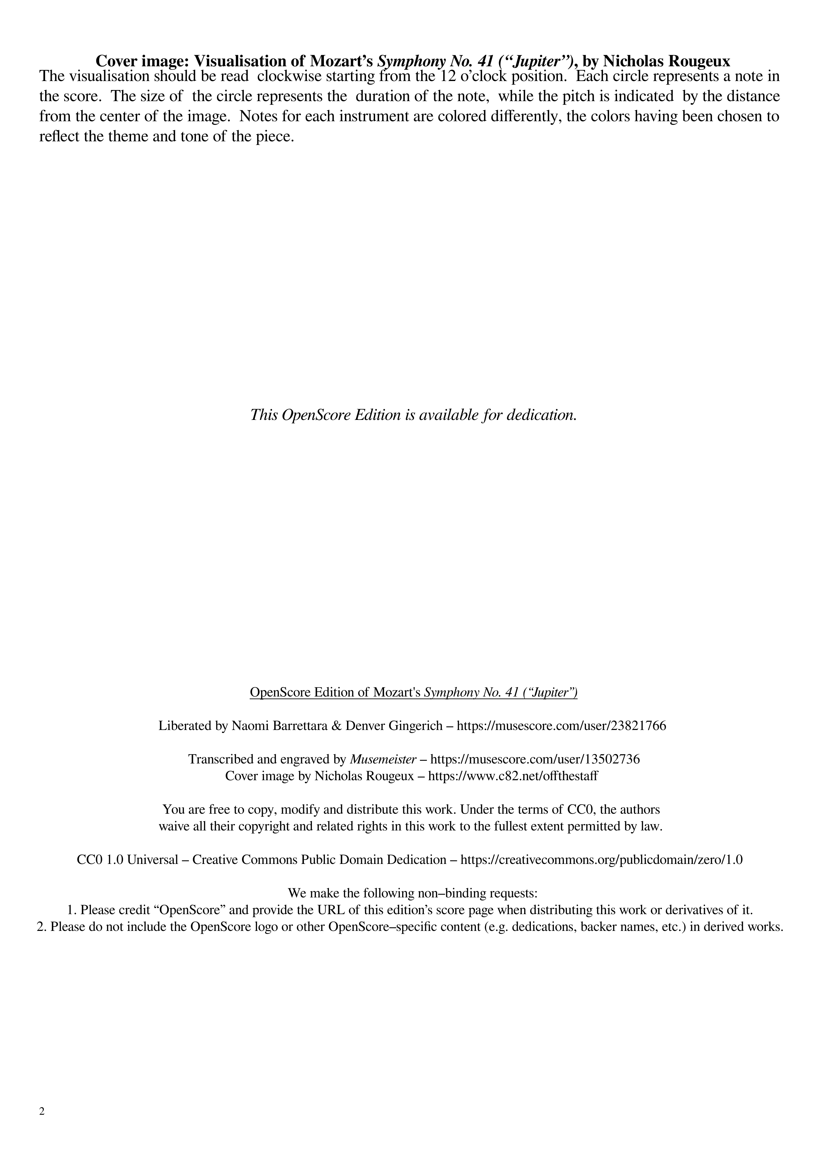

Slide 3
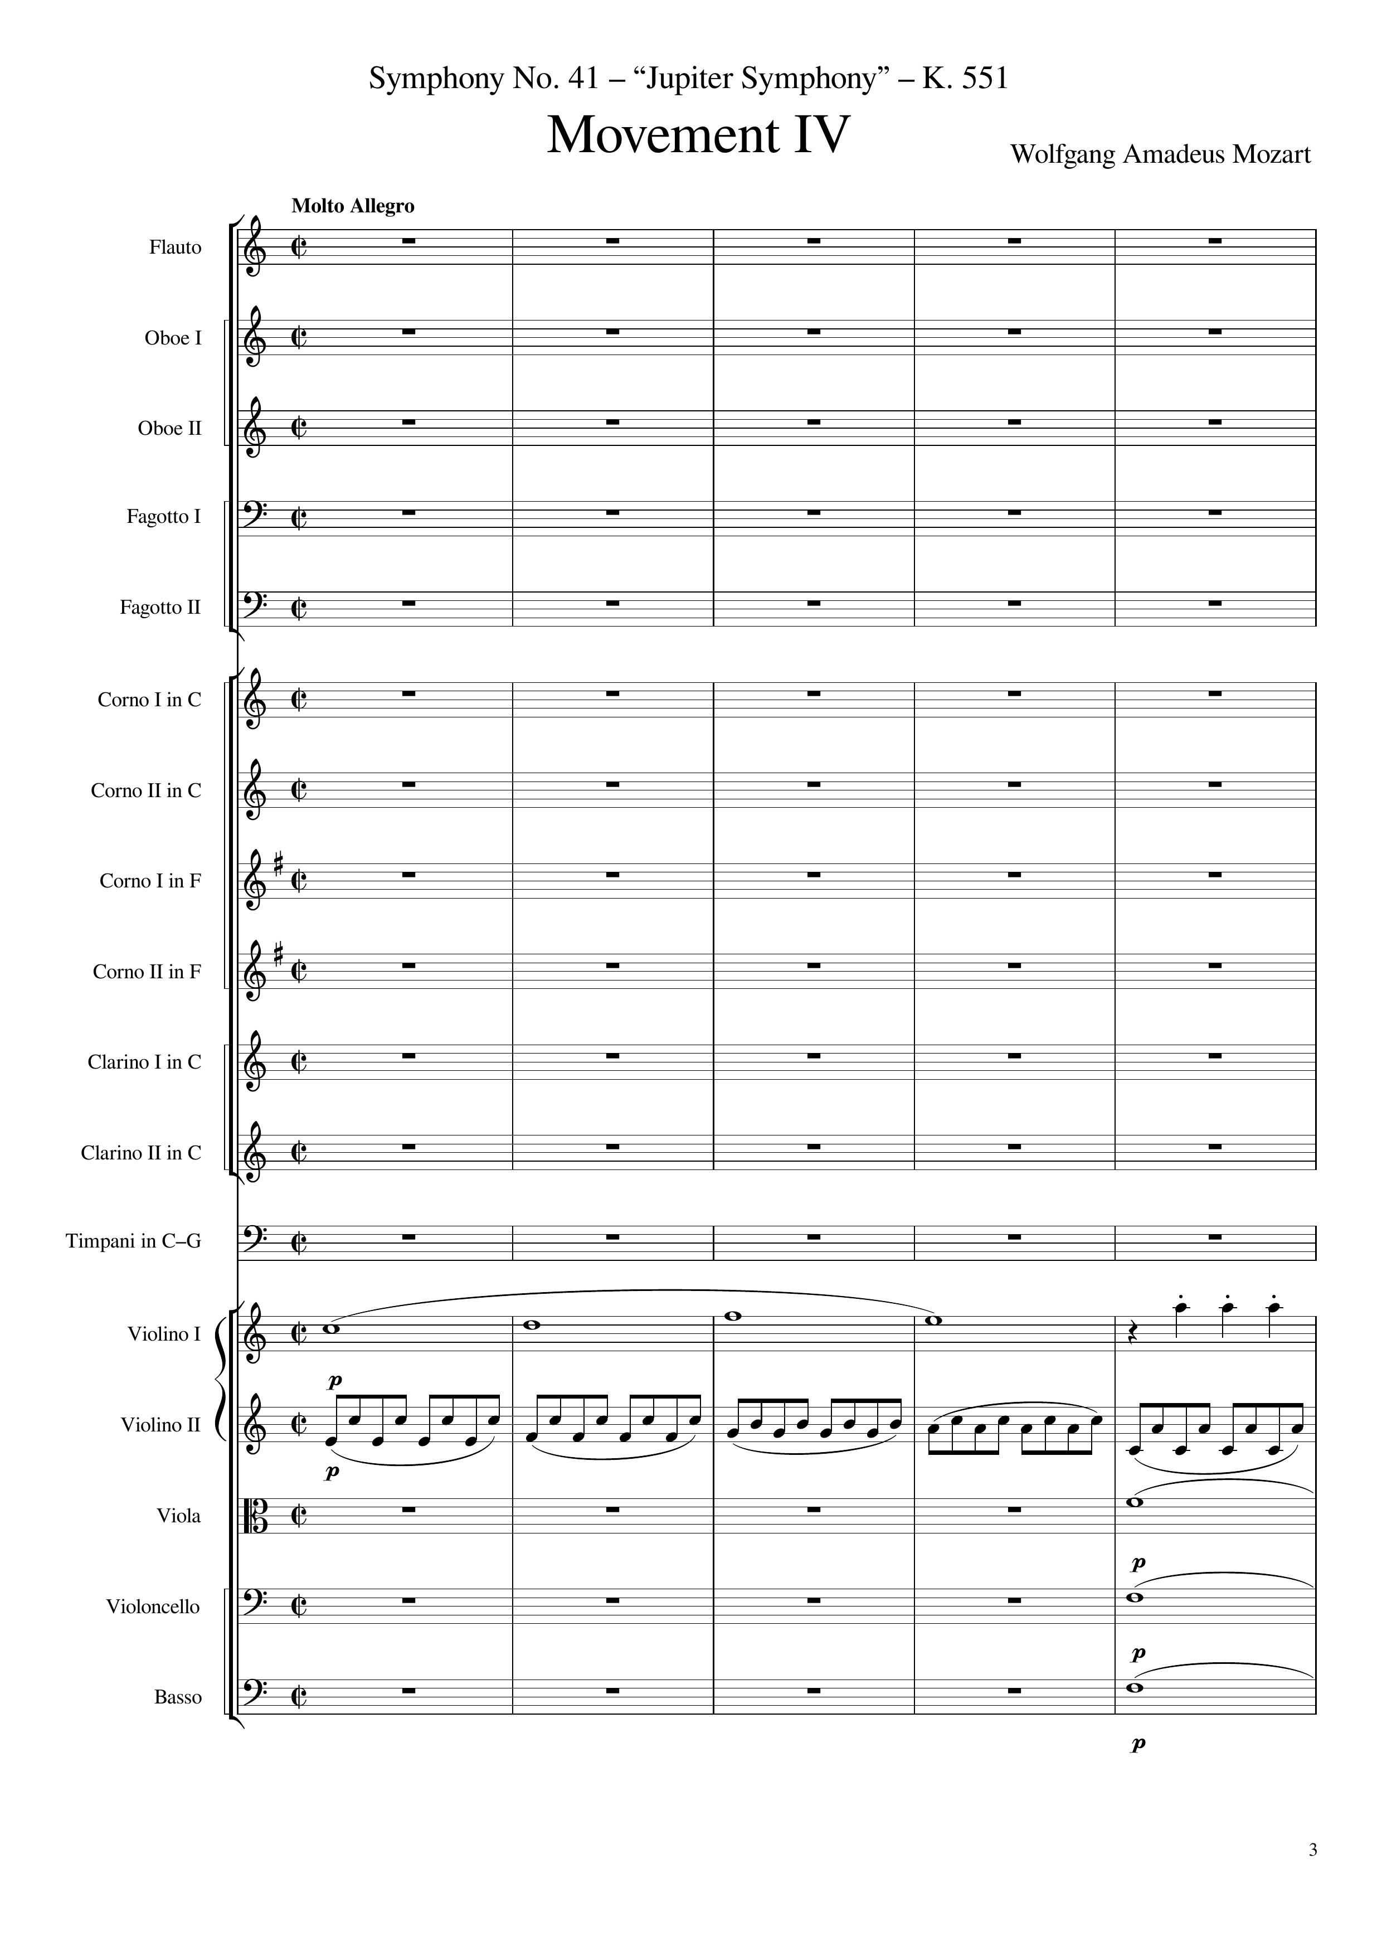
mel
rhythm
harm
harm
harm
0
20
Notes:
31:55

Slide 4
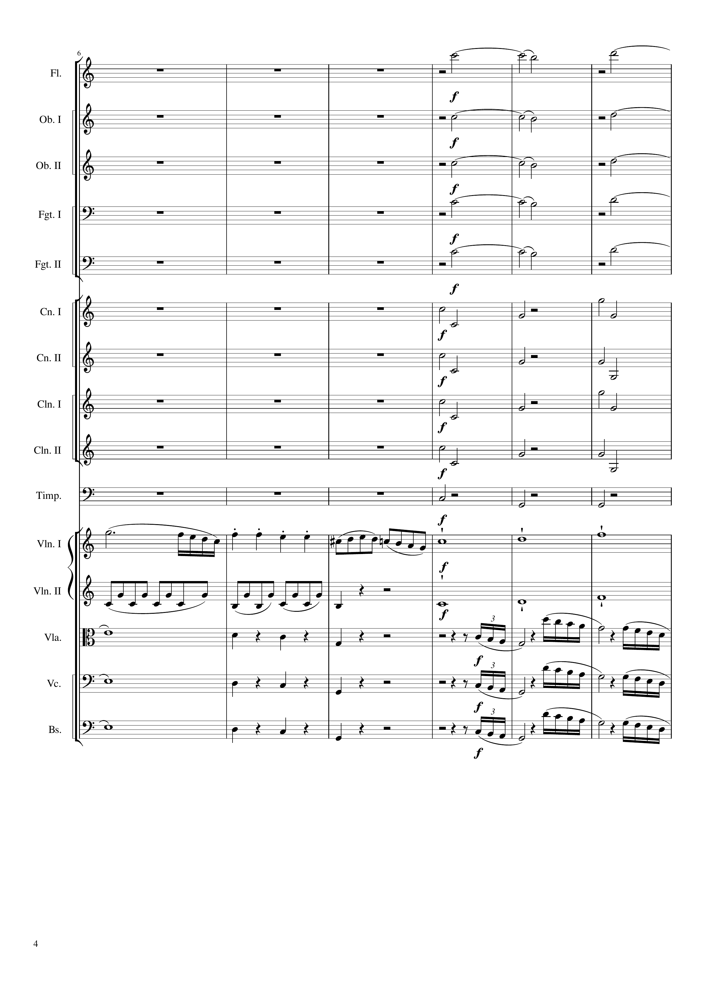
harm
harm
harm
harm
harm
rhythm+harm
rhythm+harm
rhythm+harm
rhythm+harm
rhythm+harm
mel
mel
rhythm
mel
harm
rhythm+harm
rhythm
harm
rhythm+harm
rhythm
harm
rhythm+harm
rhythm
20
32
44

Slide 5
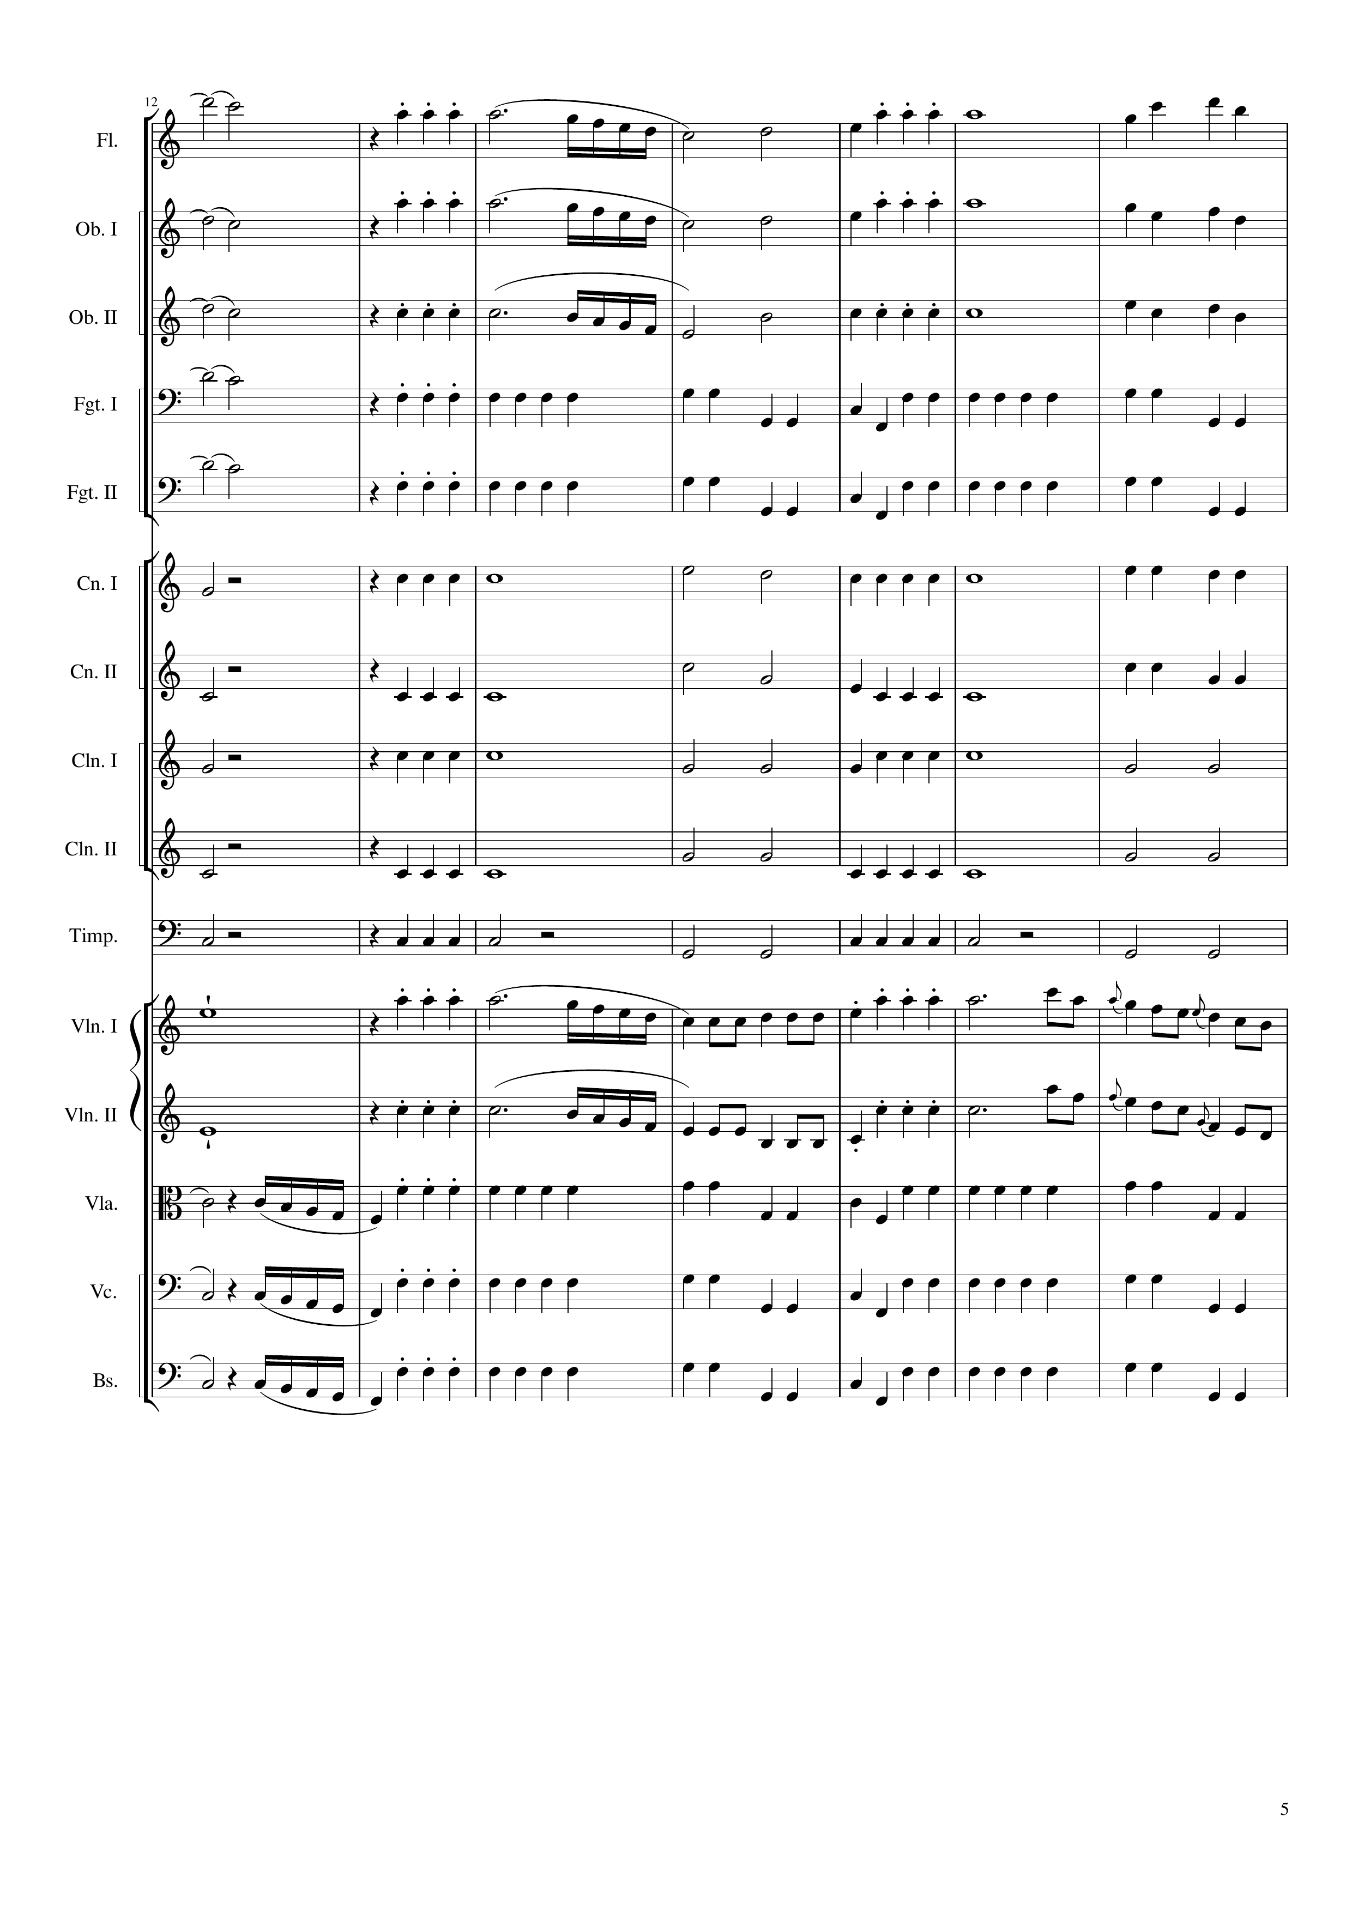
harm
mel
harm
mel
harm
mel
harm
rhythm
harm
rhythm
rhythm+harm
rhythm+harm
rhythm+harm
rhythm+harm
rhythm+harm
mel
mel
rhythm
rhythm
rhythm
44
72

Slide 6
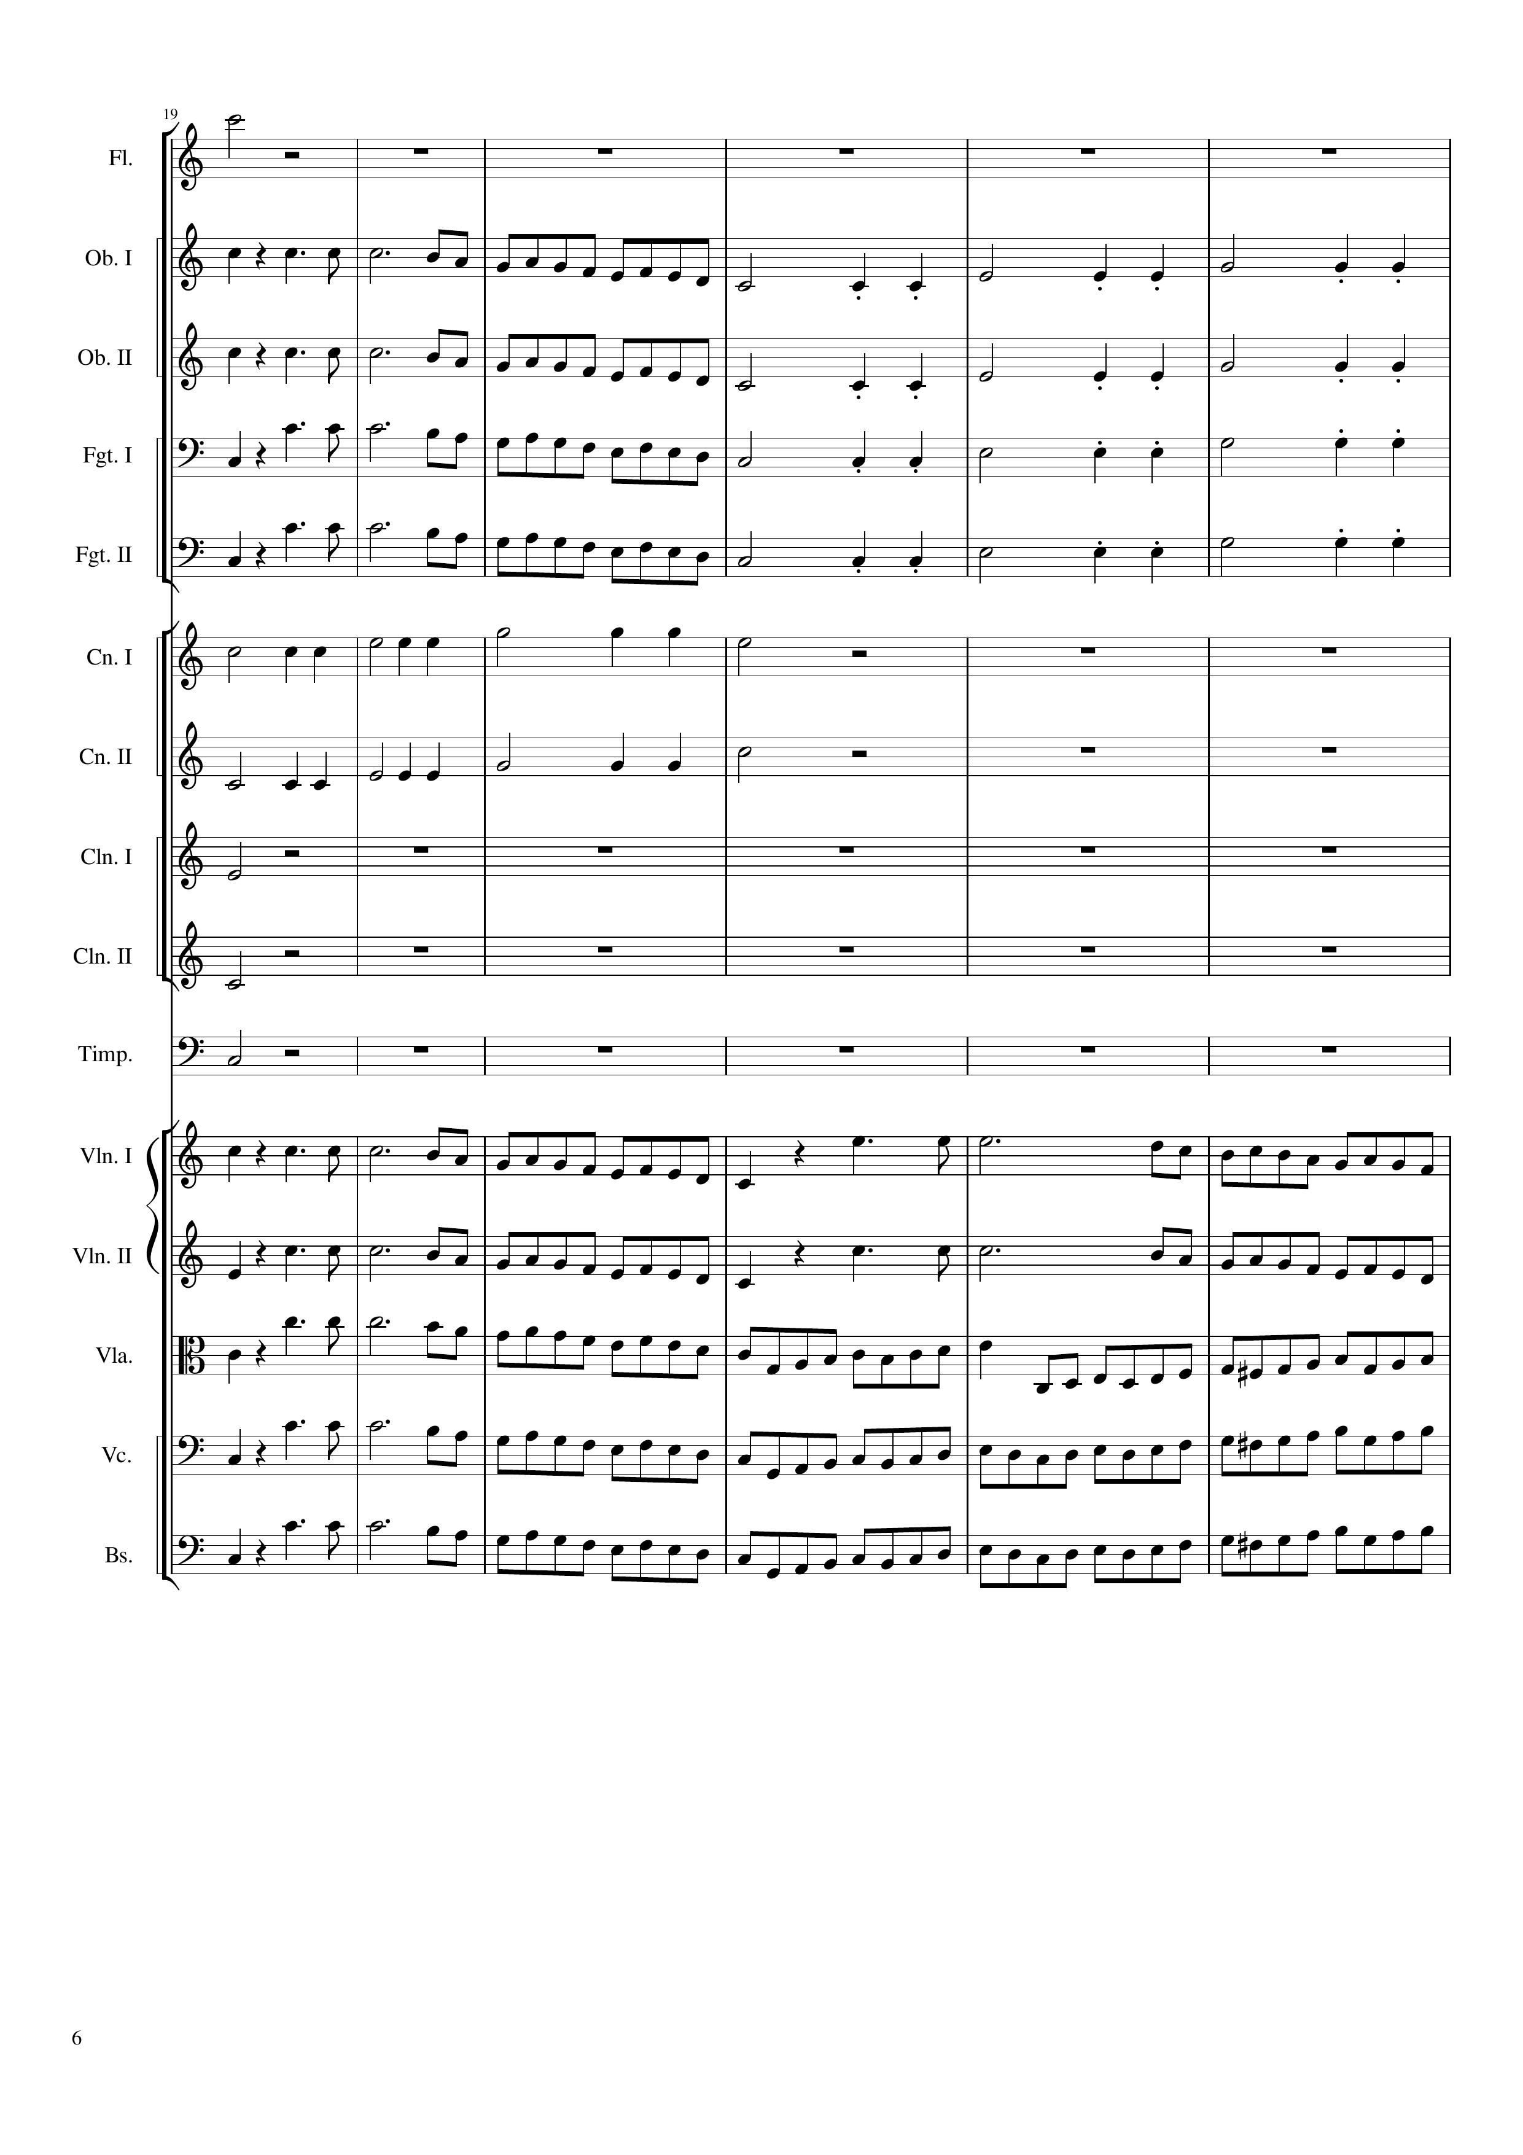
mel
mel
mel
rhythm
mel
mel
rhythm
rhythm
mel
rhythm
rhythm
mel
rhythm
rhythm+harm
rhythm
rhythm+harm
rhythm
rhythm+harm
rhythm+harm
rhythm+harm
mel
mel
mel
mel
rhythm
mel
rhythm
rhythm
mel
rhythm
rhythm
mel
rhythm
72
84
96

Slide 7
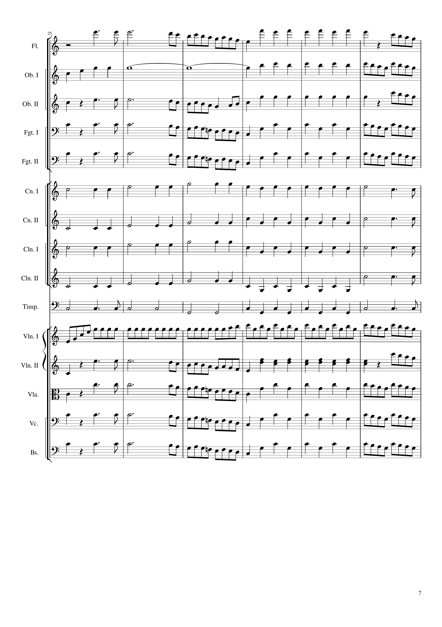
mel
rhythm+harm
mel
rhythm
rhythm+harm
mel
rhythm
mel
rhythm+harm
mel
rhythm
mel
rhythm+harm
mel
rhythm
mel
rhythm+harm
mel
rhythm
rhythm+harm
rhythm
rhythm
rhythm+harm
rhythm
rhythm
rhythm+harm
rhythm
rhythm
rhythm+harm
rhythm
rhythm
rhythm+harm
rhythm
rhythm
mel
mel
rhythm+harm
mel
rhythm
mel
rhythm+harm
mel
rhythm
mel
rhythm+harm
mel
rhythm
mel
rhythm+harm
mel
96
108
120

Slide 8
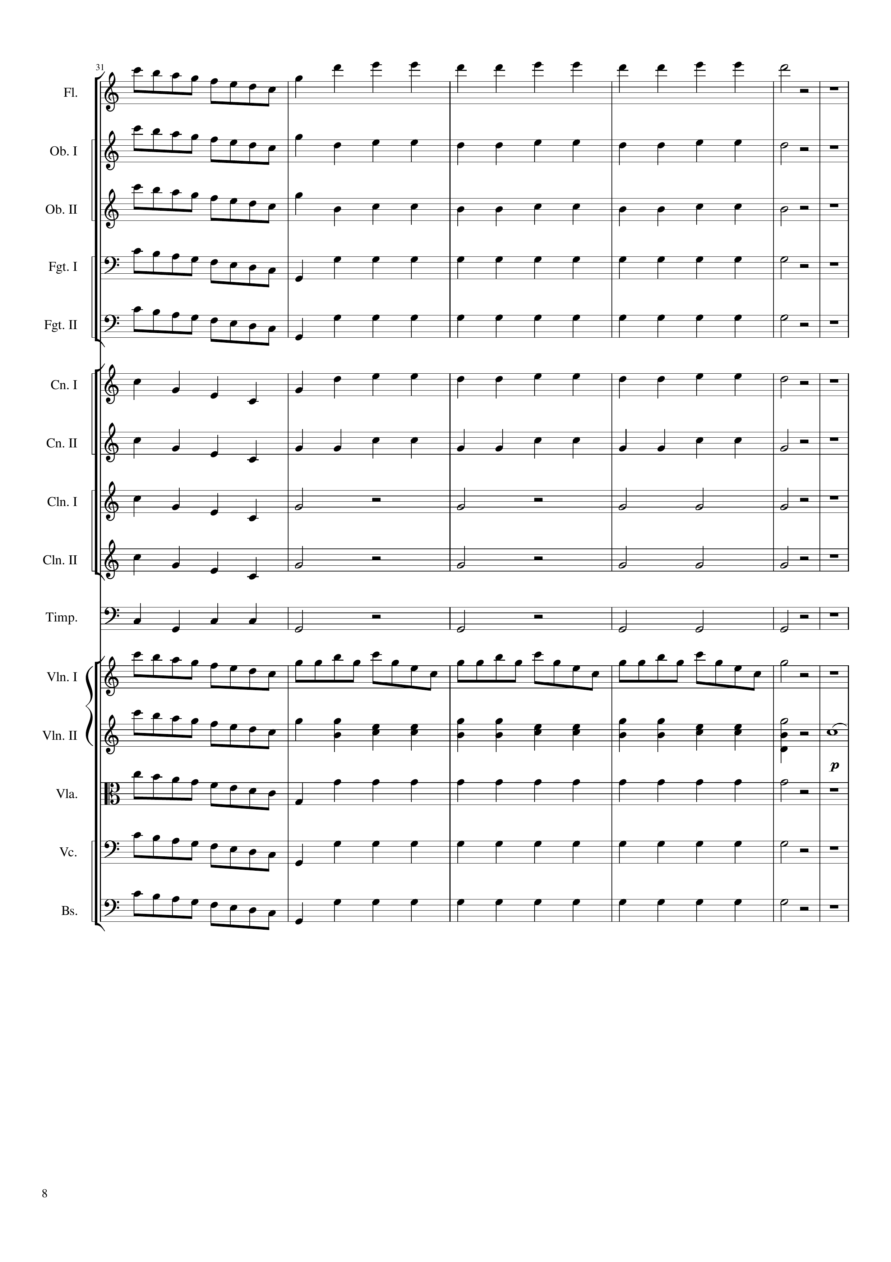
mel
rhythm+harm
mel
rhythm+harm
mel
rhythm+harm
mel
rhythm
mel
rhythm
rhythm
rhythm+harm
rhythm
rhythm+harm
rhythm
rhythm
rhythm
rhythm
rhythm
rhythm
mel
mel
rhythm+harm
mel
mel
rhythm
mel
rhythm
mel
rhythm
120
144

Slide 9
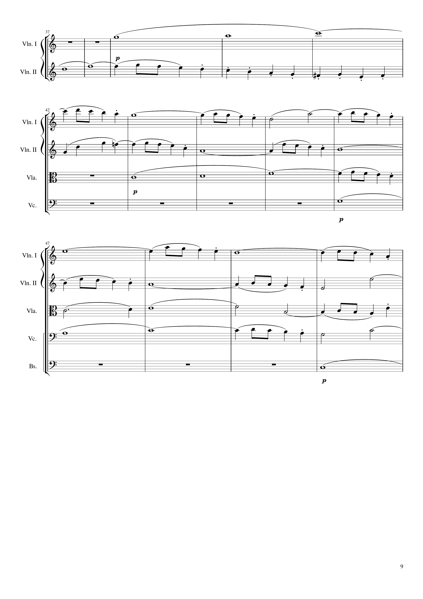
mel
mel
144
164
mel
mel
mel
mel
164
184
mel
mel
mel
mel
mel
184
200

Slide 10
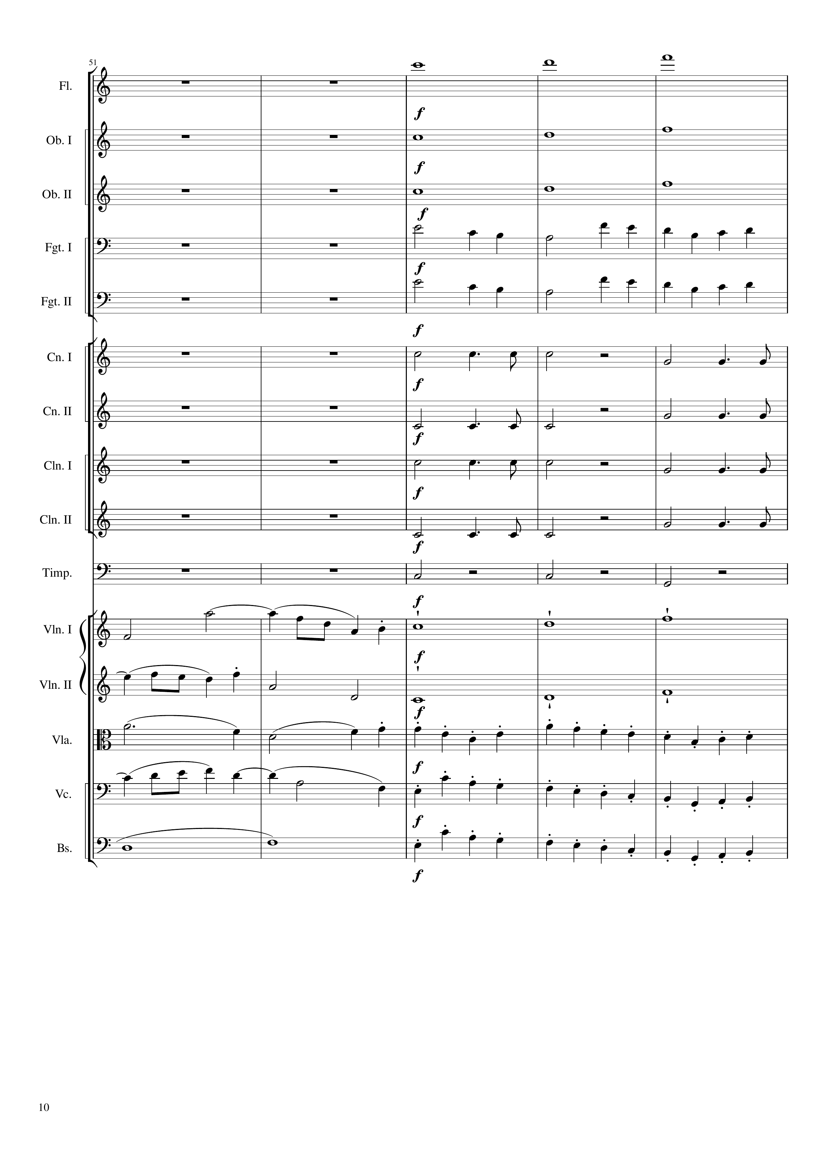
mel
mel
mel
rhythm
rhythm
rhythm
rhythm
rhythm
rhythm
rhythm
mel
mel
mel
mel
mel
rhythm
mel
rhythm
mel
rhythm
200
208
220

Slide 11
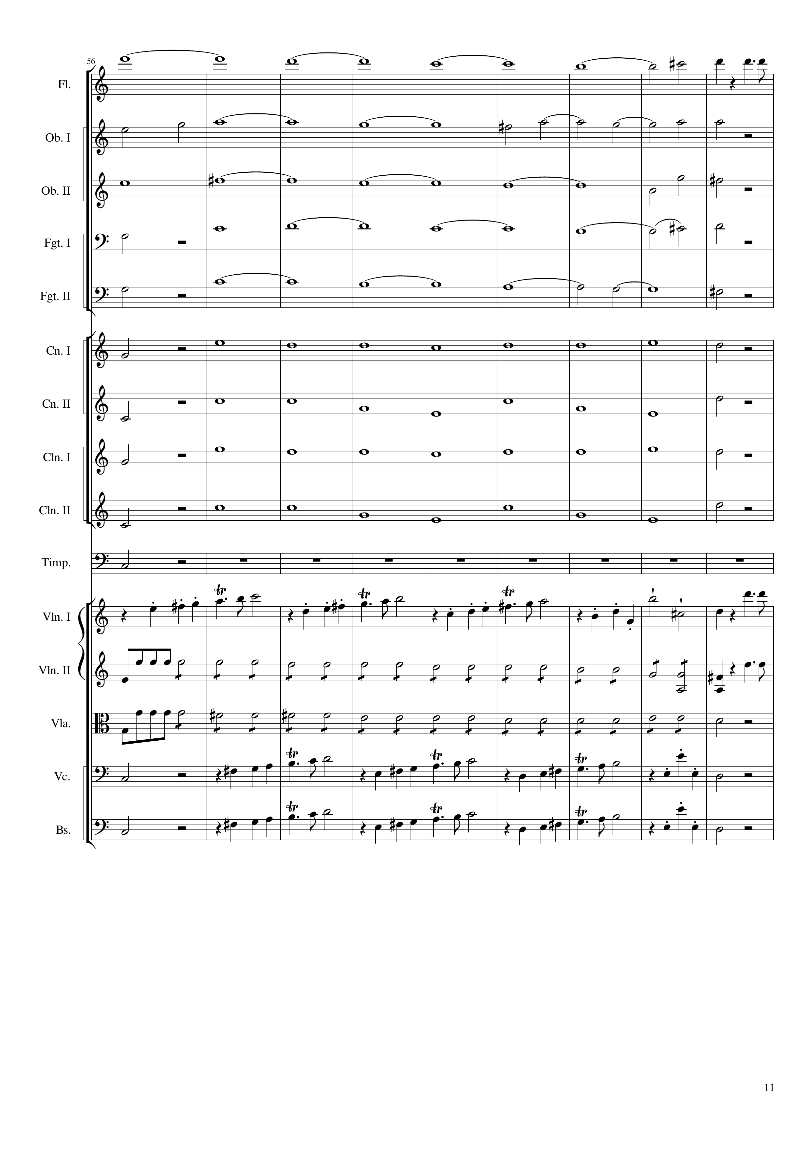
mel
harm
mel
mel
harm
mel
harm
rhythm
harm
rhythm
harm
rhythm
harm
rhythm
harm
rhythm
harm
rhythm
harm
rhythm
mel
mel
rhythm
rhythm
mel
rhythm
rhythm
rhythm
mel
rhythm
mel
220
224
256

Slide 12
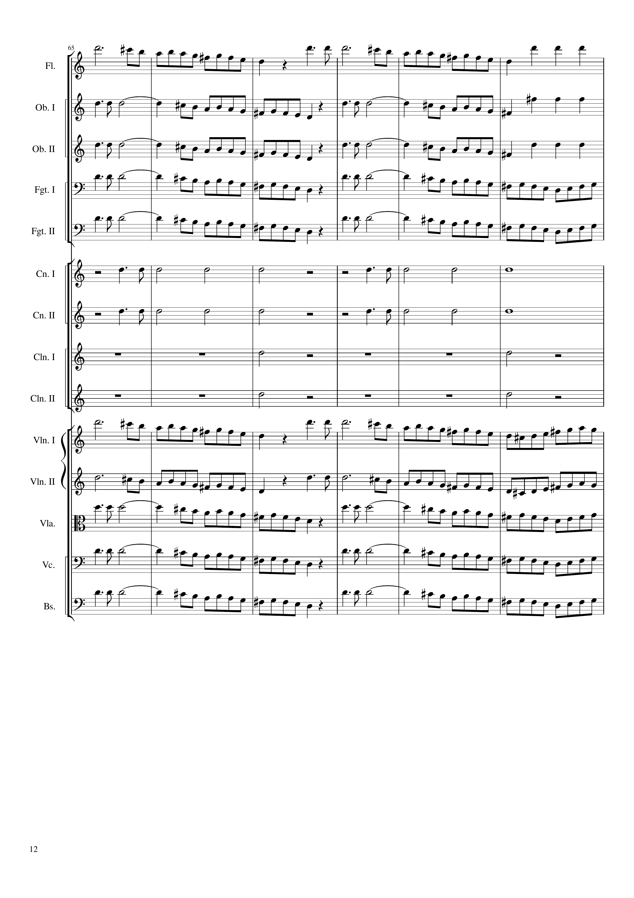
mel
rhythm+harm
mel
rhythm+harm
mel
rhythm+harm
mel
mel
rhythm
rhythm
rhythm
rhythm
rhythm
rhythm
mel
mel
mel
mel
mel
256
280

Slide 13
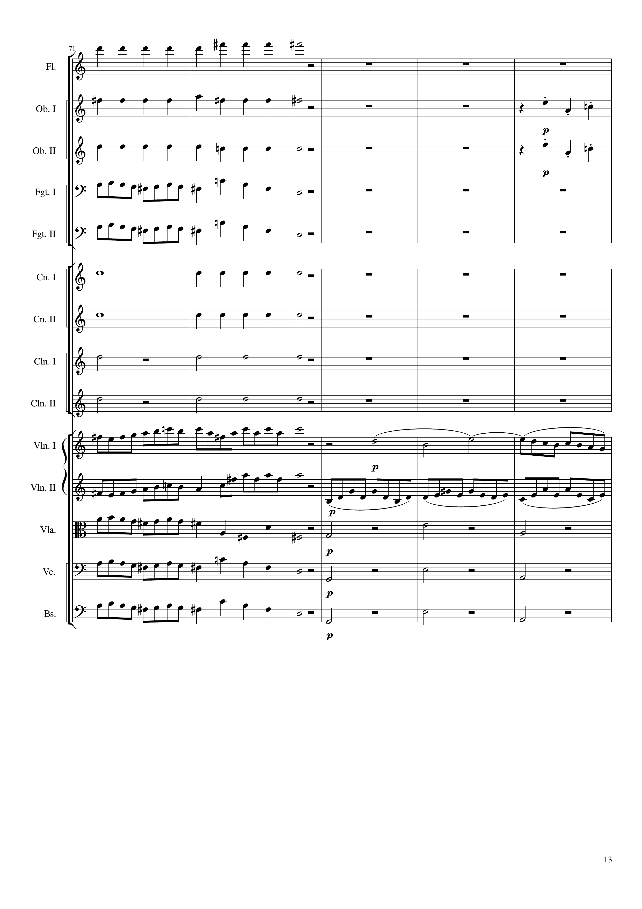
rhythm+harm
rhythm+harm
rhythm
rhythm+harm
rhythm
mel
mel
rhythm
rhythm
rhythm
rhythm
mel
mel
mel
rhythm
mel
rhythm+harm
mel
rhythm+harm
mel
rhythm+harm
280
292
304

Slide 14
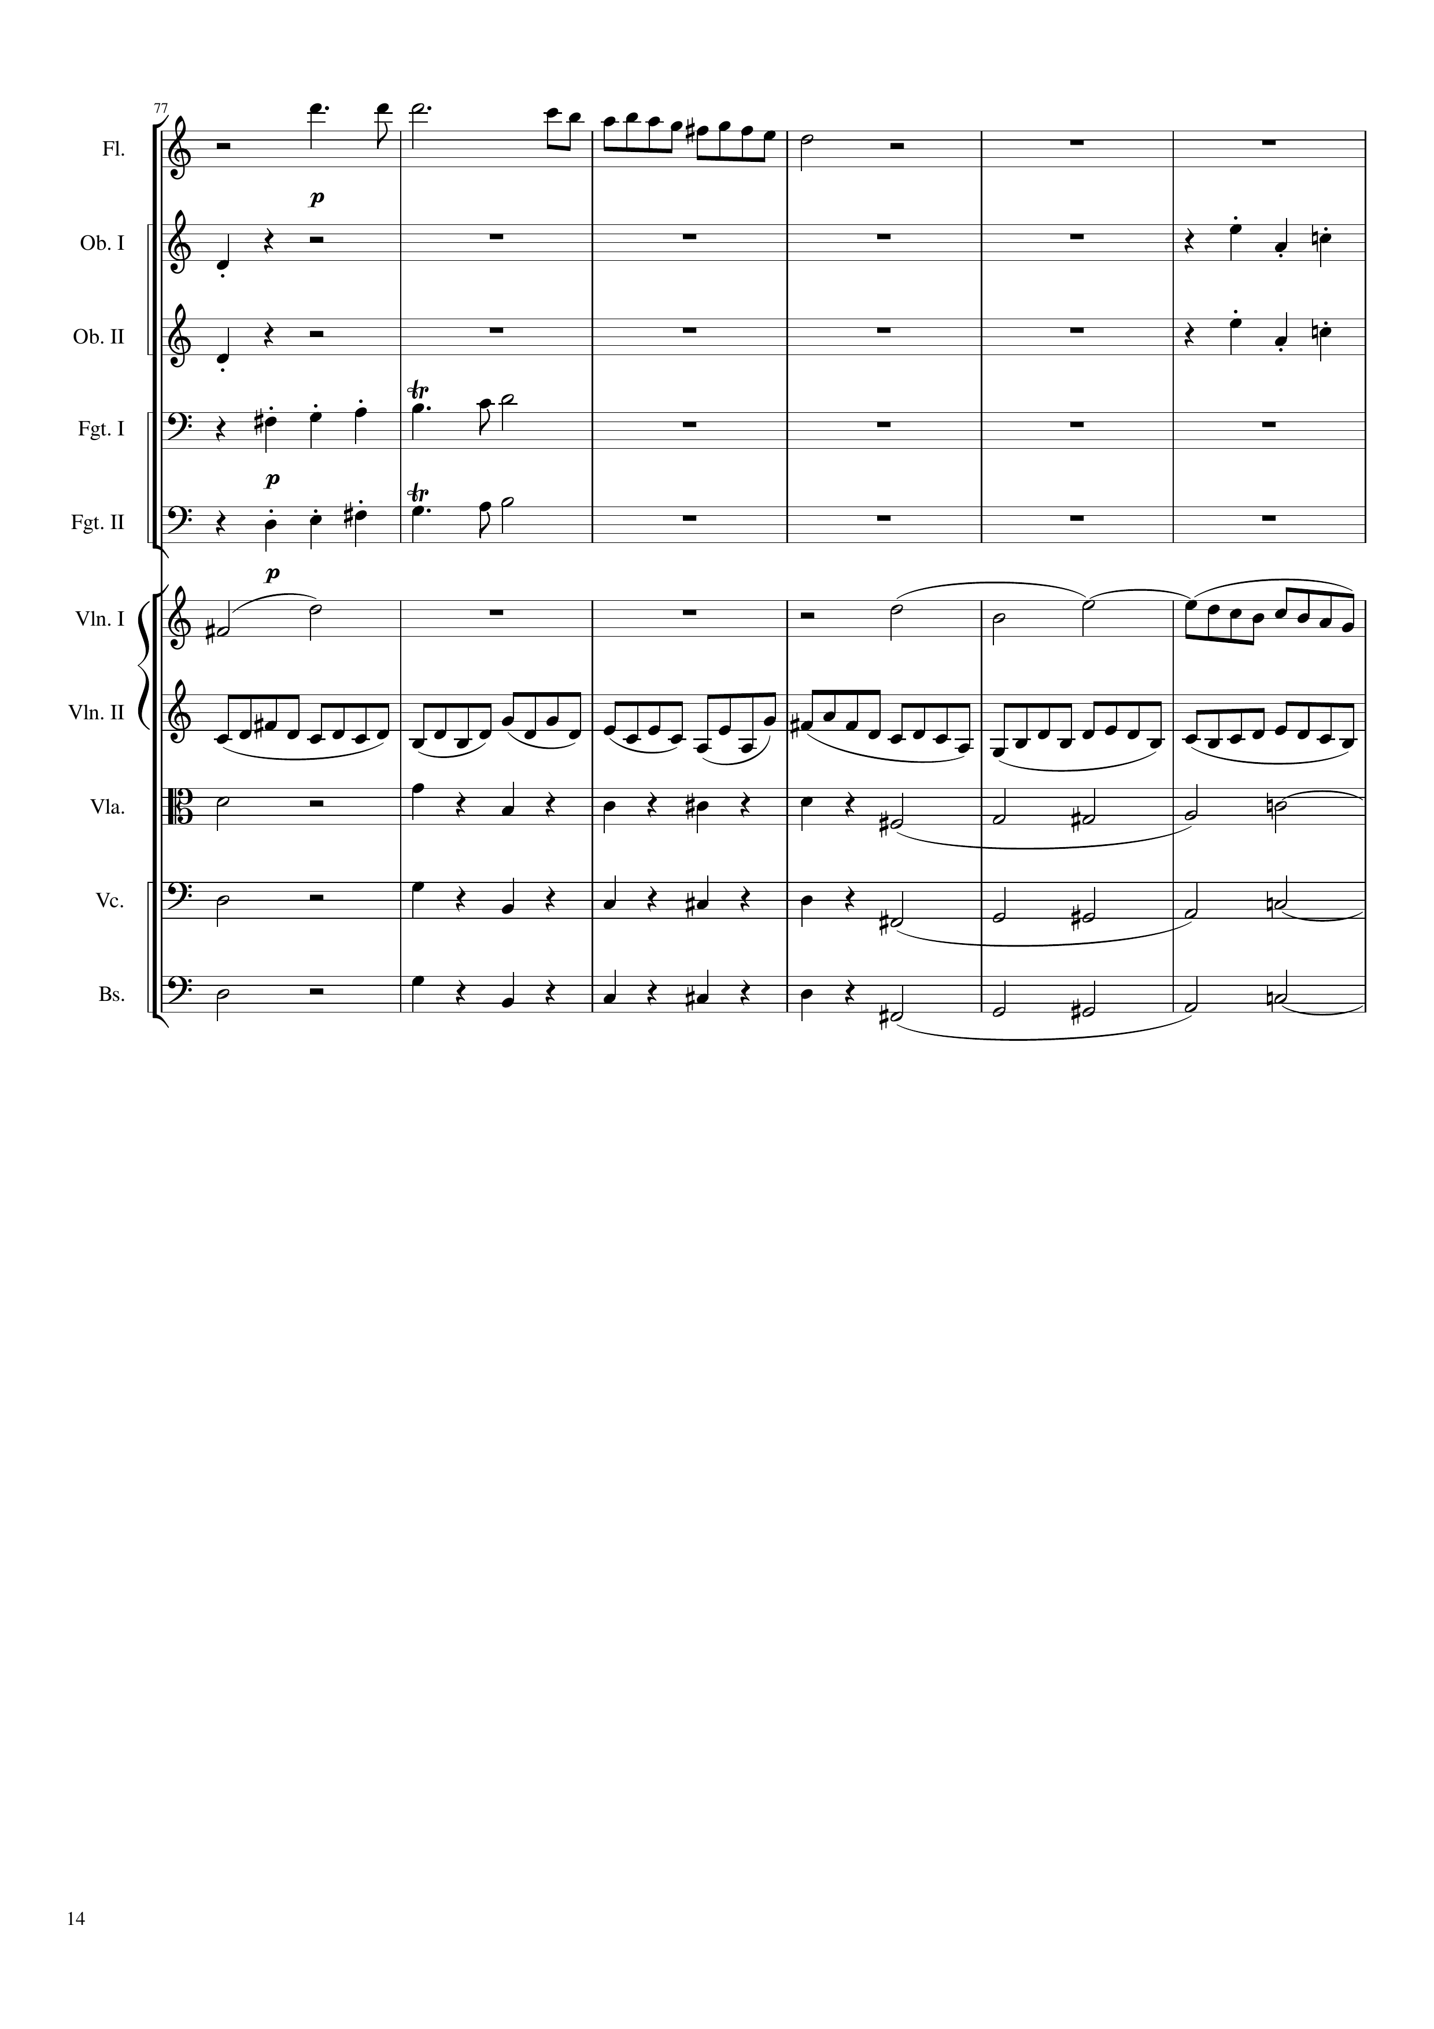
mel
rhythm
rhythm
rhythm
rhythm
mel
mel
mel
mel
rhythm
rhythm+harm
mel+harm
rhythm+harm
mel+harm
rhythm+harm
mel+harm
304
316
328

Slide 15
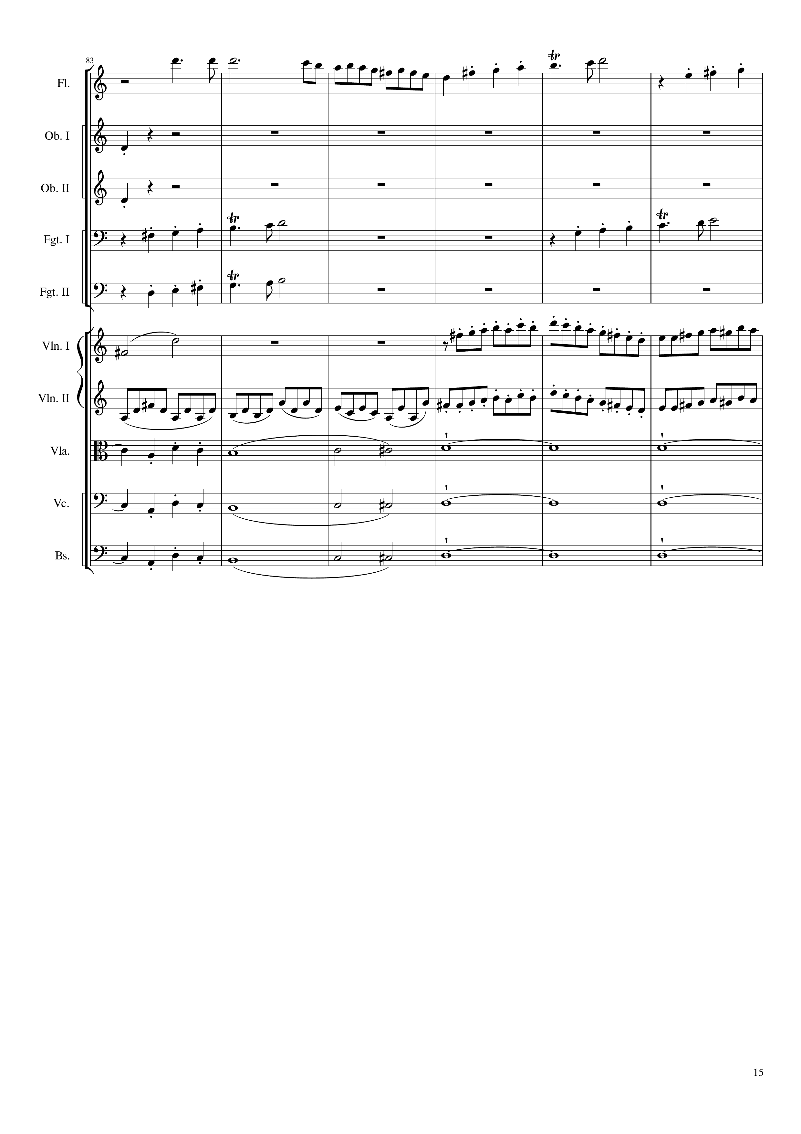
mel
rhythm
rhythm
mel
mel
mel
mel
mel
rhythm
mel
mel+harm
harm
mel+harm
harm
mel+harm
harm
328
340
352

Slide 16
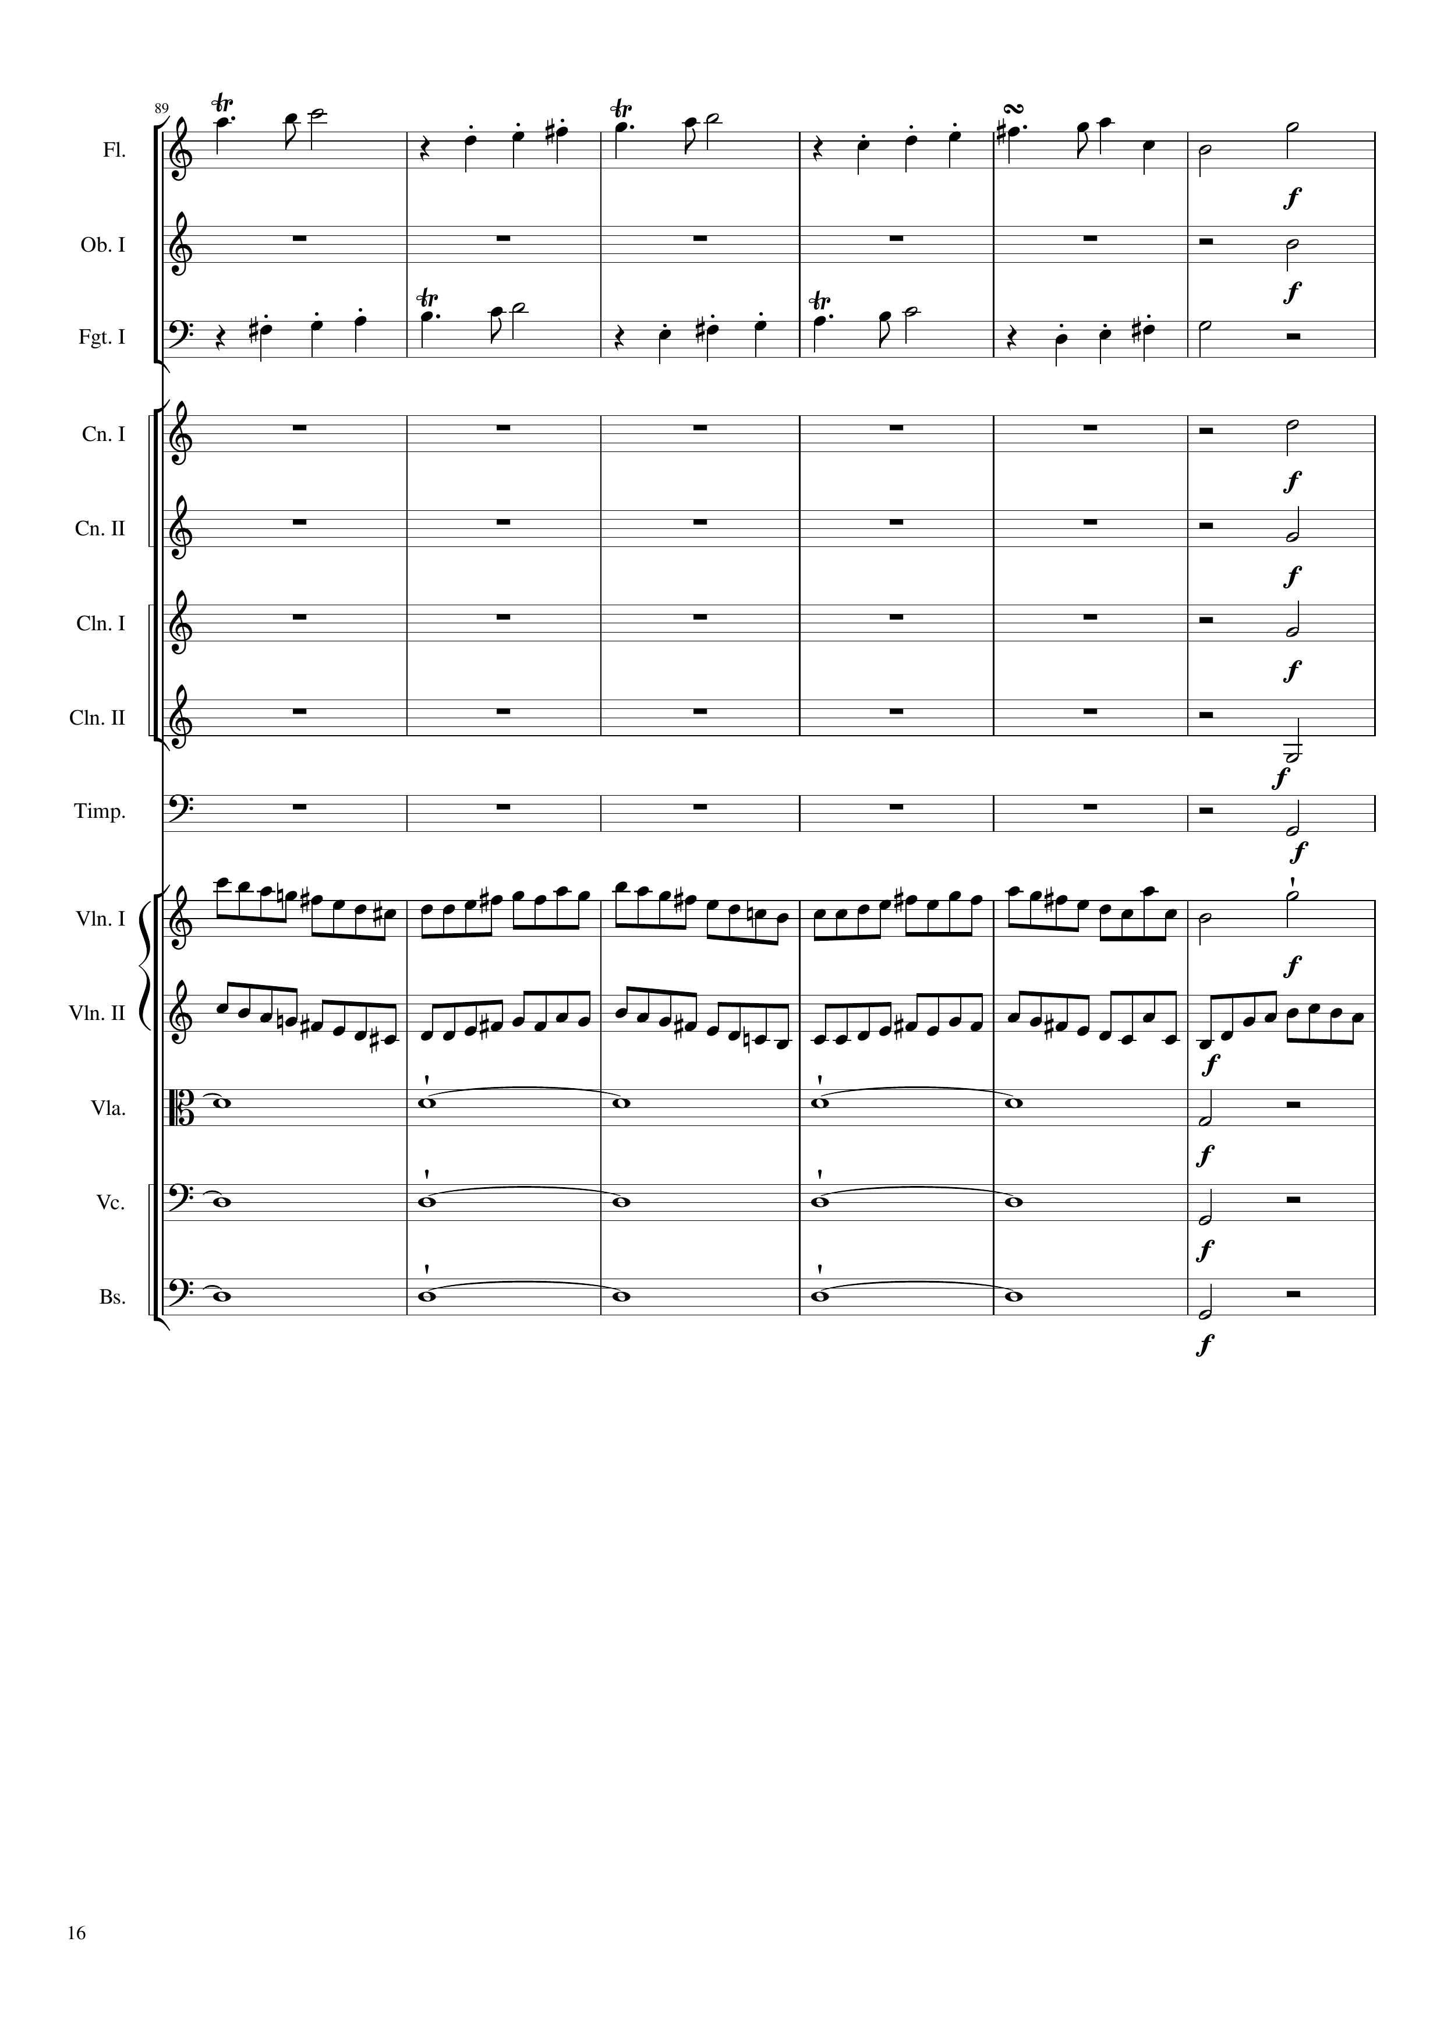
mel
mel
mel
mel
rhythm
rhythm
rhythm
rhythm
rhythm
mel
mel
mel
harm
harm
harm
352
376
Notes:
33:15

Slide 17
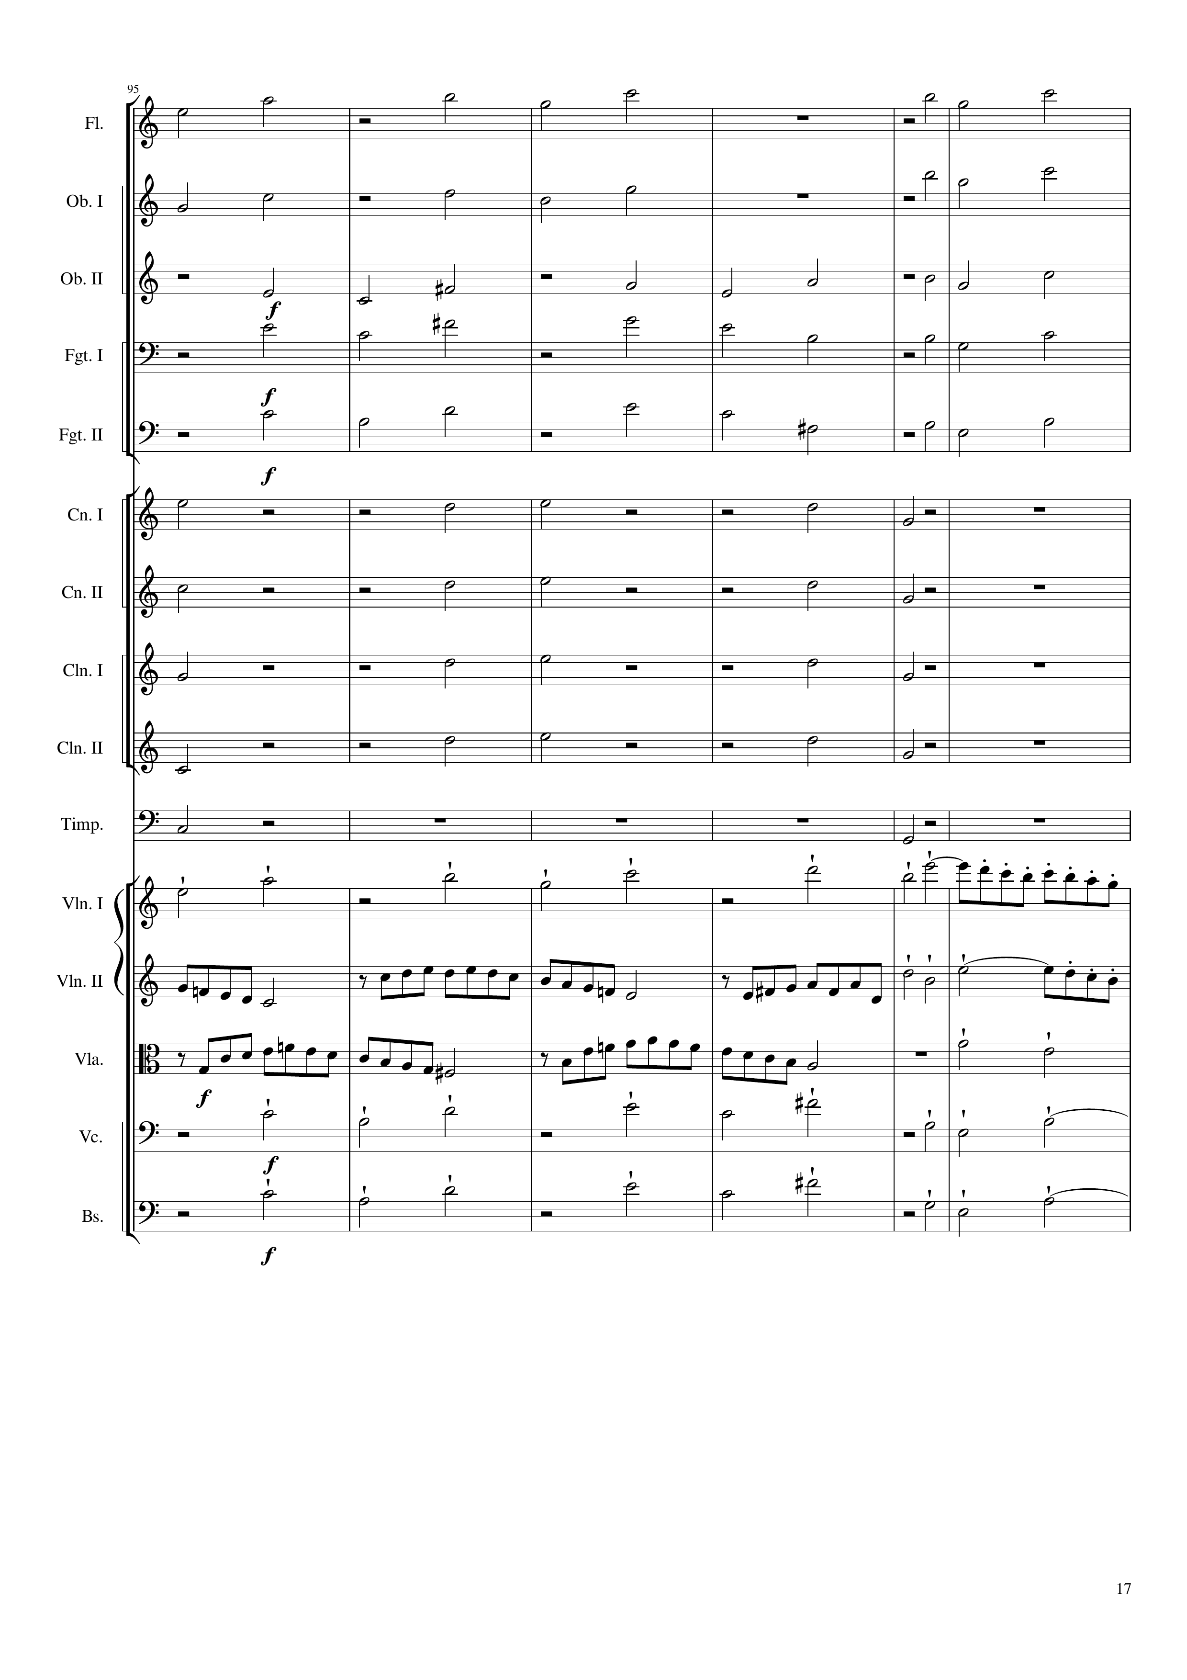
mel
mel
mel
mel
mel
mel
mel
mel
mel
mel
rhythm
rhythm
rhythm
rhythm
rhythm
rhythm
mel
mel
mel
mel
mel
376
400

Slide 18
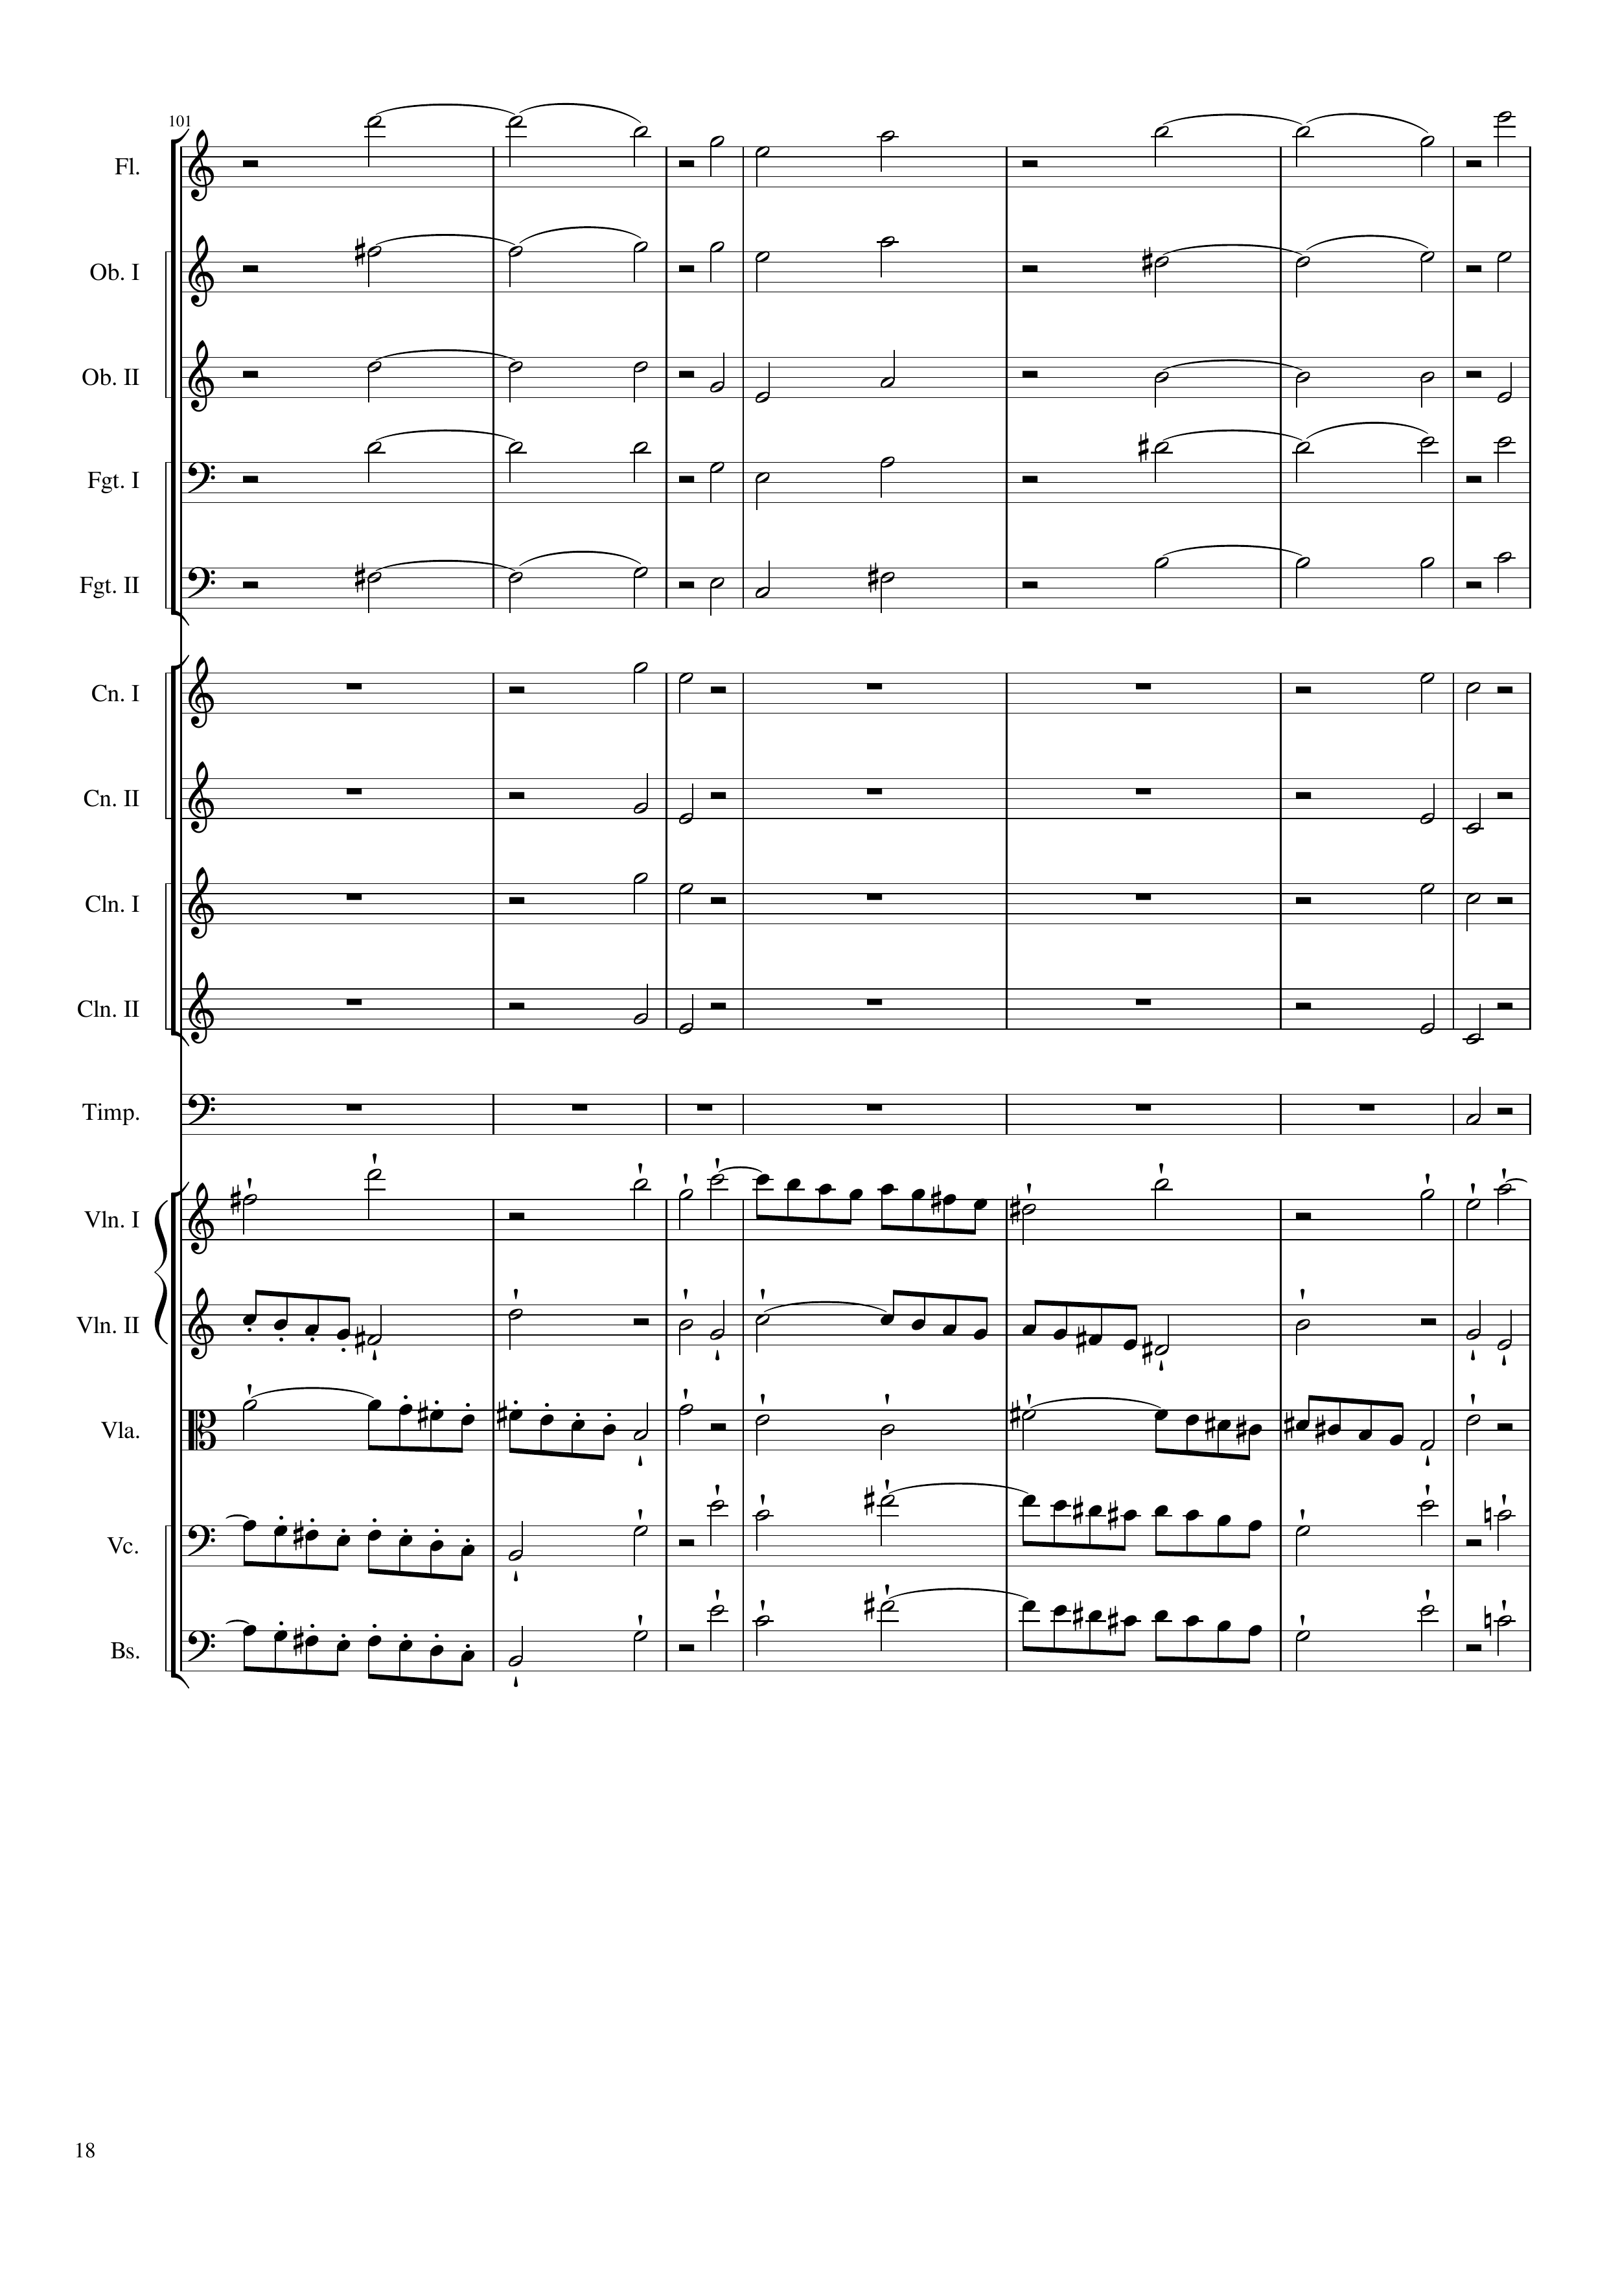
harm
mel
harm
mel
harm
mel
harm
mel
harm
mel
harm
mel
harm
mel
harm
mel
harm
mel
harm
mel
rhythm
rhythm
rhythm
rhythm
rhythm
rhythm
rhythm
rhythm
rhythm
mel
mel
mel
mel
mel
400
428

Slide 19
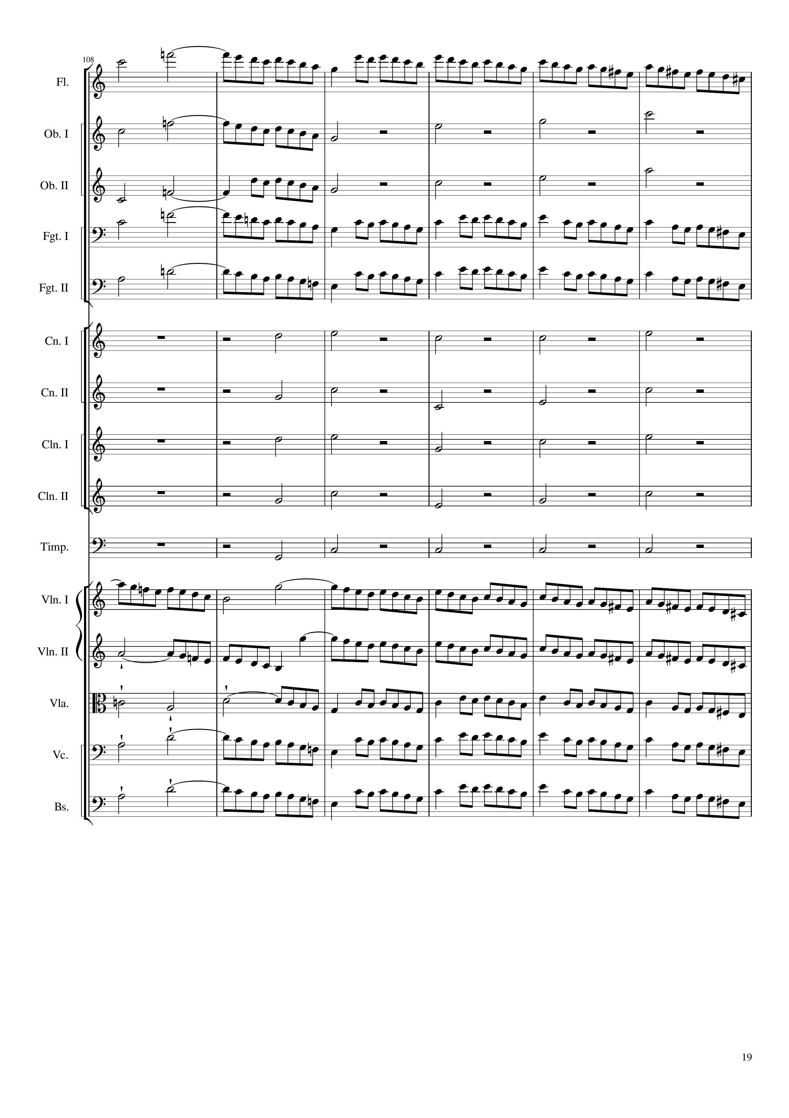
mel
mel
rhythm+harm
mel
rhythm+harm
mel
mel
rhythm+harm
rhythm+harm
rhythm+harm
rhythm+harm
rhythm+harm
mel
mel
mel
mel
mel
428
452

Slide 20
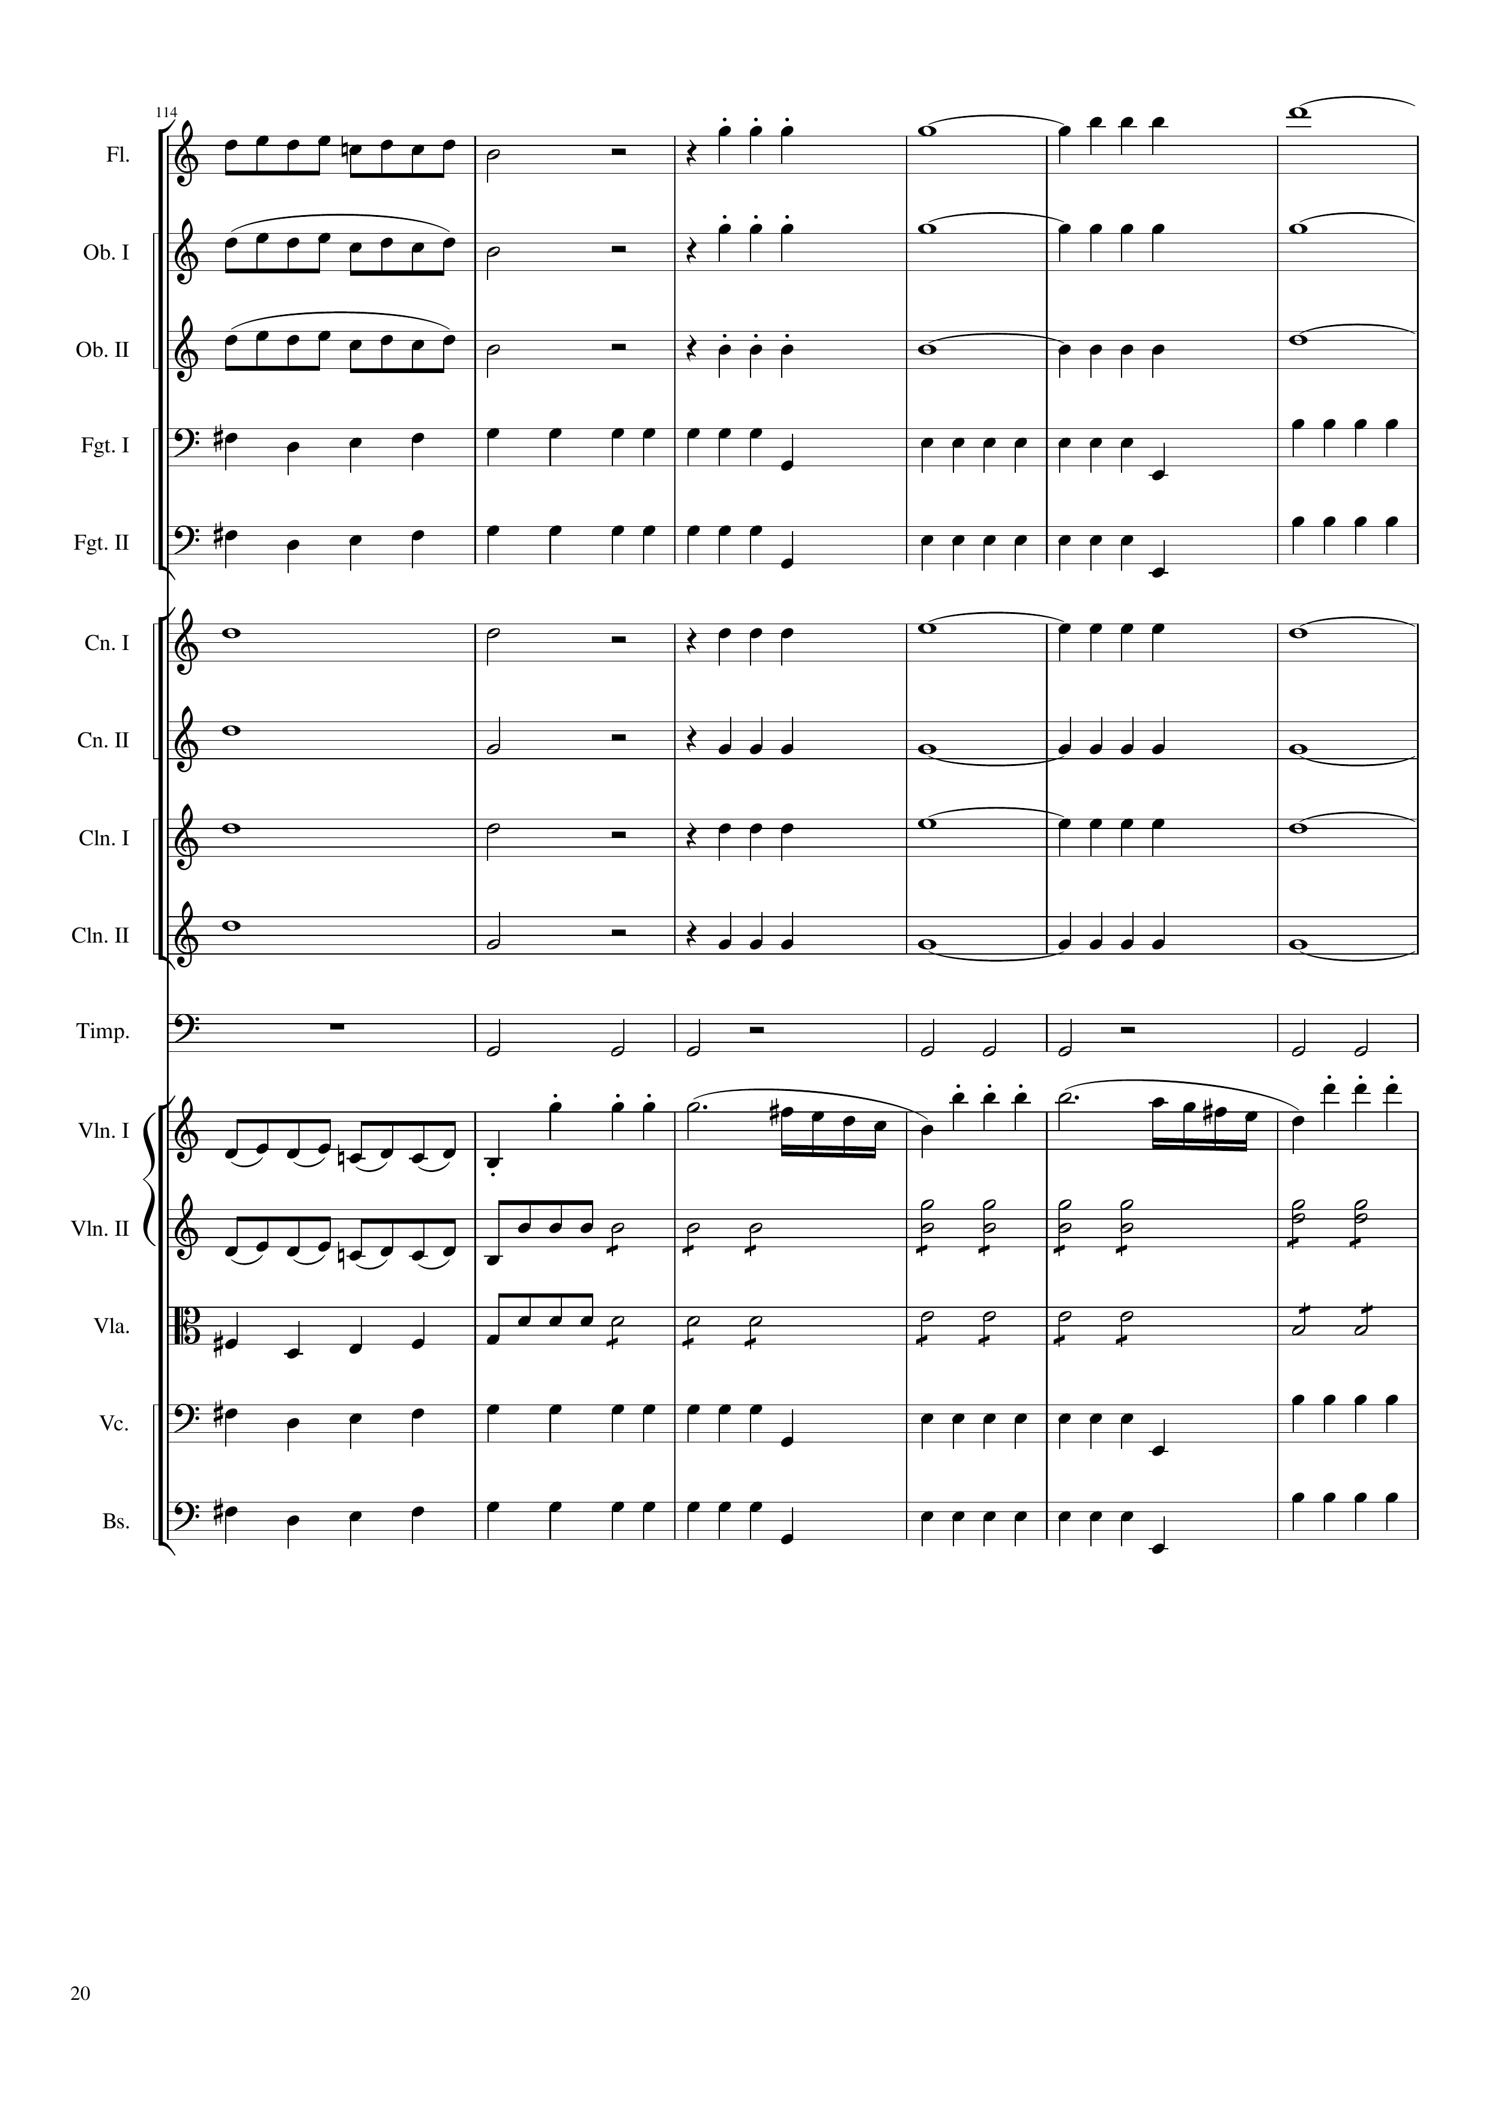
mel
mel+harm
mel
mel+harm
mel
mel+harm
mel
rhythm
mel
rhythm
rhythm+harm
mel+harm
rhythm+harm
mel+harm
rhythm+harm
mel+harm
rhythm+harm
mel+harm
rhythm
mel
mel
rhythm
mel
rhythm
mel
rhythm
mel
rhythm
452
476

Slide 21
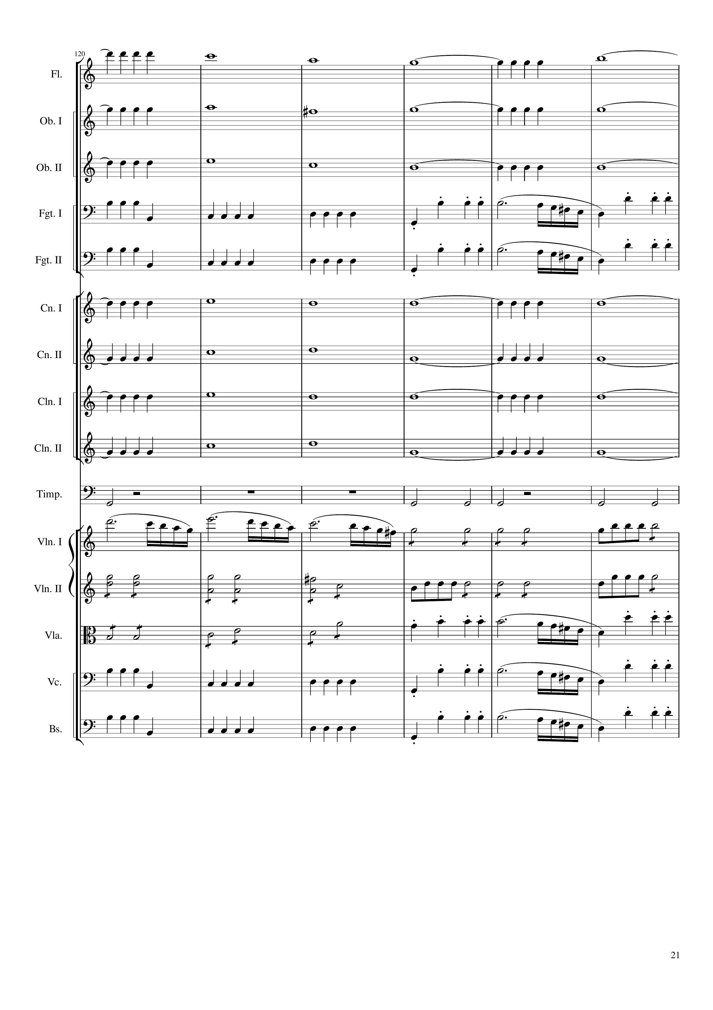
mel+harm
mel+harm
mel+harm
rhythm
mel
rhythm
mel
mel+harm
mel+harm
mel+harm
mel+harm
rhythm
mel
rhythm
rhythm
rhythm
rhythm
mel
rhythm
mel
rhythm
mel
476
488
500

Slide 22
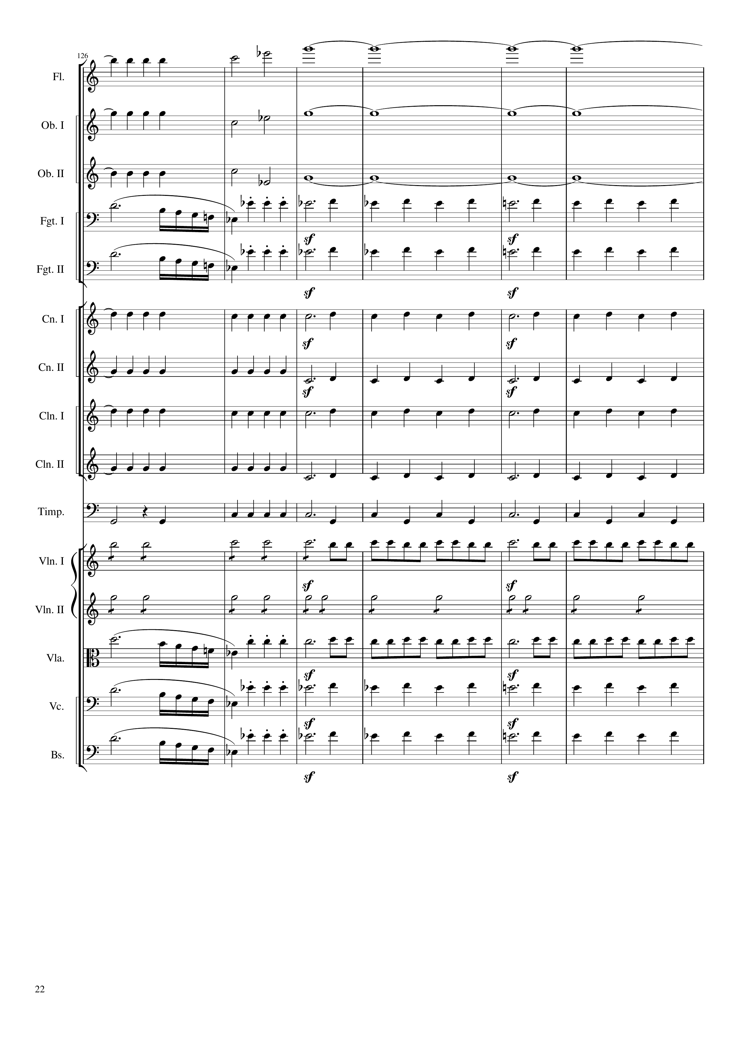
mel+harm
harm
mel+harm
harm
mel+harm
harm
mel
rhythm+harm
mel
rhythm+harm
mel+harm
rhythm+harm
mel+harm
rhythm+harm
mel+harm
rhythm+harm
mel+harm
rhythm+harm
rhythm
rhythm+harm
rhythm
mel+rhythm
rhythm
rhythm
mel
mel+rhythm
mel
rhythm+harm
mel
rhythm+harm
500
508
524

Slide 23
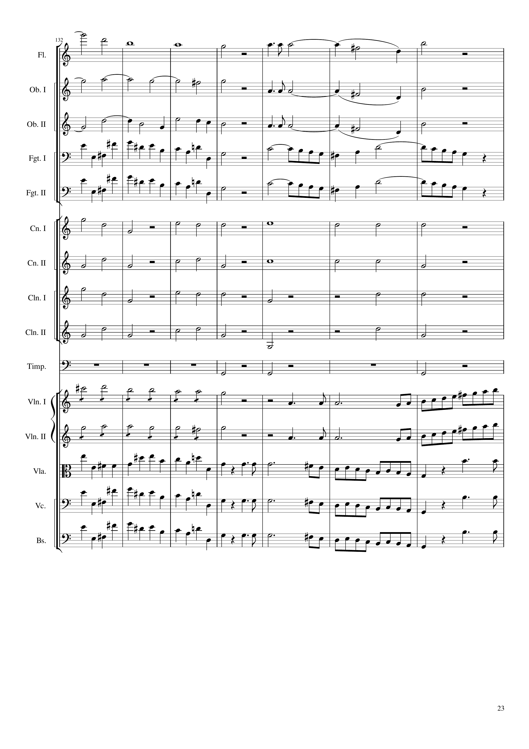
harm
mel
mel
harm
mel
harm
mel
mel
rhythm
mel
rhythm
mel
rhythm+harm
rhythm+harm
rhythm+harm
rhythm+harm
rhythm+harm
rhythm+harm
rhythm+harm
rhythm+harm
rhythm
rhythm+harm
mel+rhythm
mel
mel+rhythm
mel
rhythm
mel
rhythm
mel
rhythm
mel
524
536
552
Notes:
33:50

Slide 24
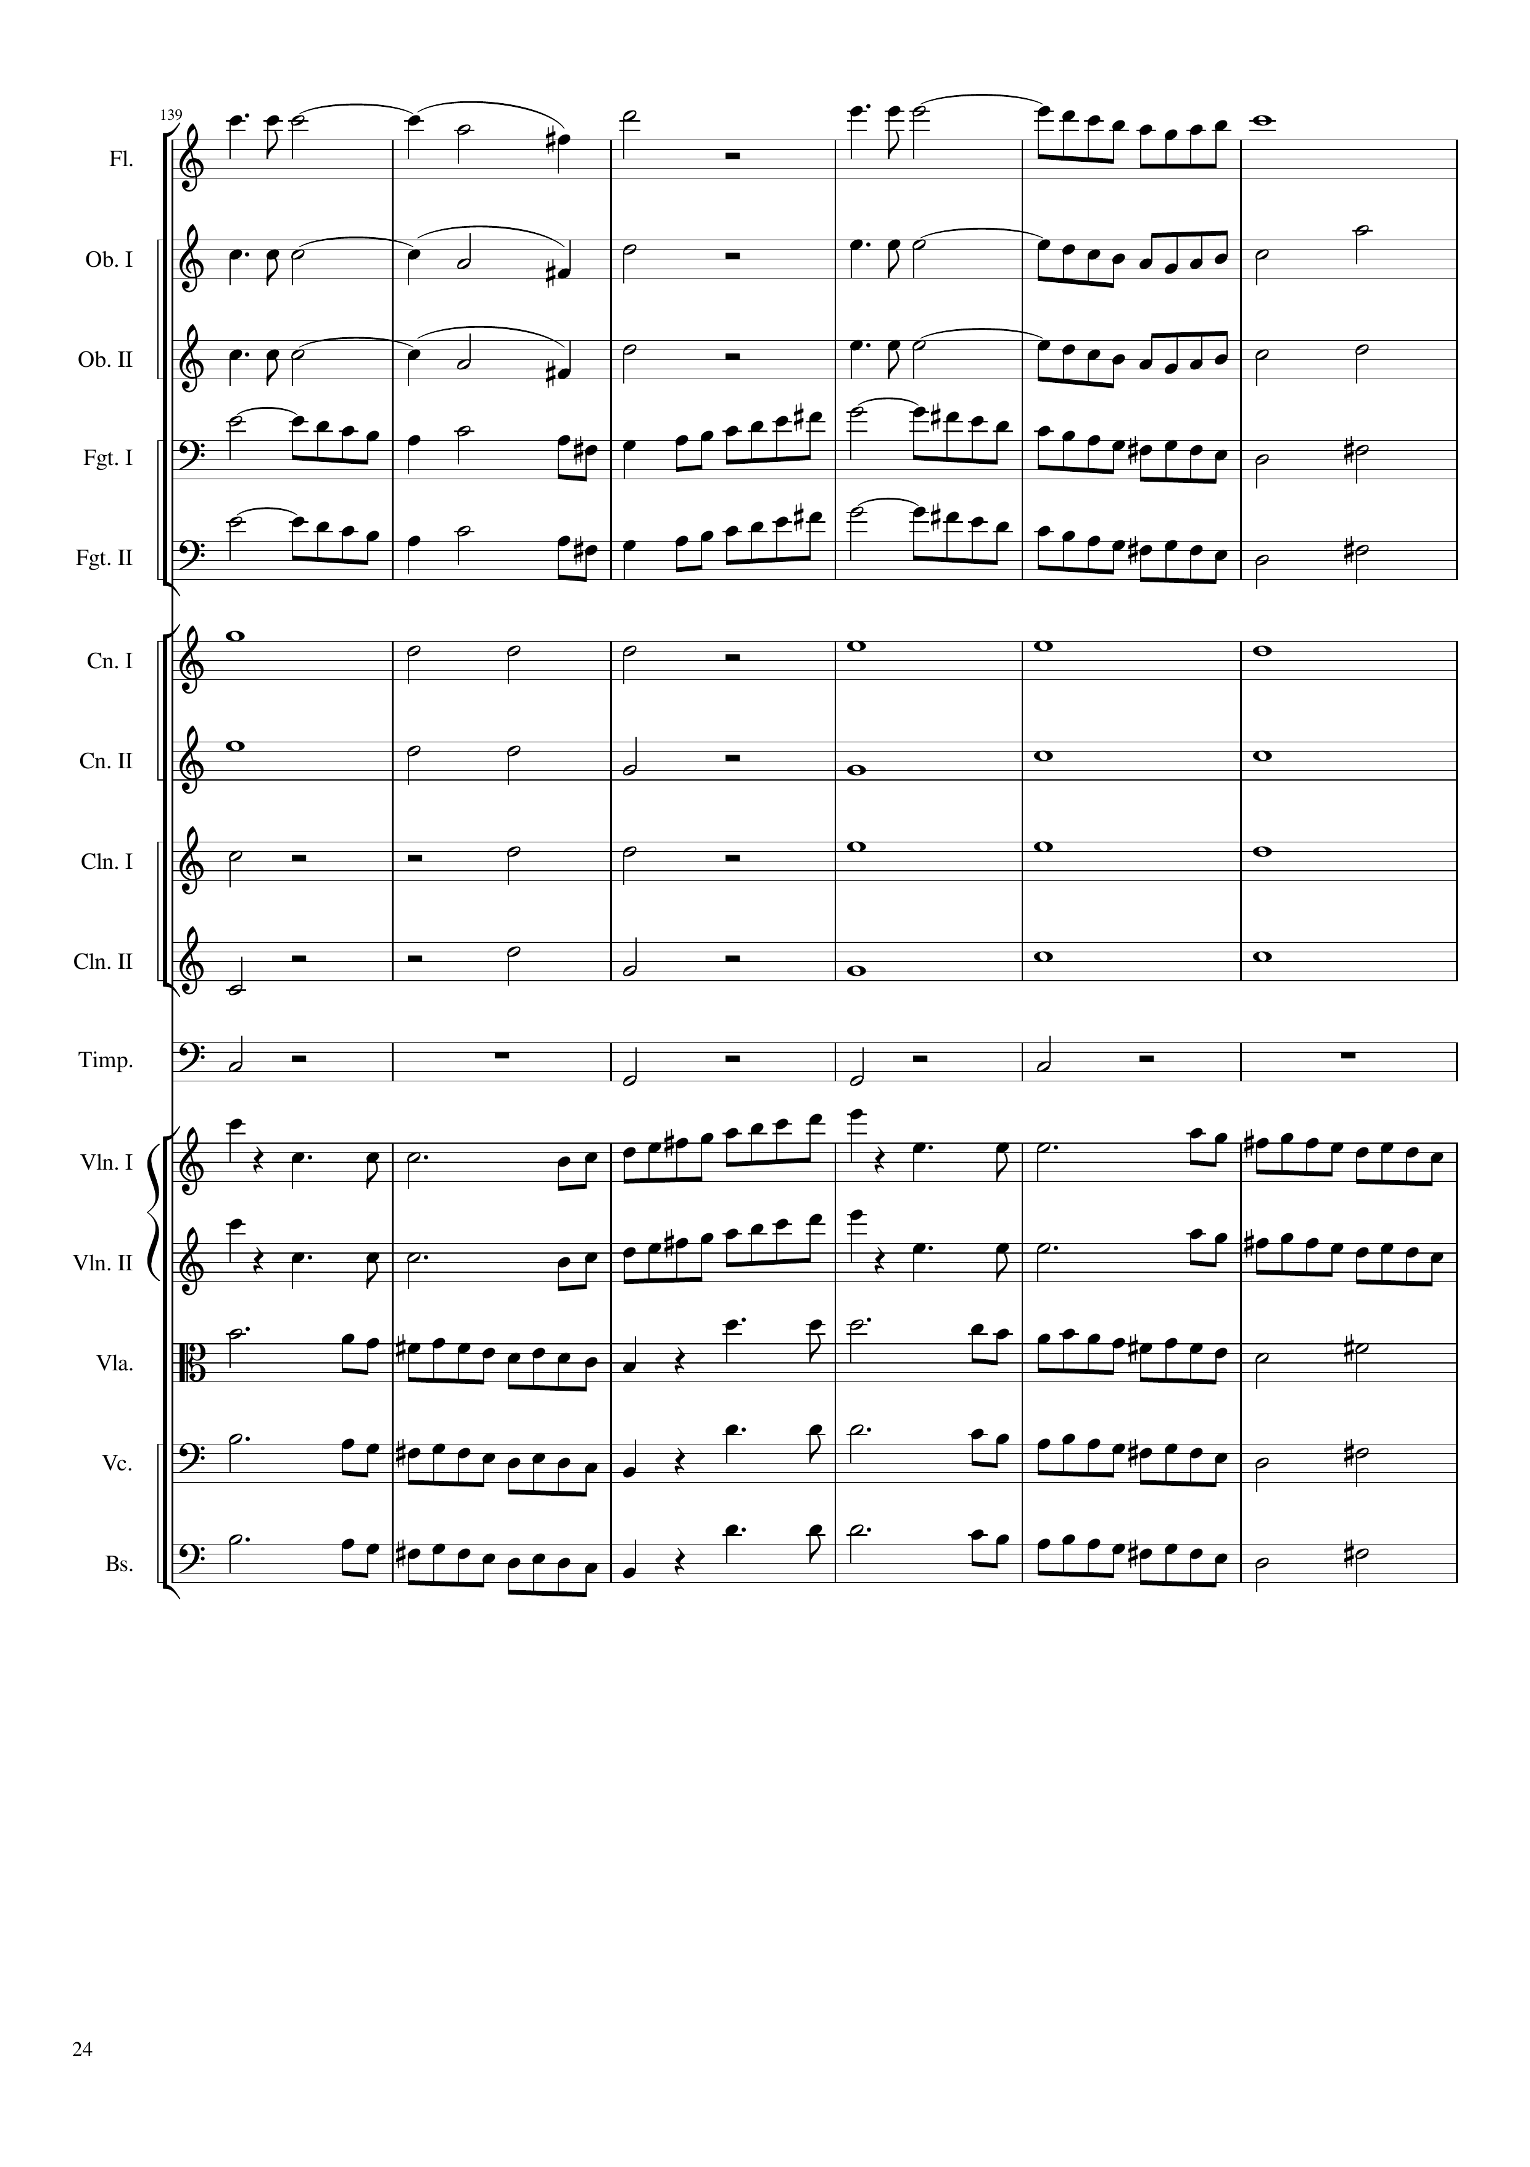
mel
mel
mel
mel
mel
rhythm+harm
rhythm+harm
rhythm+harm
rhythm+harm
rhythm+harm
mel
mel
mel
mel
mel
552
576

Slide 25
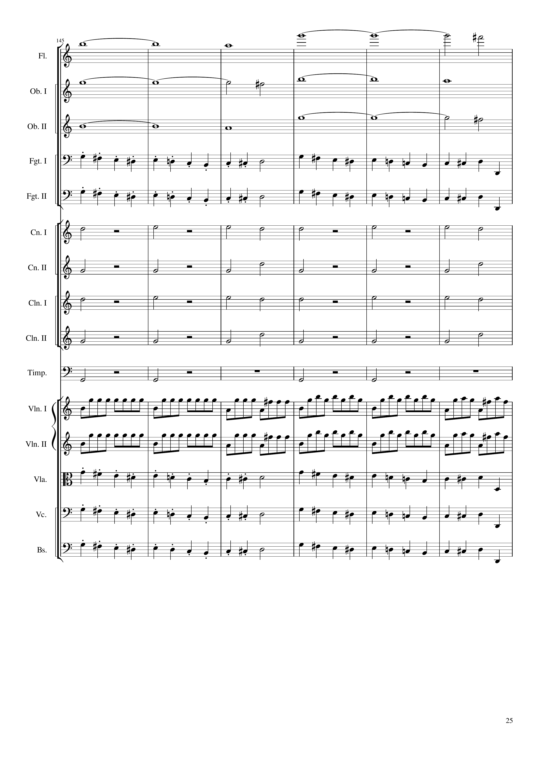
harm
harm
harm
mel
mel
rhythm+harm
rhythm+harm
rhythm+harm
rhythm+harm
rhythm+harm
mel
mel
mel
mel
mel
576
600

Slide 26
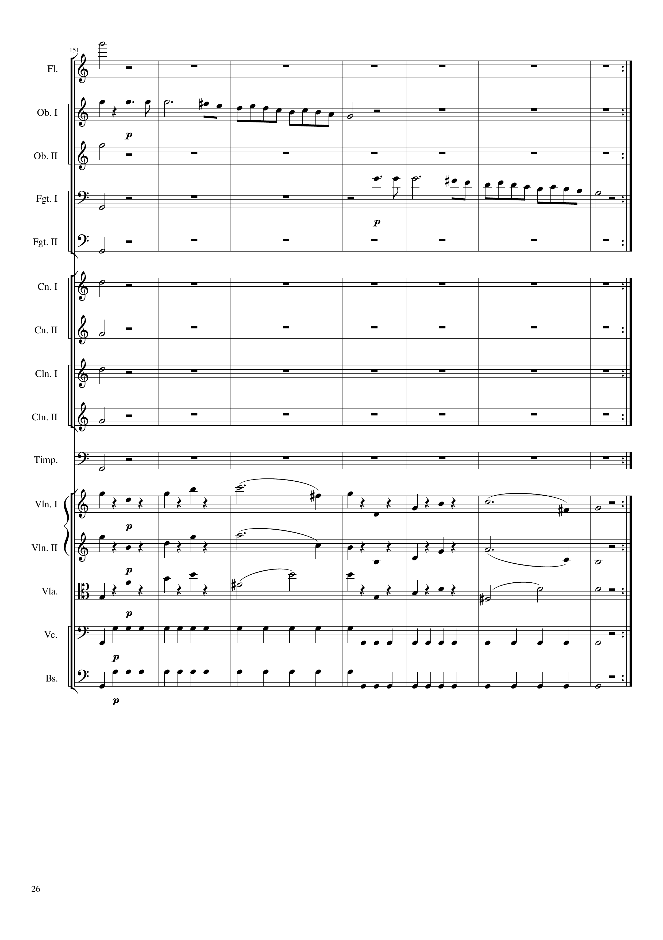
harm
harm
mel
harm
mel
mel
mel
rhythm+harm
rhythm+harm
rhythm+harm
rhythm+harm
rhythm+harm
mel
mel
mel
mel
mel
mel
rhythm
rhythm
600
628
1256
Notes:
34:10

Slide 27
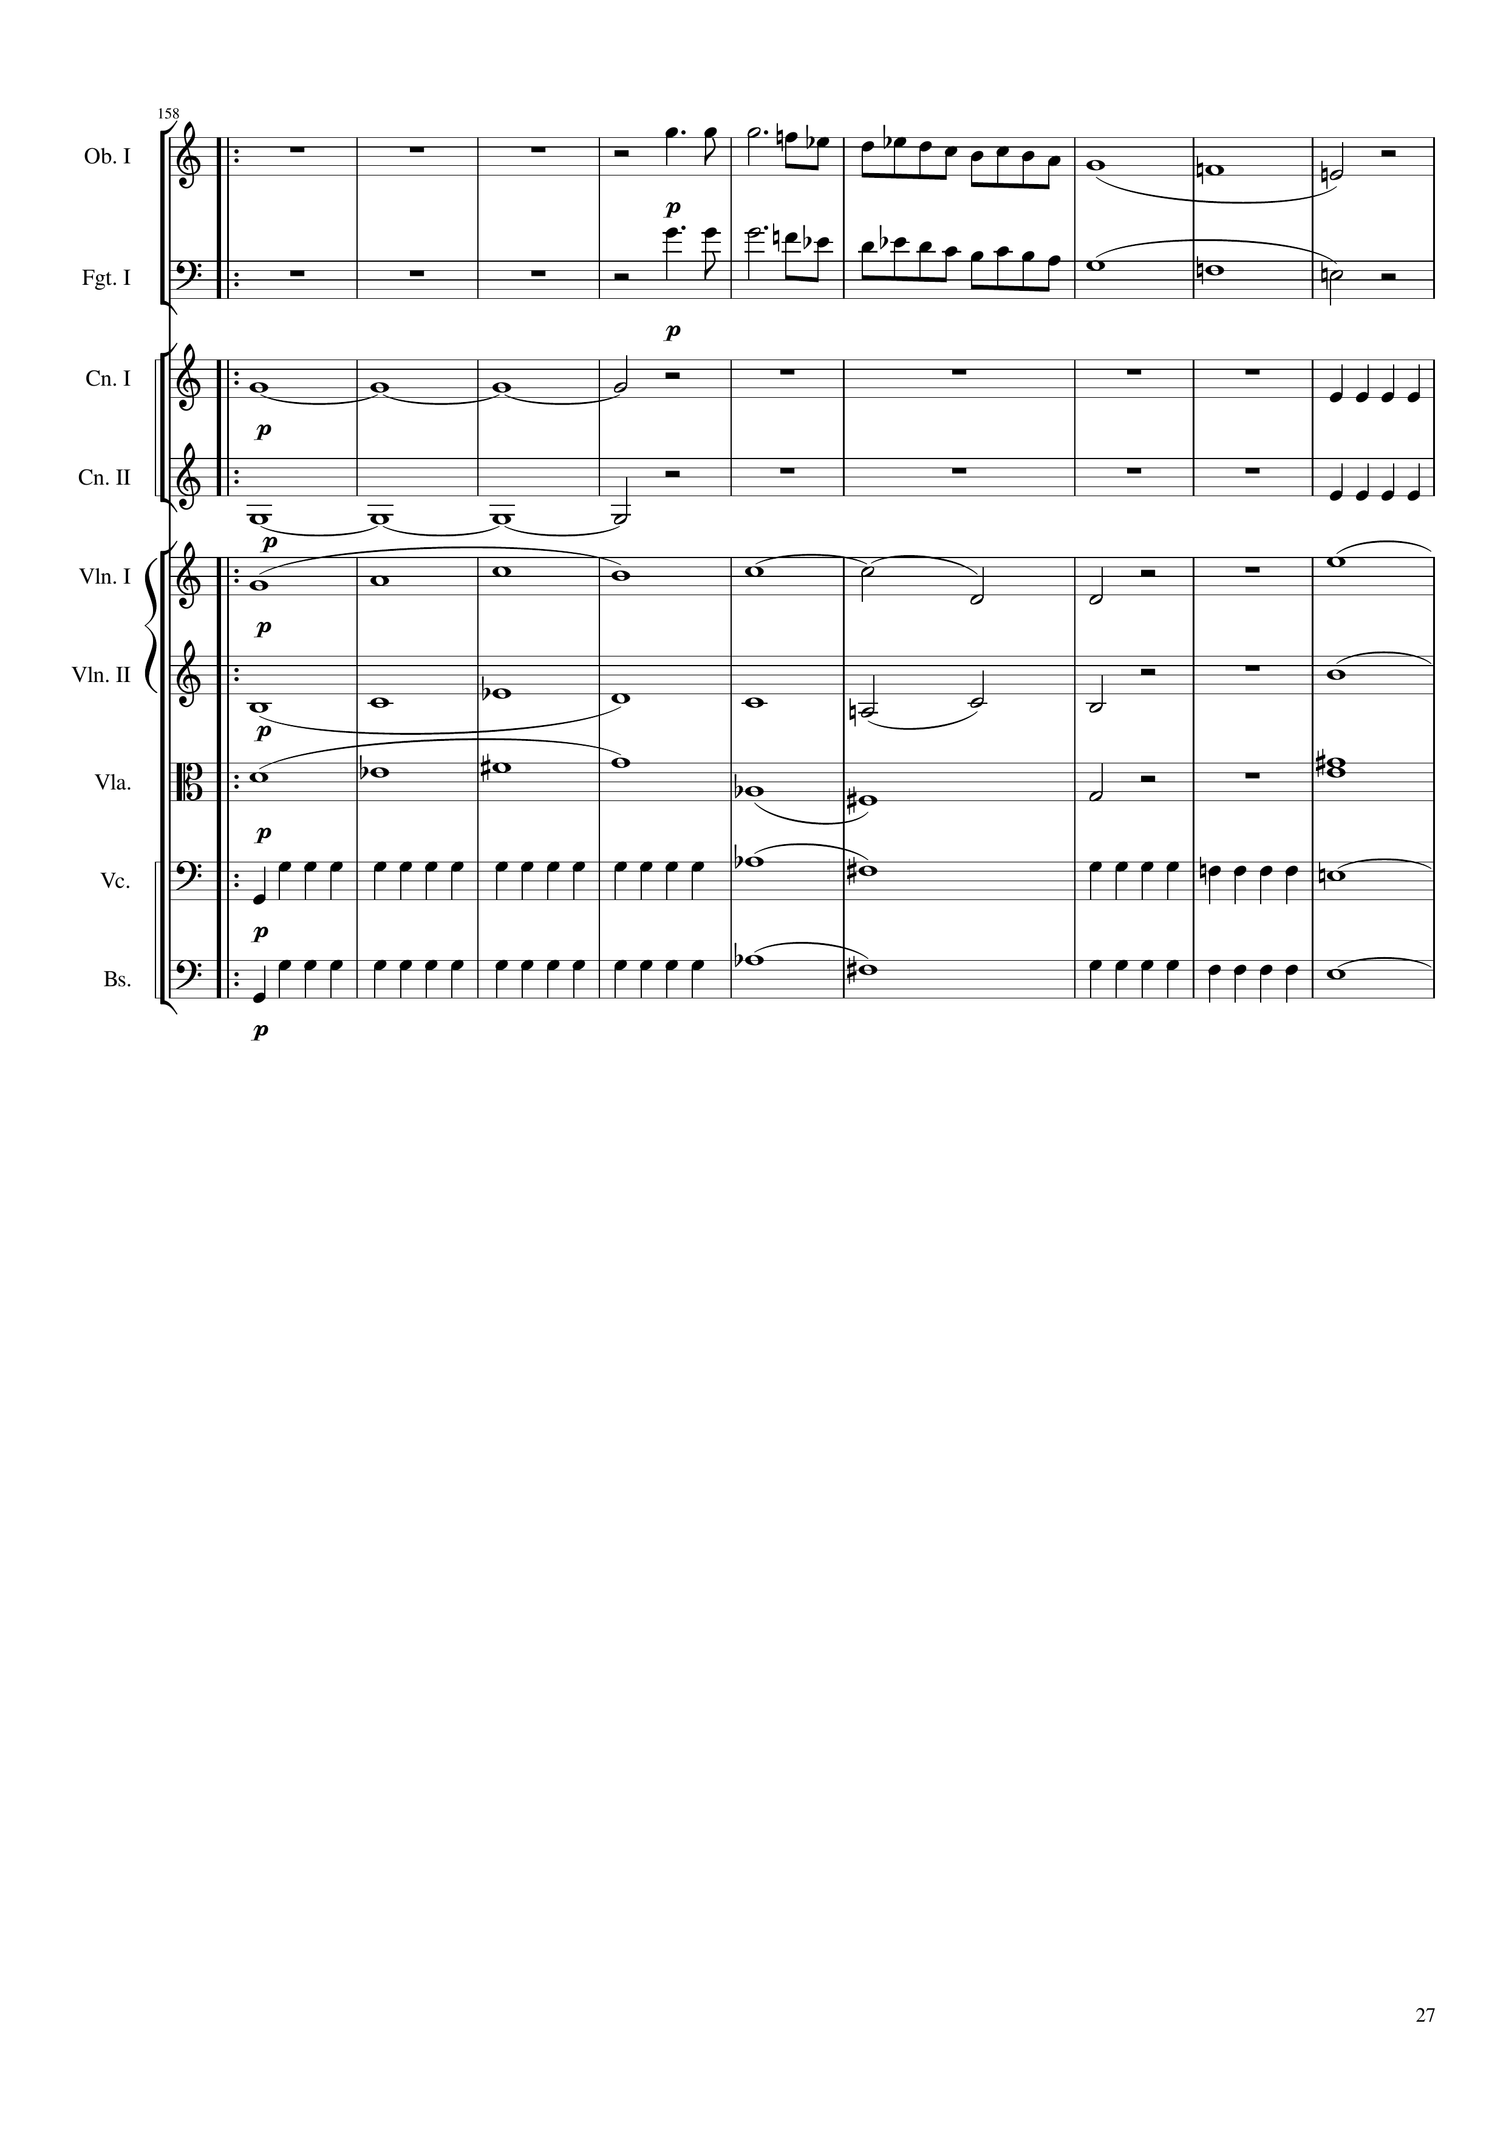
mel
harm
mel
harm
harm
rhythm
harm
rhythm
mel+harm
mel+harm
mel+harm
mel+harm
mel+harm
mel+harm
rhythm
harm
rhythm
harm
rhythm
harm
rhythm
harm
1256
1272
1292
Notes:
36:30

Slide 28
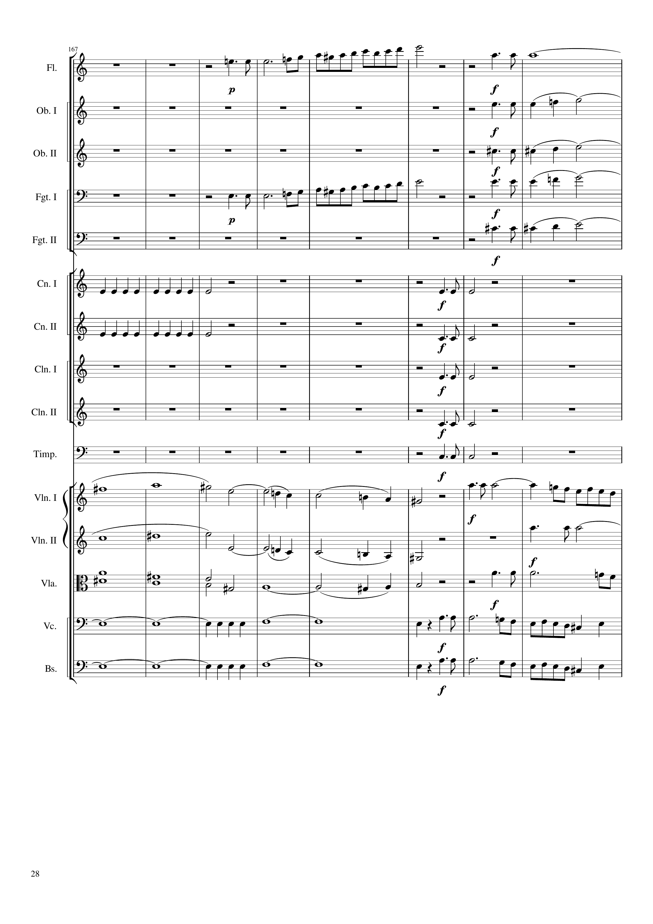
mel
mel+harm
mel+harm
mel+harm
mel
mel+harm
mel+harm
rhythm
rhythm
rhythm
rhythm
rhythm
rhythm
rhythm
mel+harm
mel
mel+harm
mel
mel+harm
mel
harm
mel
harm
mel
1292
1312
1324

Slide 29
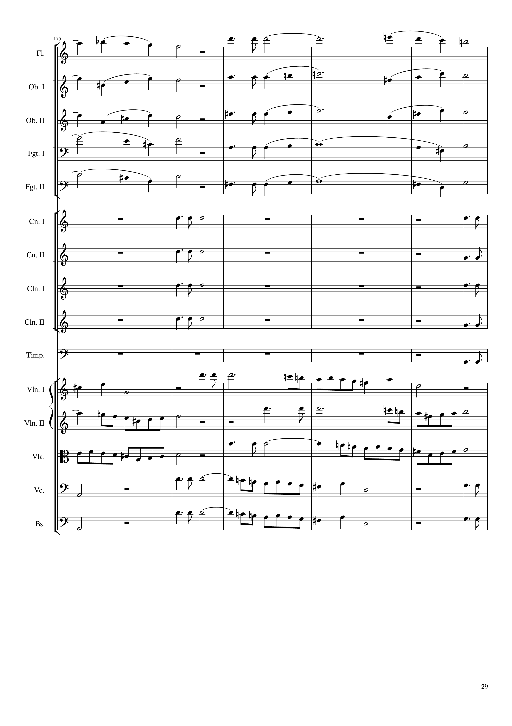
mel+harm
mel+harm
mel+harm
mel+harm
mel+harm
rhythm
rhythm
rhythm
rhythm
rhythm
rhythm
rhythm
rhythm
rhythm
mel
mel
mel
mel
mel
1324
1344

Slide 30
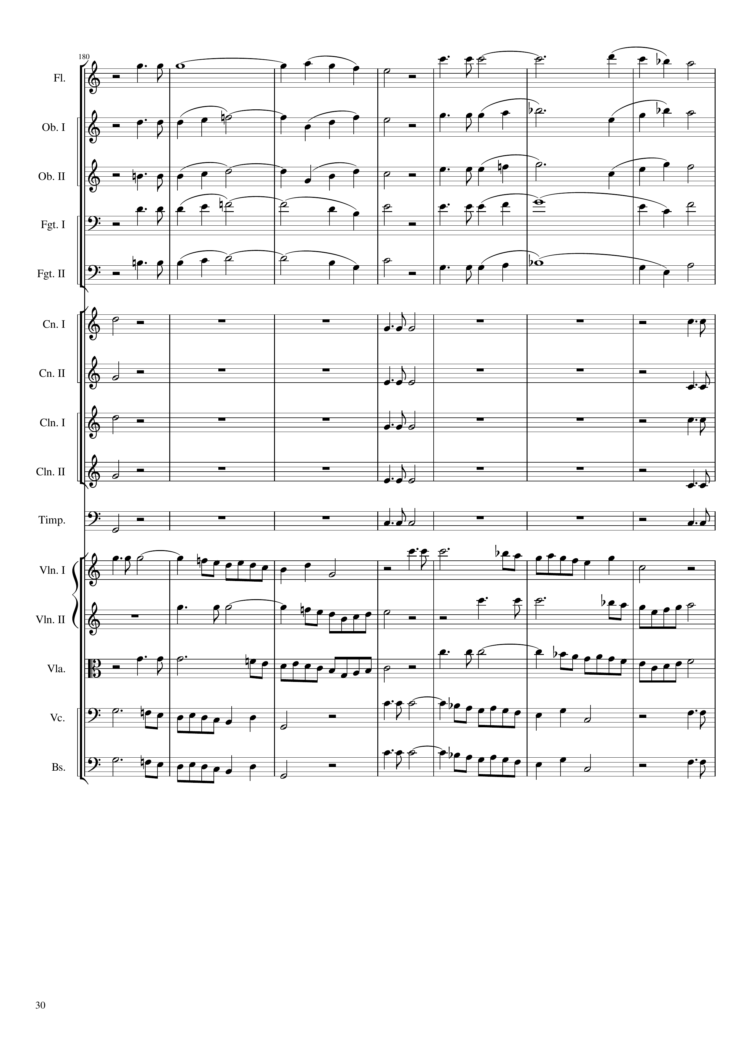
mel+harm
mel+harm
mel+harm
mel+harm
mel+harm
rhythm
rhythm
rhythm
rhythm
rhythm
rhythm
rhythm
rhythm
rhythm
rhythm
rhythm
rhythm
rhythm
rhythm
rhythm
mel
mel
mel
mel
mel
1344
1372

Slide 31
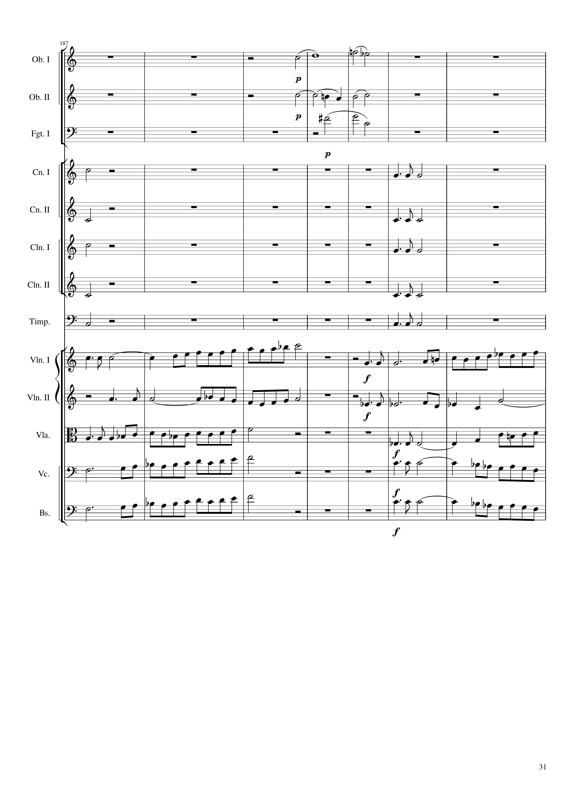
mel+harm
mel+harm
mel+harm
rhythm
rhythm
rhythm
rhythm
rhythm
rhythm
rhythm
rhythm
rhythm
rhythm
mel
mel
mel
mel
mel
mel
mel
mel
mel
mel
1372
1384
1400

Slide 32
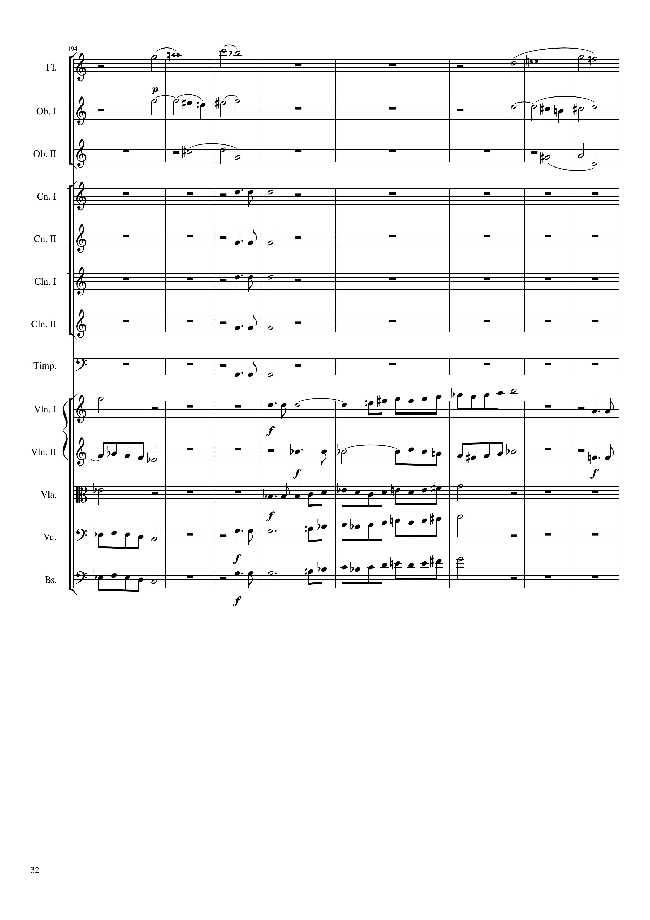
mel+harm
mel+harm
mel+harm
mel+harm
mel+harm
mel+harm
rhythm
rhythm
rhythm
rhythm
rhythm
mel
mel
mel
mel
mel
mel
mel
mel
mel
mel
mel
mel
1400
1432

Slide 33
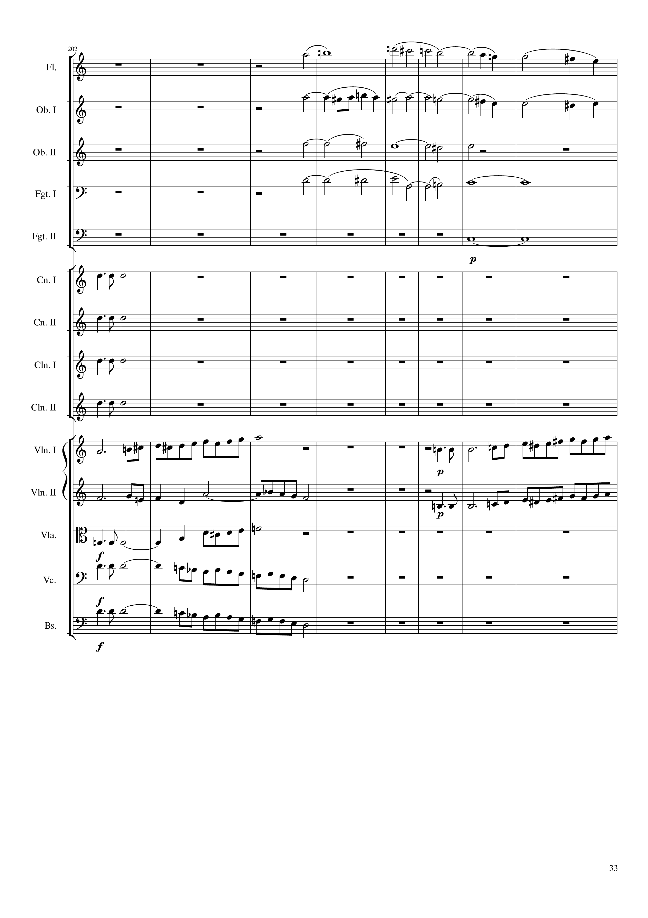
mel+harm
mel+harm
harm
harm
harm
rhythm
rhythm
rhythm
rhythm
mel
mel
mel
mel
mel
mel
mel
1432
1464

Slide 34
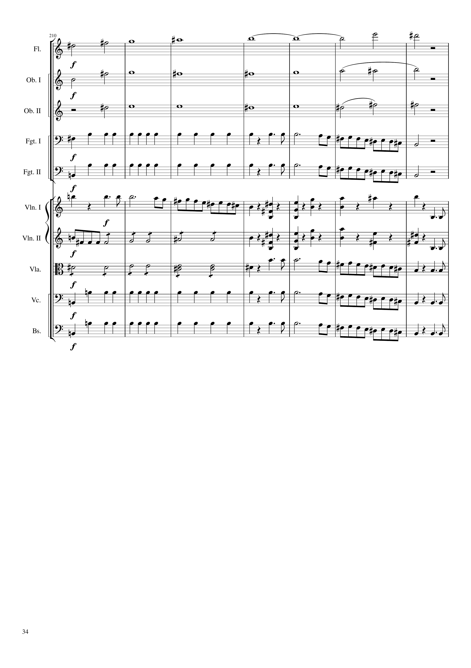
harm
harm
harm
rhythm
mel
rhythm
mel
mel
rhythm+harm
mel
rhythm
rhythm+harm
mel
rhythm
mel
rhythm
mel
rhythm
mel
1464
1492

Slide 35
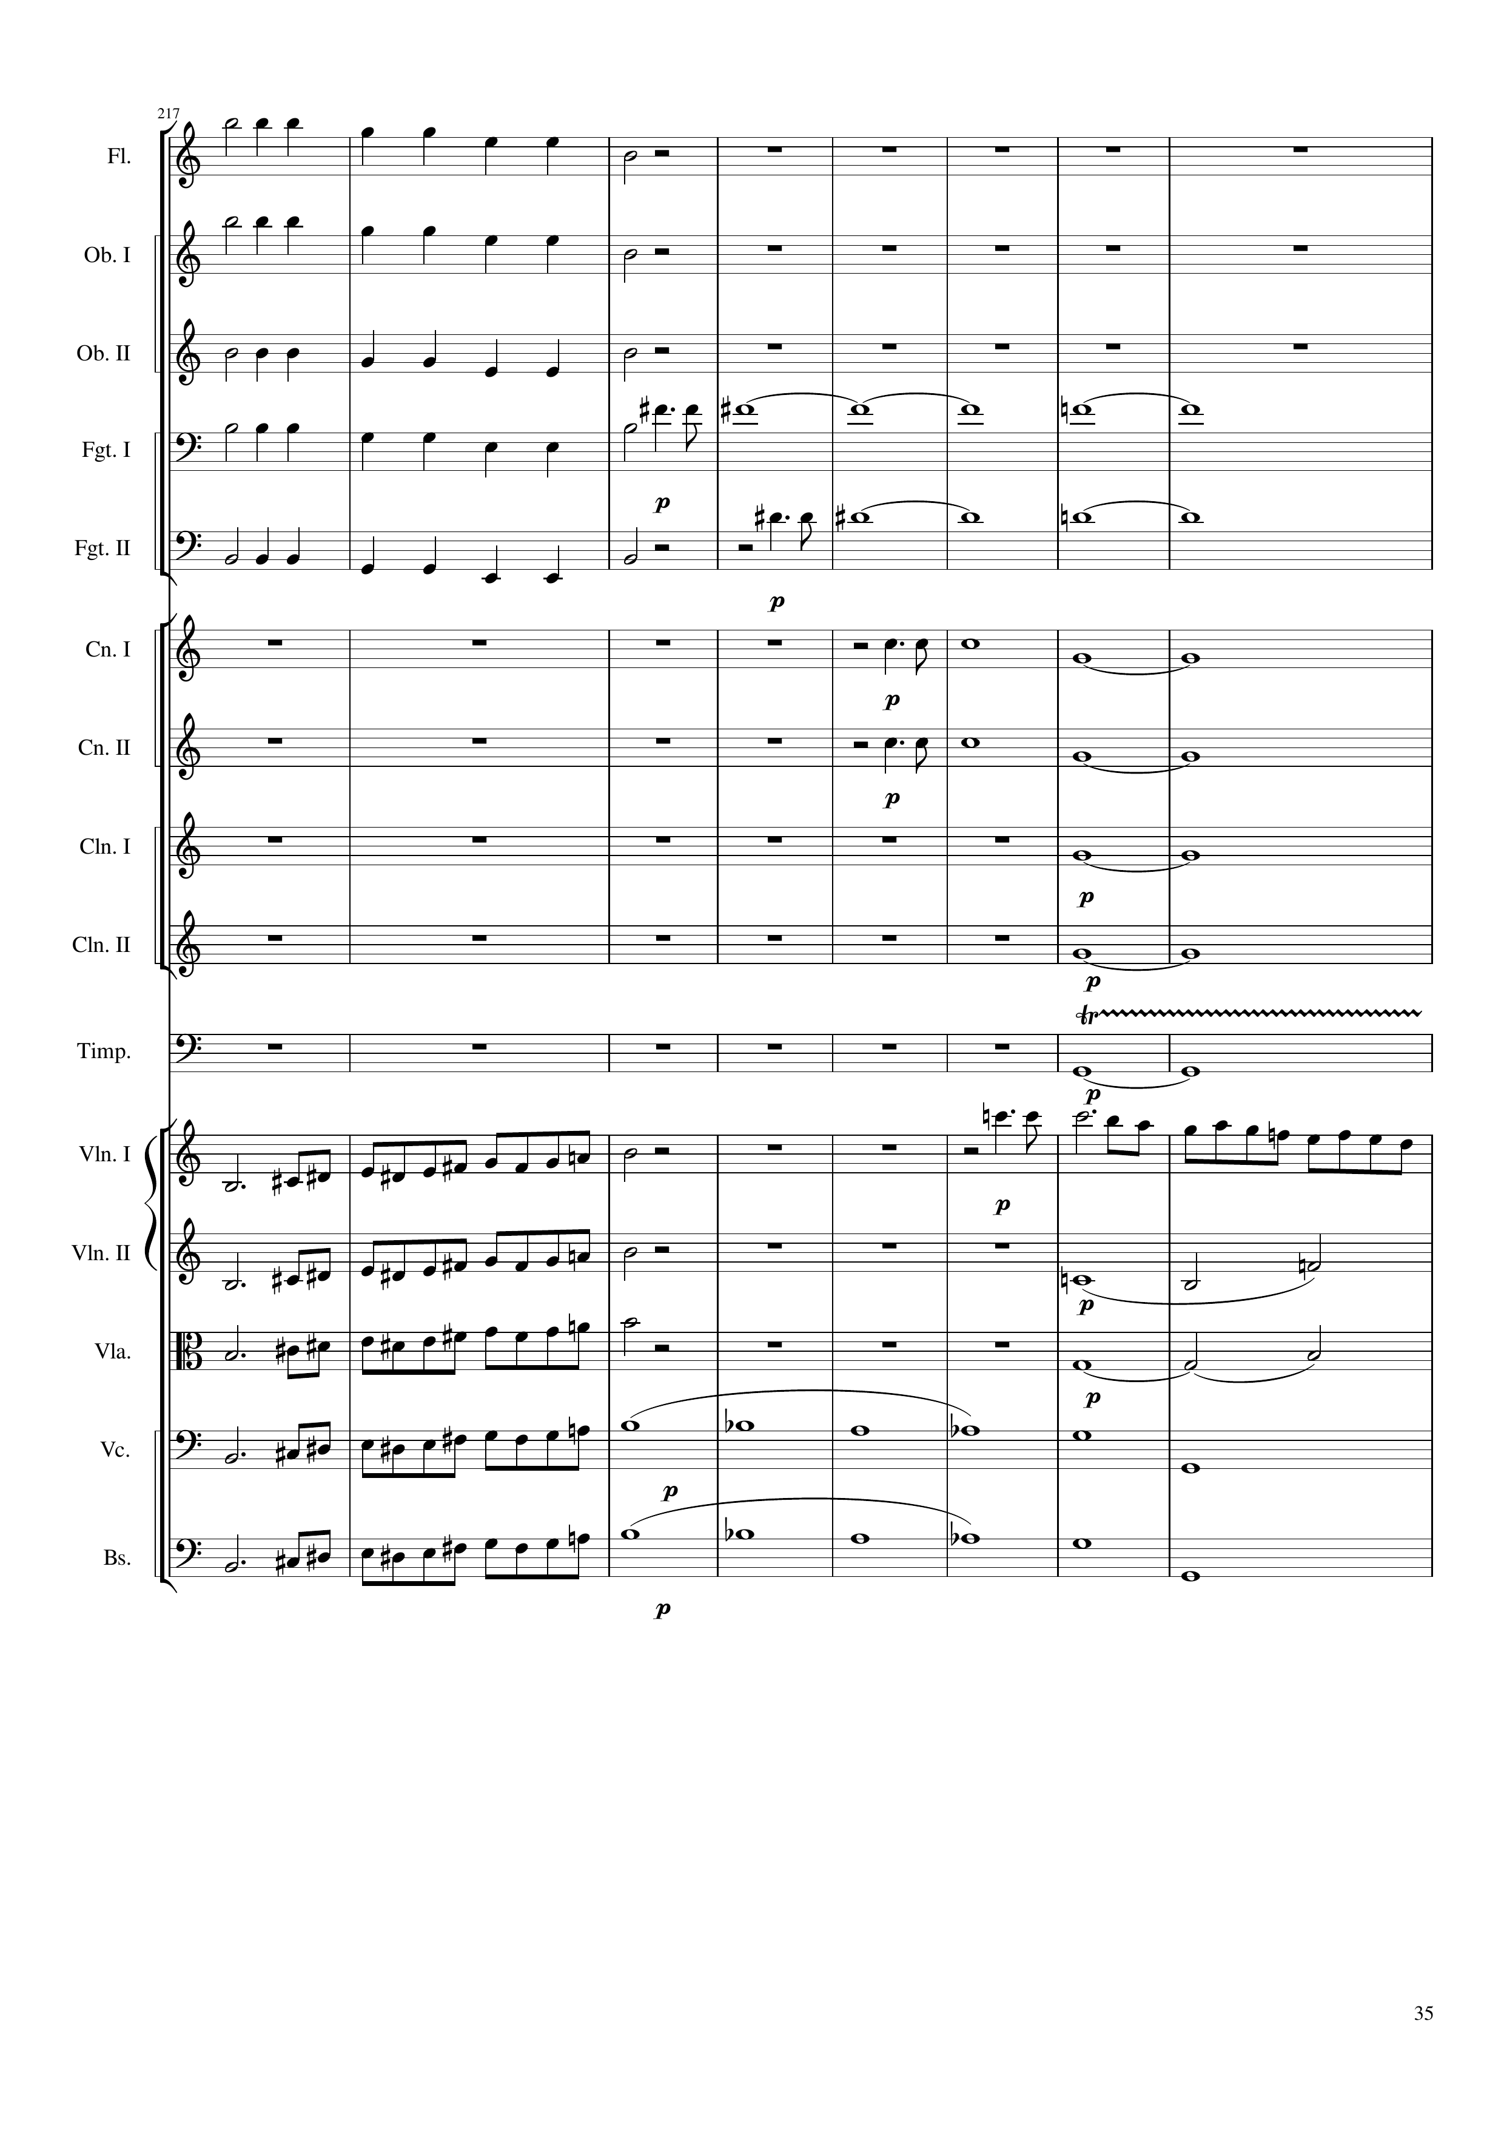
rhythm
rhythm
rhythm
rhythm
harm
rhythm
harm
harm
harm
harm
harm
rhythm
mel
mel
mel
harm
mel
harm
mel
harm
mel
harm
1492
1524

Slide 36
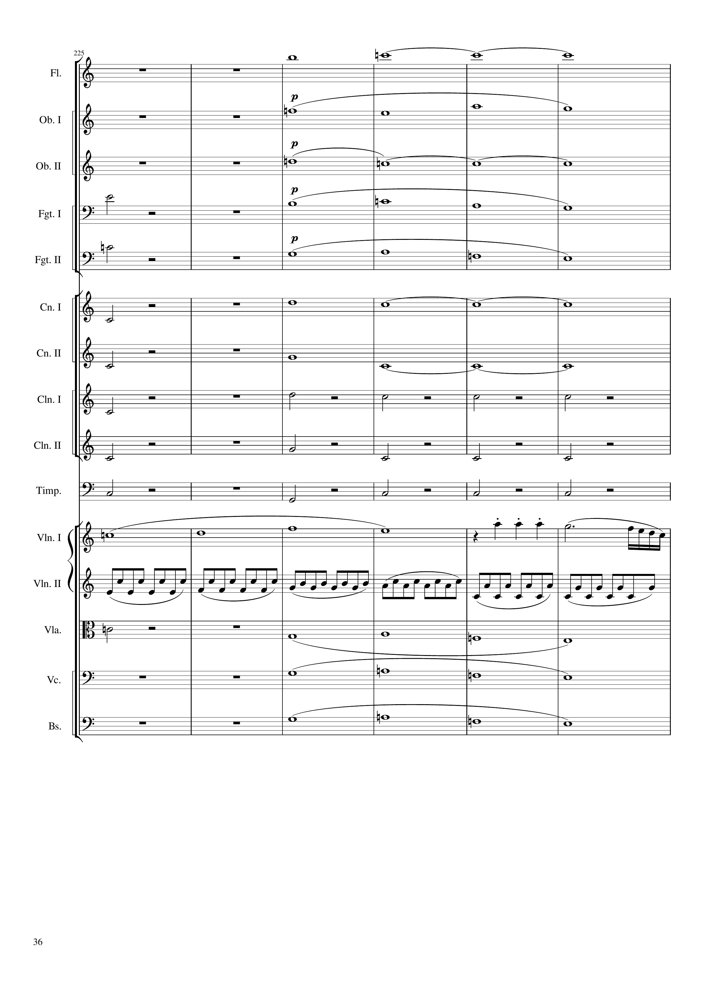
harm
harm
harm
harm
harm
harm
harm
harm
harm
harm
harm
harm
rhythm+harm
harm
rhythm+harm
rhythm
rhythm+harm
mel
rhythm
harm
harm
harm
harm
1524
1548
Notes:
37:31

Slide 37
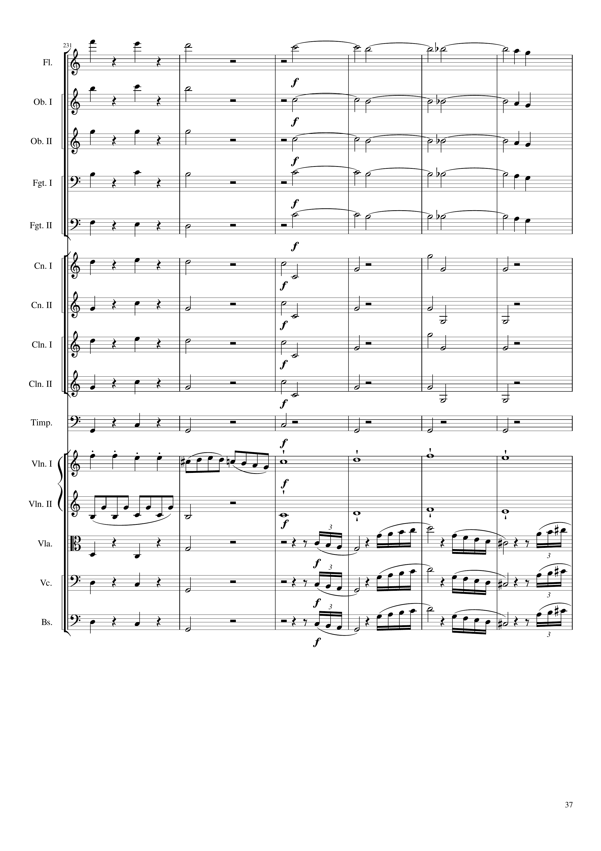
rhythm+harm
harm
rhythm+harm
harm
rhythm+harm
harm
rhythm+harm
harm
rhythm+harm
harm
rhythm+harm
rhythm+harm
rhythm+harm
rhythm+harm
rhythm+harm
rhythm+harm
rhythm+harm
rhythm+harm
rhythm+harm
rhythm+harm
mel
rhythm
mel
rhythm+harm
rhythm
rhythm+harm
rhythm
rhythm+harm
rhythm
1548
1572

Slide 38
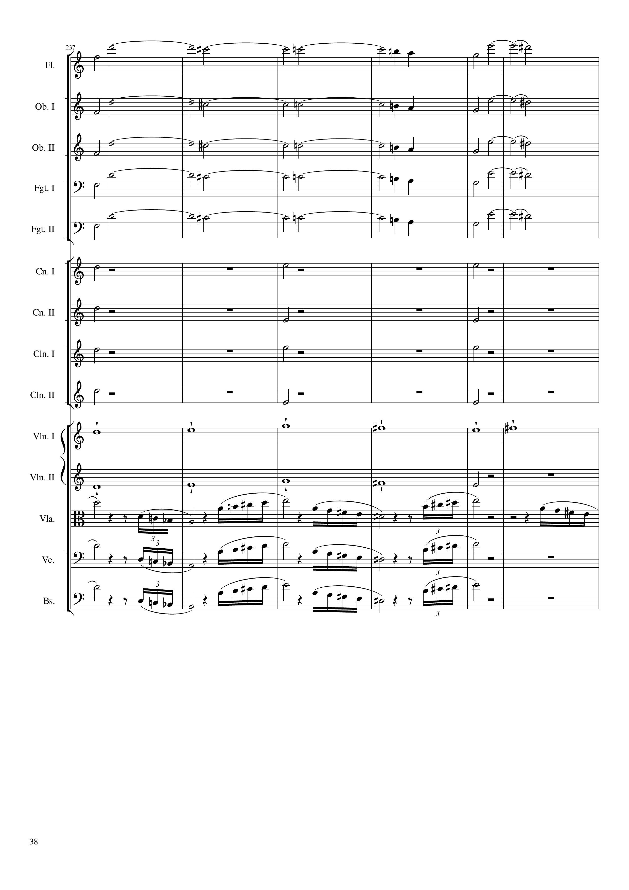
harm
harm
harm
harm
harm
rhythm+harm
rhythm+harm
rhythm+harm
rhythm+harm
mel
mel
rhythm
rhythm
rhythm
1572
1596

Slide 39
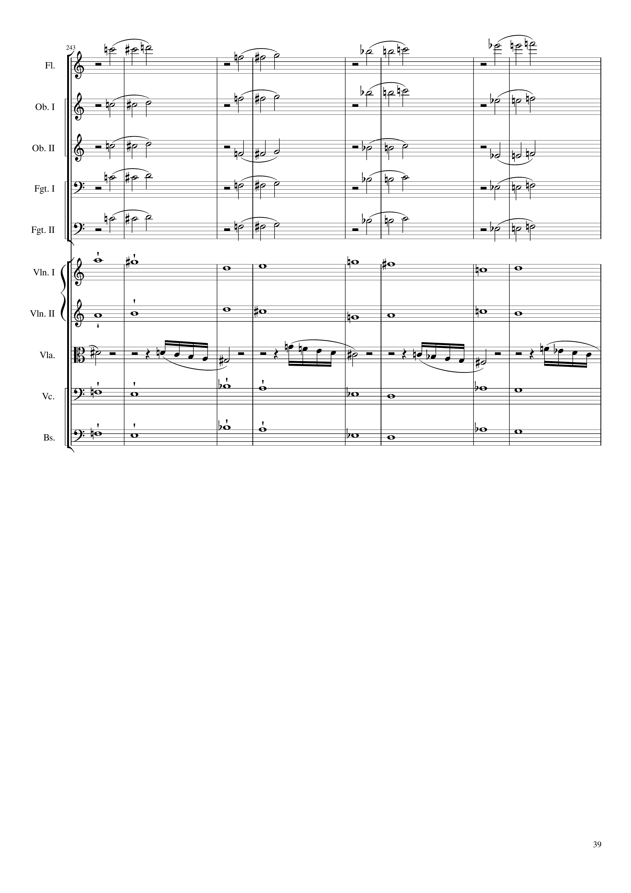
rhythm
rhythm
rhythm
rhythm
rhythm
mel
mel+harm
rhythm
mel+harm
mel+harm
1596
1628

Slide 40
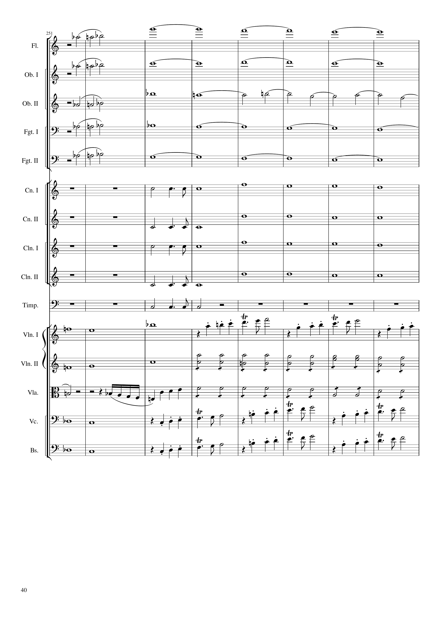
rhythm
harm
rhythm
harm
rhythm
harm
rhythm
harm
rhythm
harm
rhythm
harm
rhythm
harm
rhythm
harm
rhythm
harm
rhythm
mel
mel
mel+harm
rhythm
rhythm
rhythm
mel+harm
mel
mel+harm
mel
1628
1640
1660

Slide 41
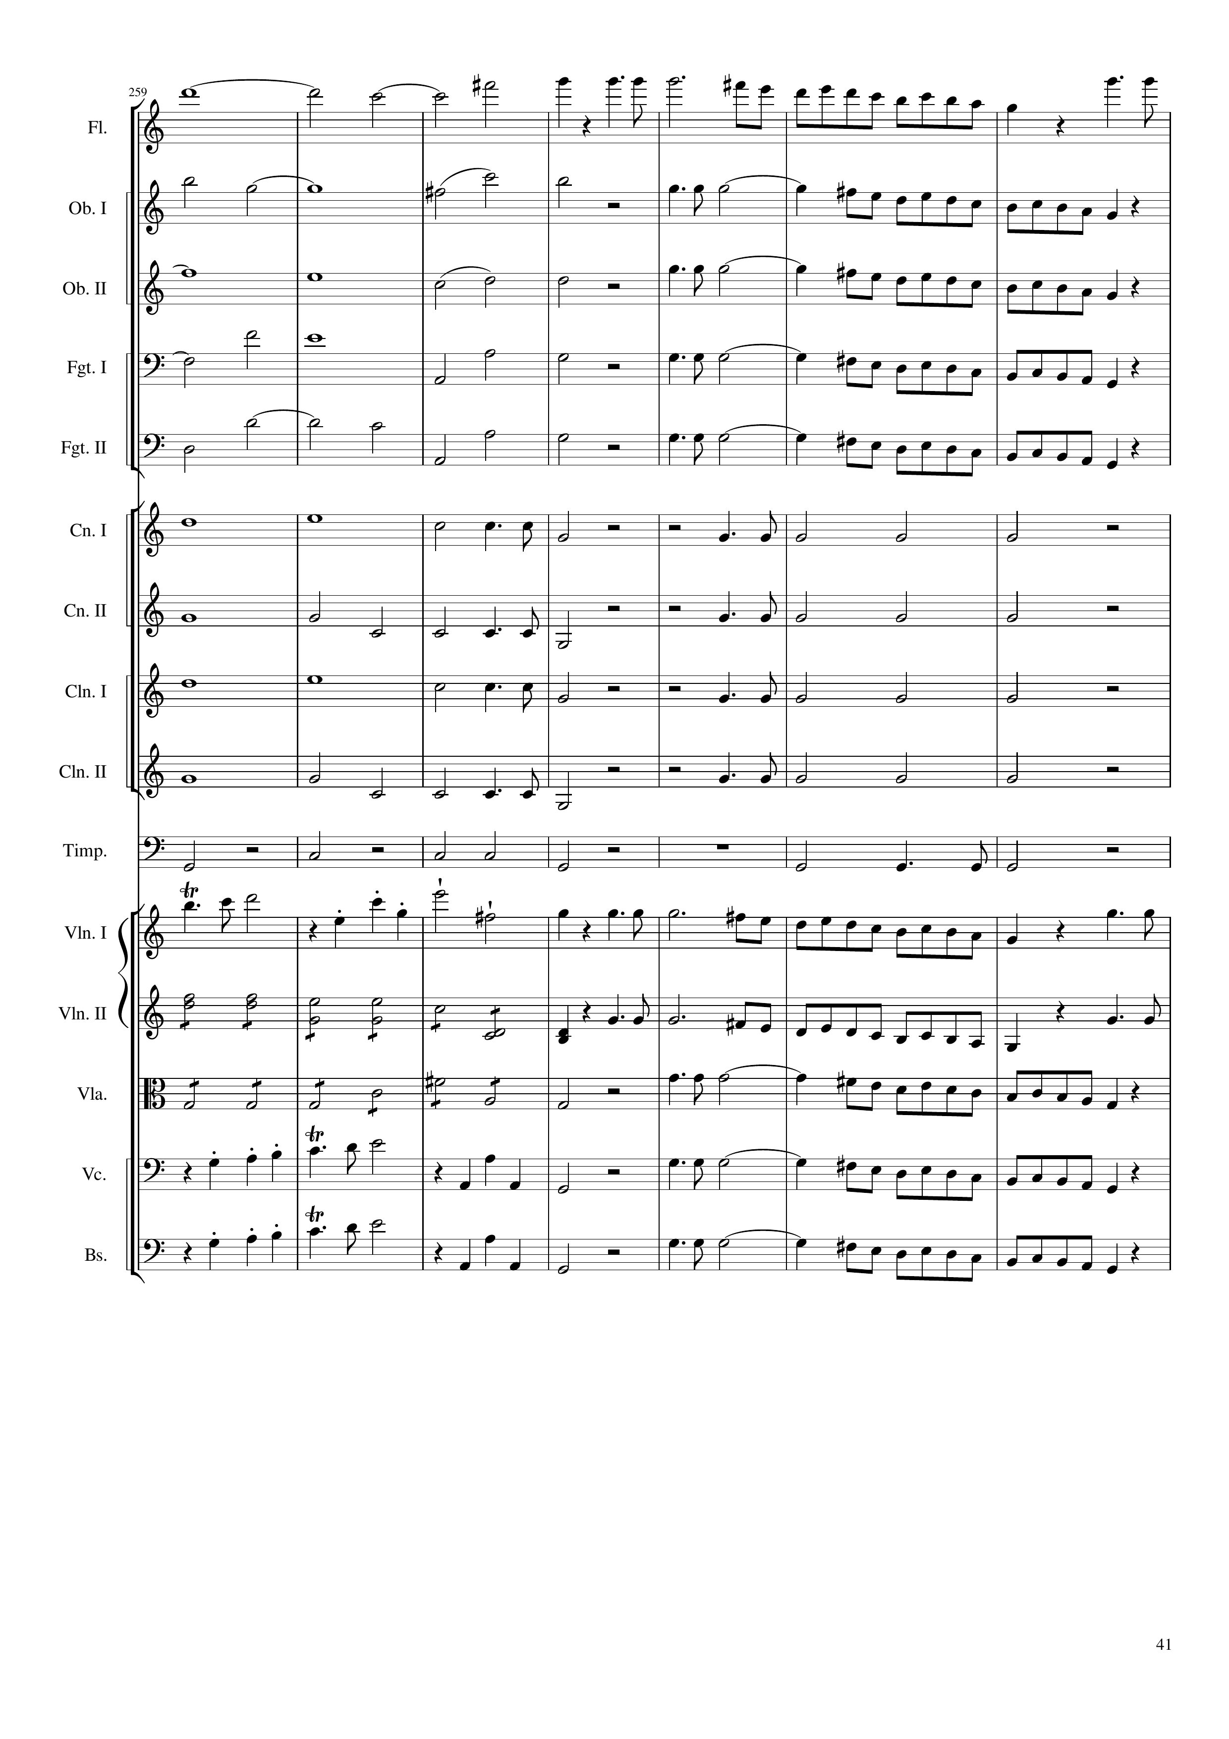
harm
mel
harm
mel
harm
mel
harm
mel
harm
mel
harm
rhythm
rhythm
harm
rhythm
rhythm
harm
rhythm
rhythm
harm
rhythm
rhythm
rhythm
rhythm
mel
mel
rhythm
mel
rhythm
mel
mel
mel
mel
mel
1660
1672
1688

Slide 42
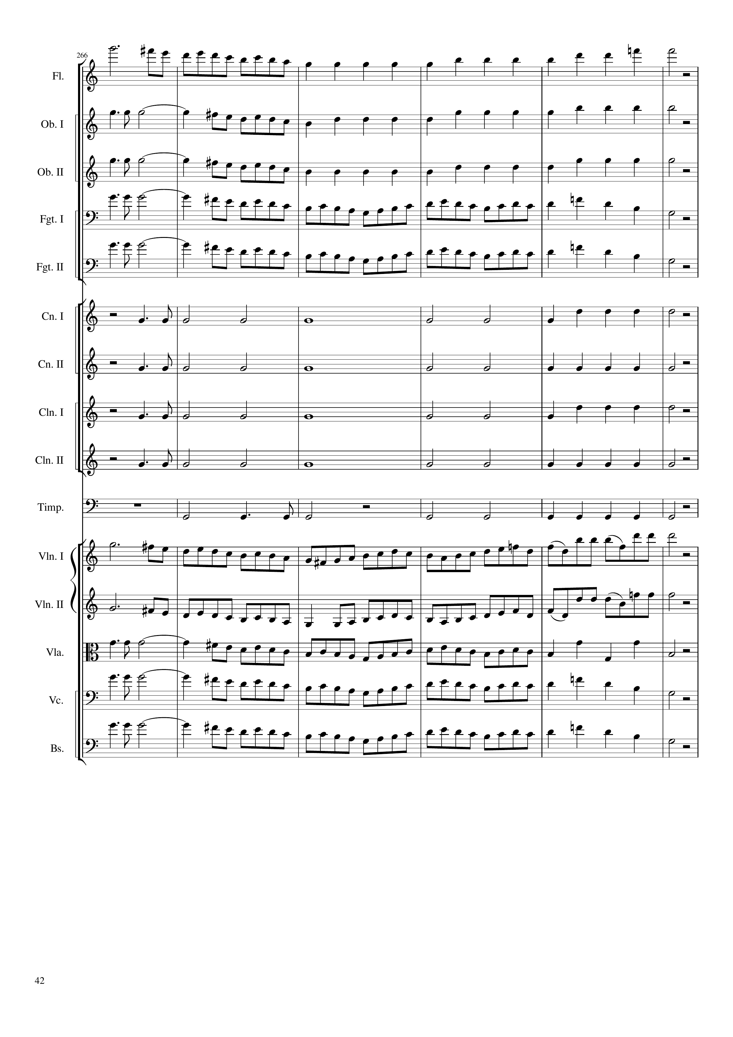
mel
rhythm
mel
rhythm
mel
rhythm
mel
mel
rhythm
rhythm
rhythm
rhythm
rhythm
mel
mel
mel
mel
mel
1688
1696
1712

Slide 43
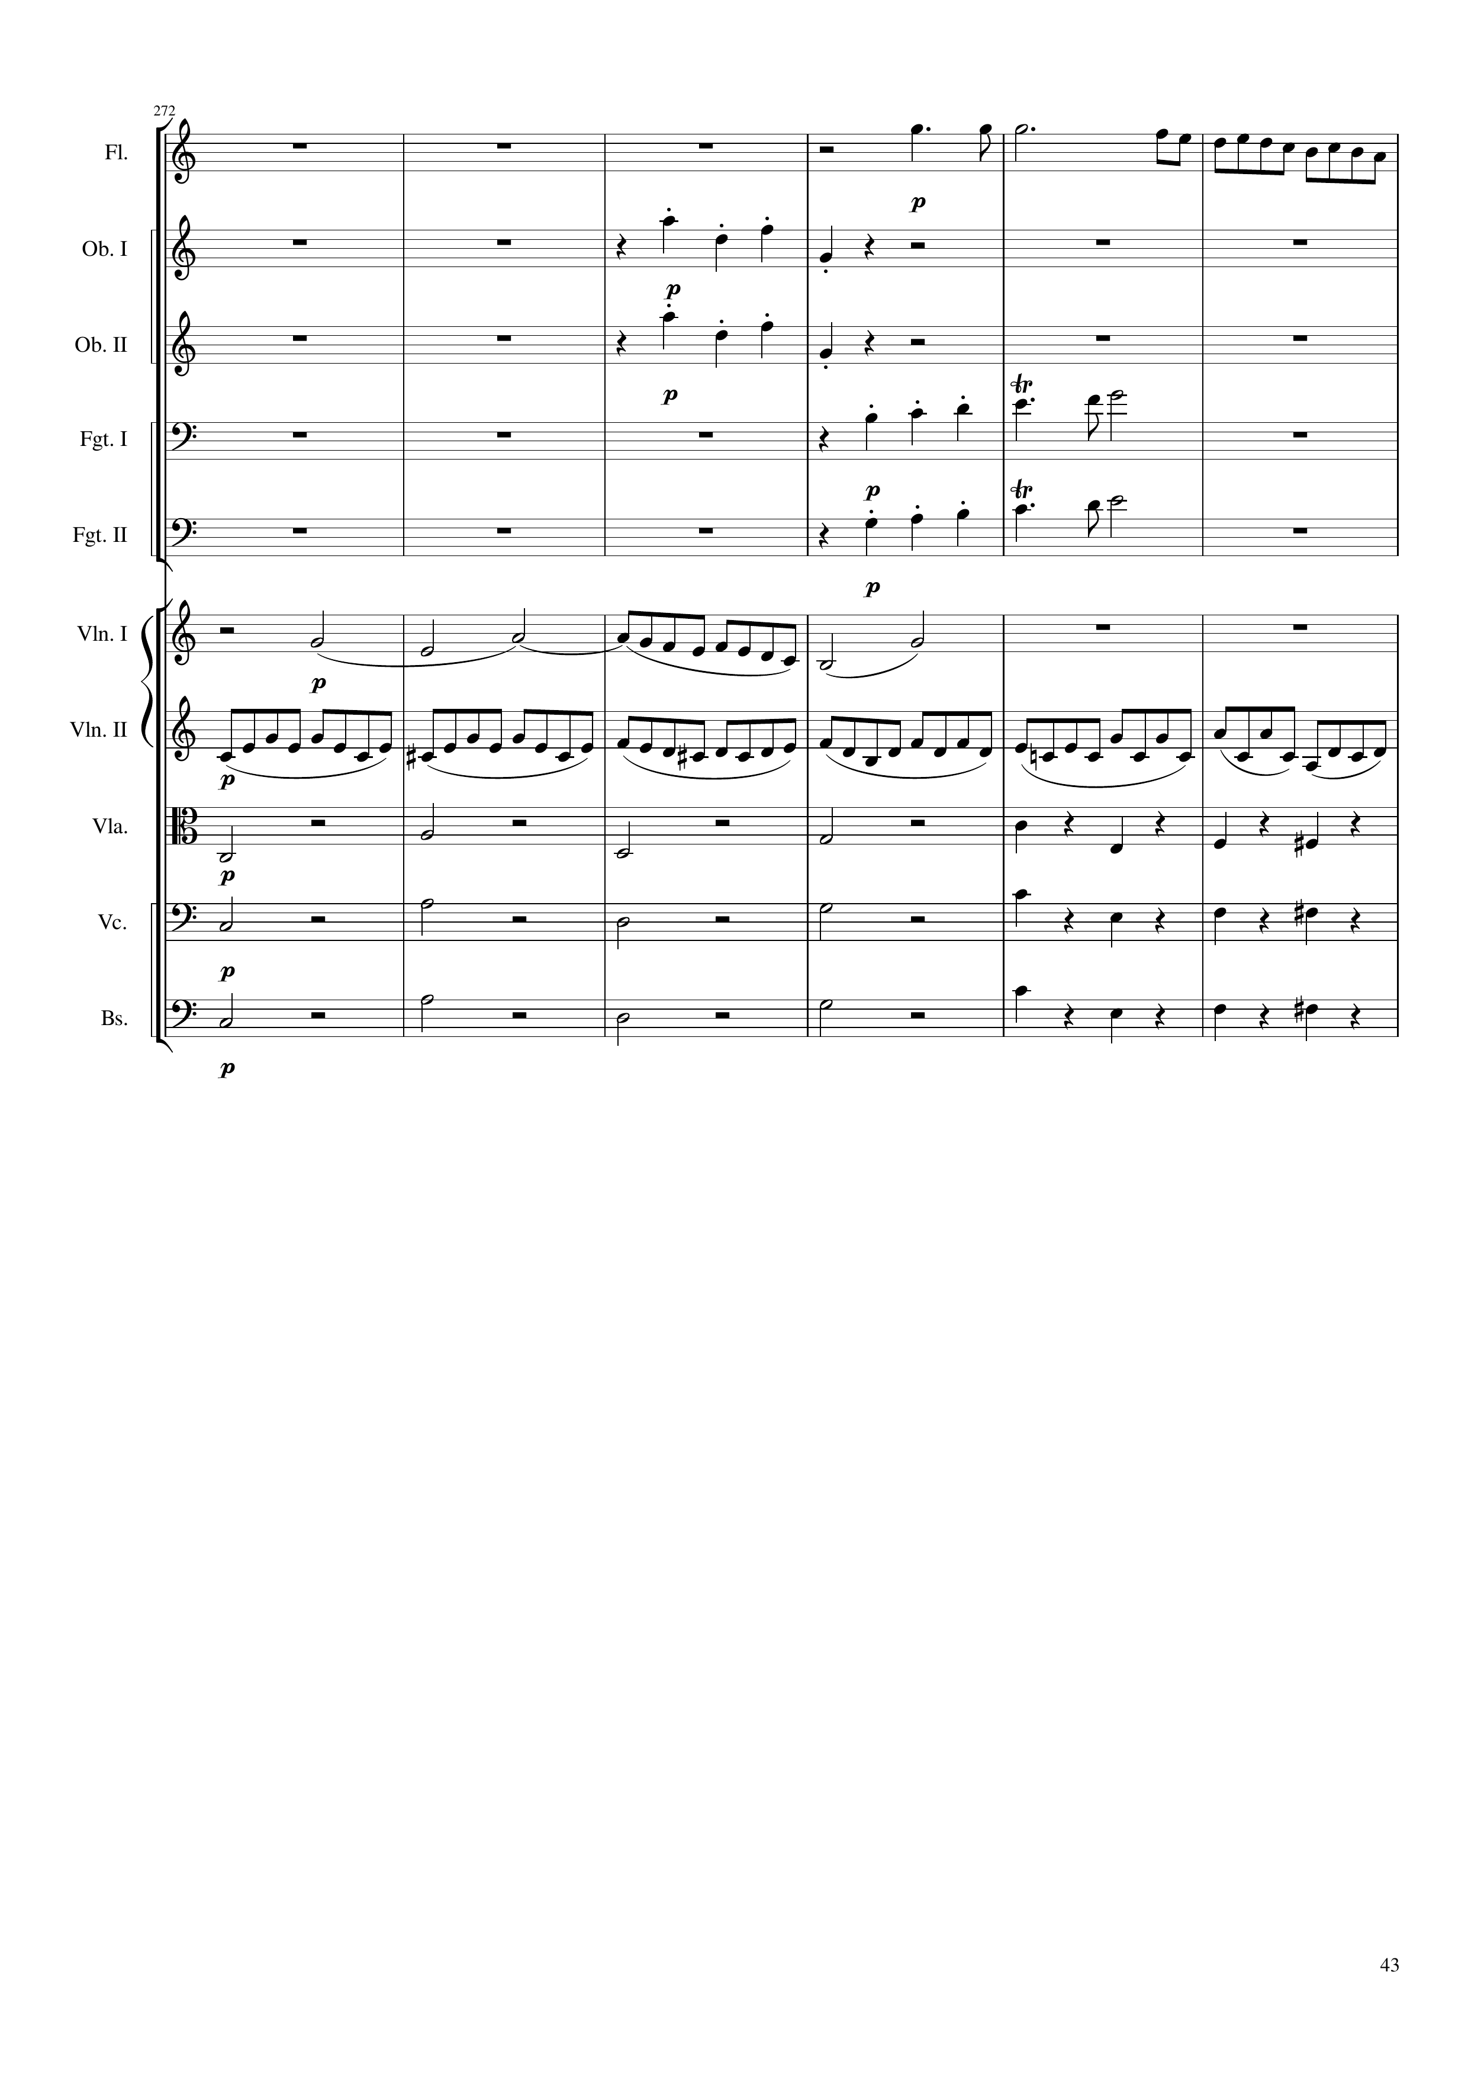
mel
rhythm
rhythm
mel
mel
mel
rhythm
rhythm+harm
rhythm+harm
rhythm+harm
1712
1736
Notes:
38:15

Slide 44
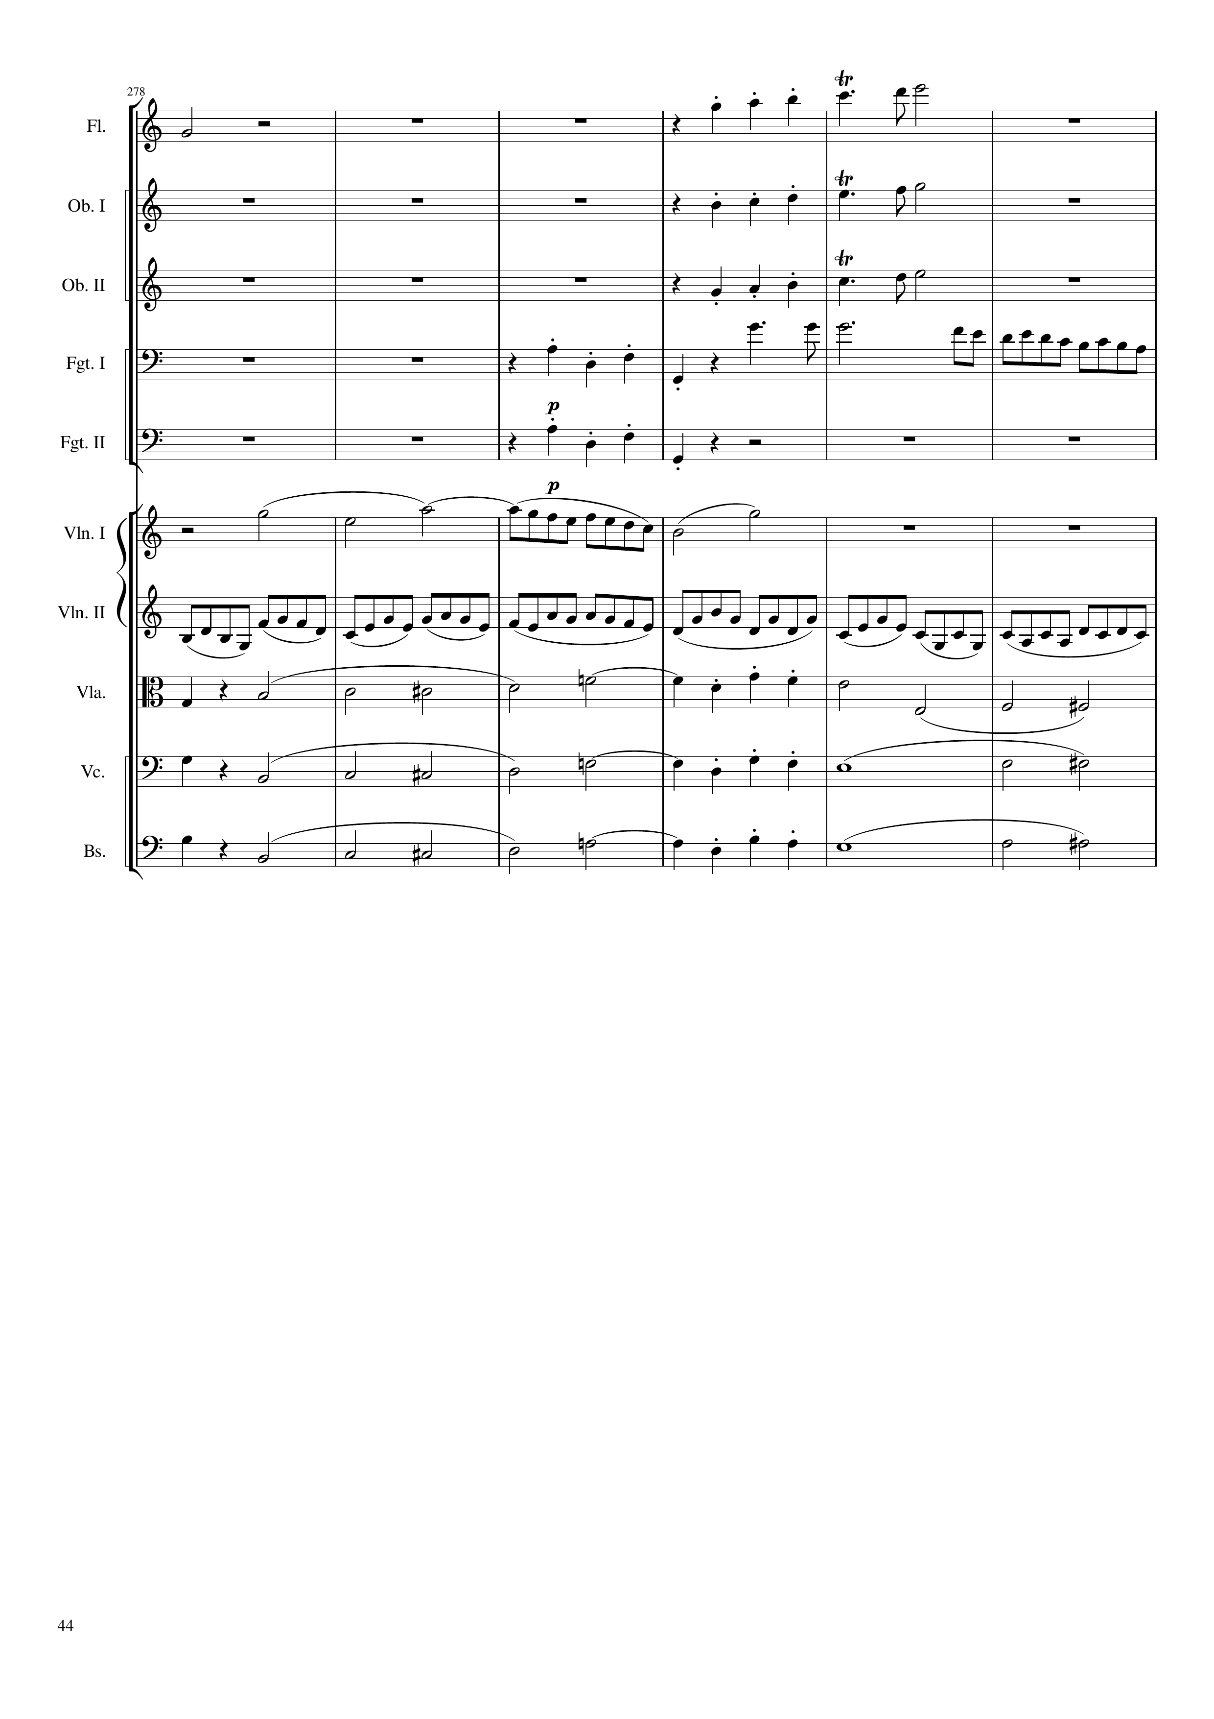
mel
mel
mel
mel
rhythm
mel
rhythm
mel
rhythm
rhythm+harm
mel+harm
rhythm+harm
mel+harm
rhythm+harm
mel+harm
1736
1760

Slide 45
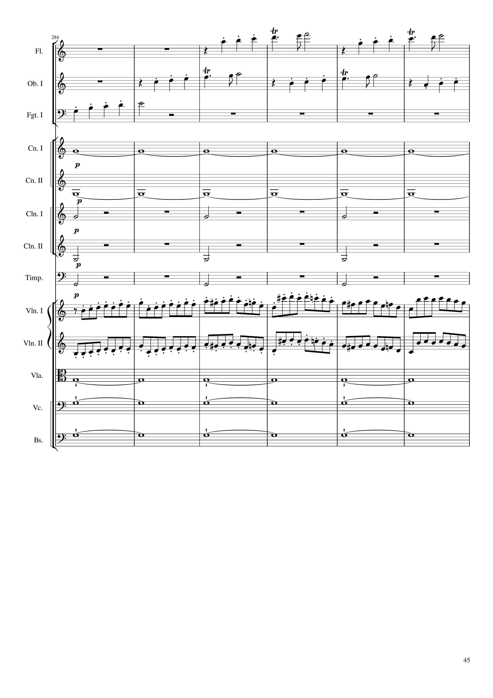
mel
mel
mel
harm
harm
rhythm
rhythm
rhythm
mel
mel
harm
harm
harm
1760
1784

Slide 46
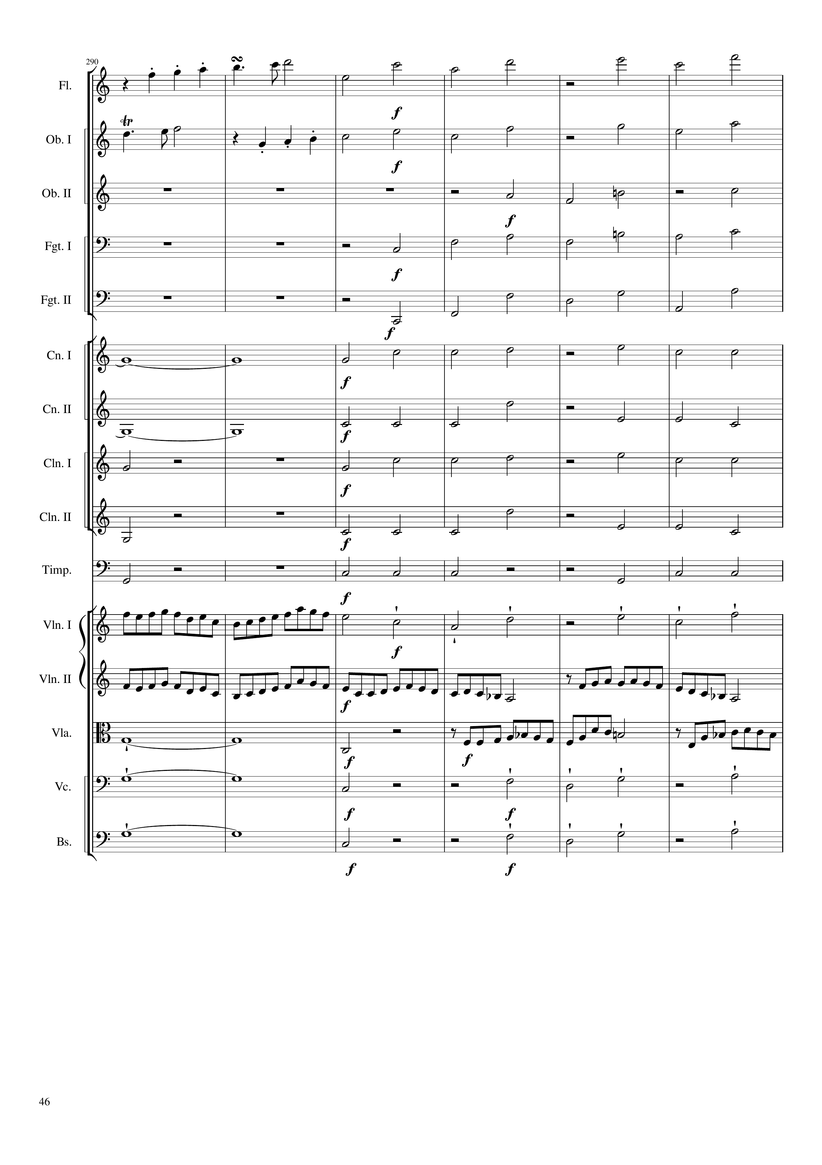
mel
mel+harm
mel
mel+harm
mel+harm
mel+harm
mel+harm
harm
rhythm
harm
rhythm
rhythm
rhythm
rhythm
rhythm
rhythm
rhythm
mel
mel
mel
mel
harm
mel
harm
mel
harm
mel
1784
1792
1808
Notes:
38:30

Slide 47
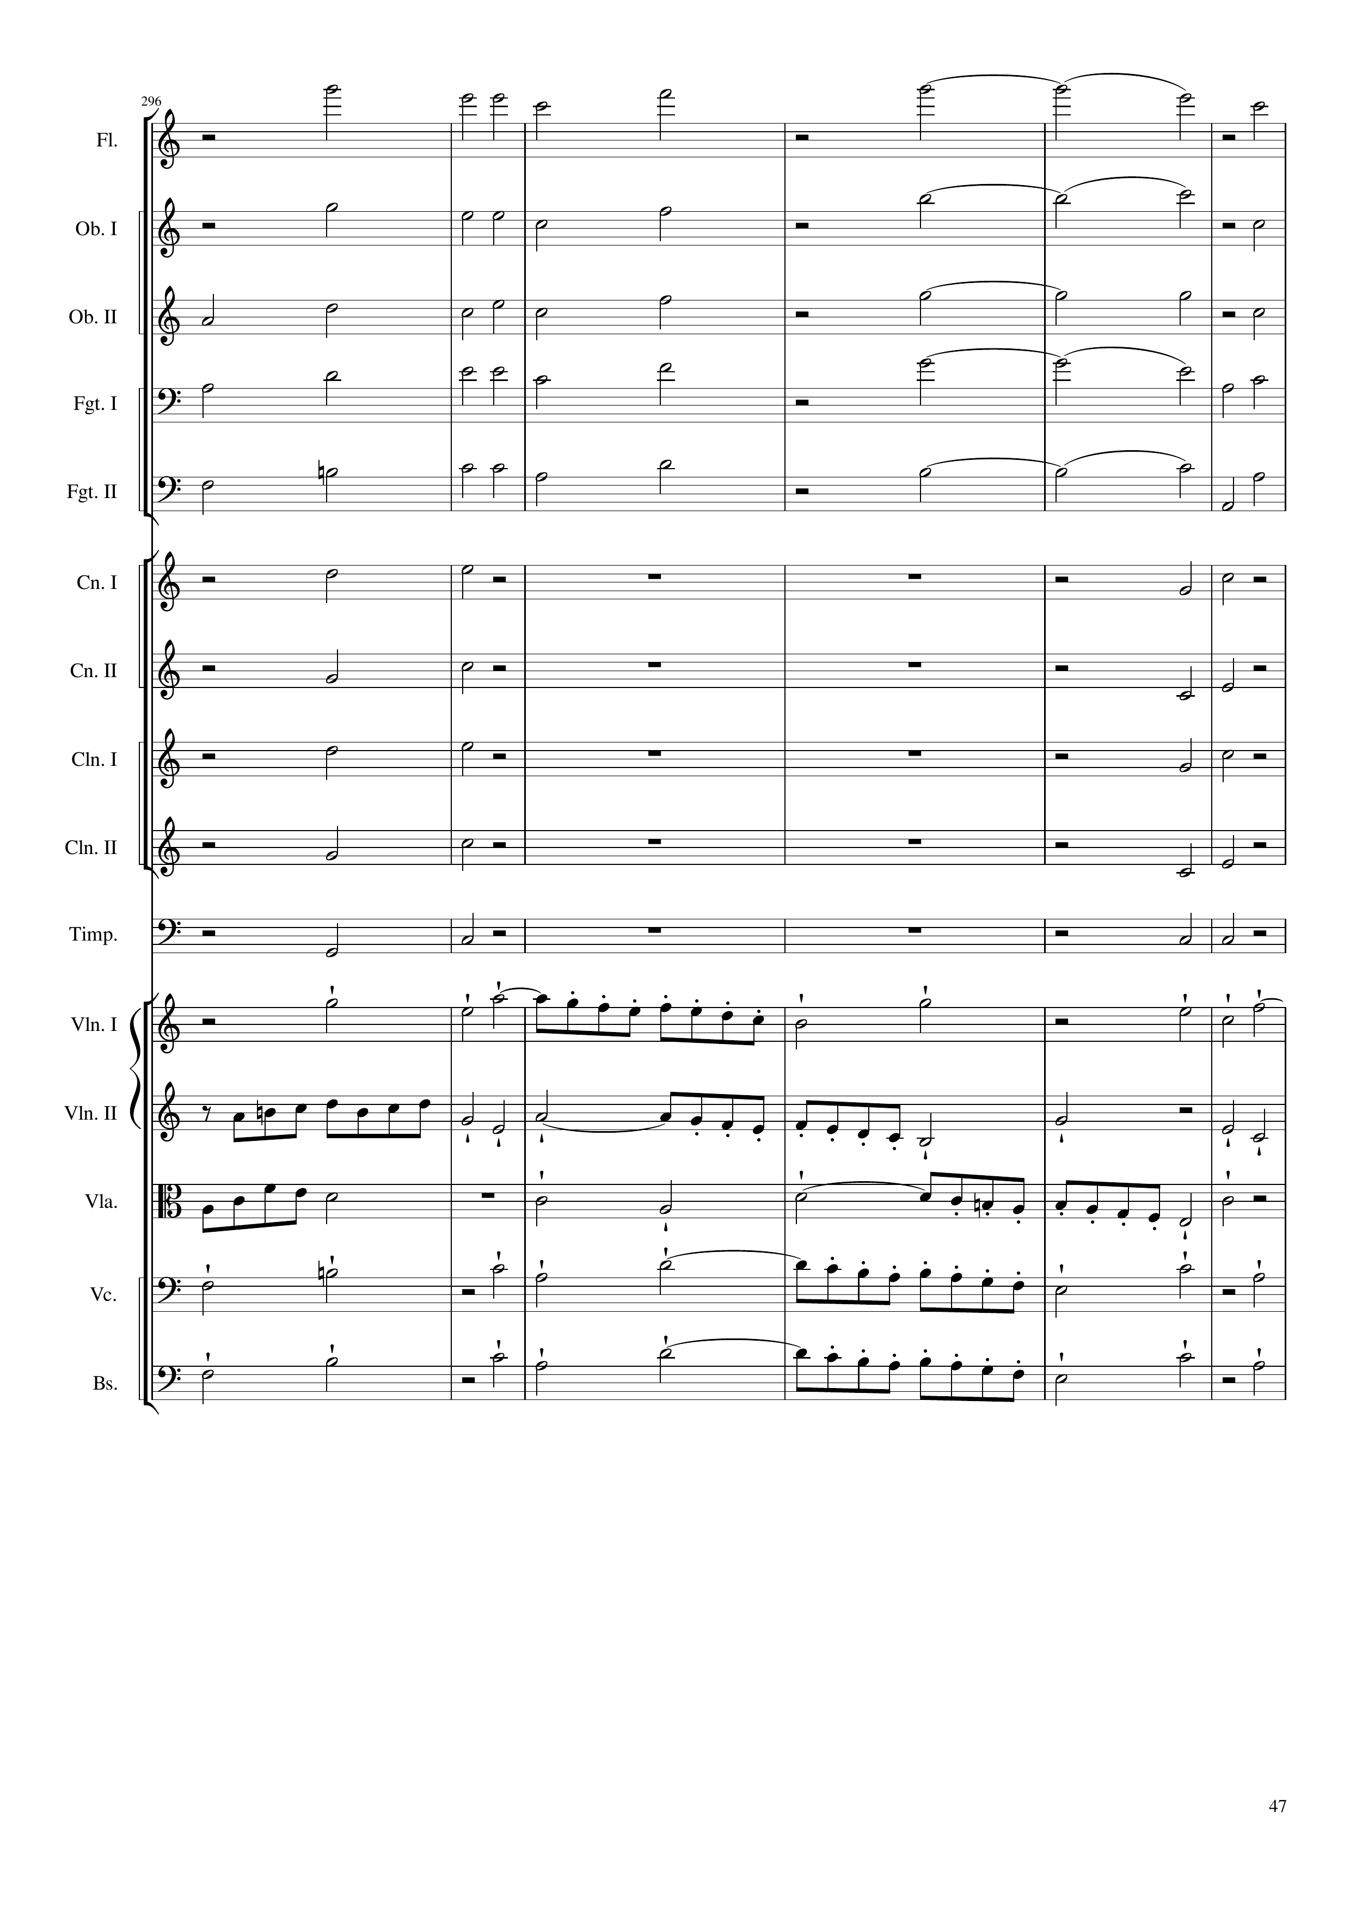
mel+harm
mel+harm
mel+harm
mel+harm
mel+harm
rhythm
rhythm
rhythm
rhythm
rhythm
rhythm
rhythm
rhythm
rhythm
rhythm
mel
mel
mel
mel
mel
1808
1832

Slide 48
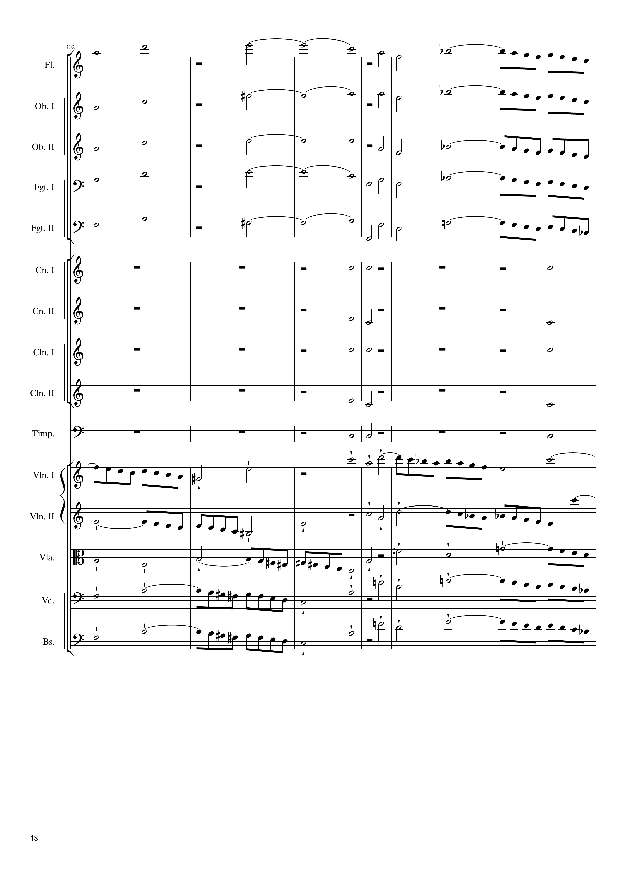
mel+harm
mel
mel+harm
mel
mel+harm
mel
mel+harm
mel
mel+harm
mel
rhythm
rhythm+harm
rhythm
rhythm+harm
rhythm
rhythm+harm
rhythm
rhythm+harm
rhythm
rhythm
mel
mel
mel
mel
mel
1832
1844
1856

Slide 49
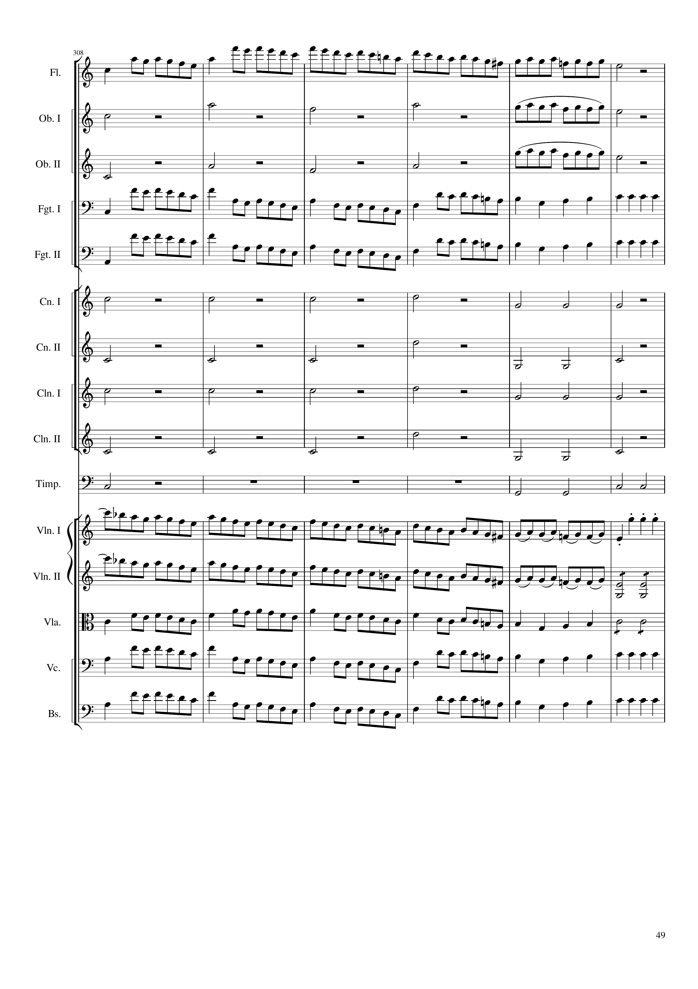
mel
mel
rhythm+harm
mel
rhythm+harm
mel
mel
rhythm
mel
rhythm
rhythm+harm
rhythm
rhythm+harm
rhythm
rhythm+harm
rhythm
rhythm+harm
rhythm
rhythm
rhythm
mel
mel
mel
mel
rhythm
mel
rhythm
mel
rhythm
mel
rhythm
1856
1872
1880

Slide 50
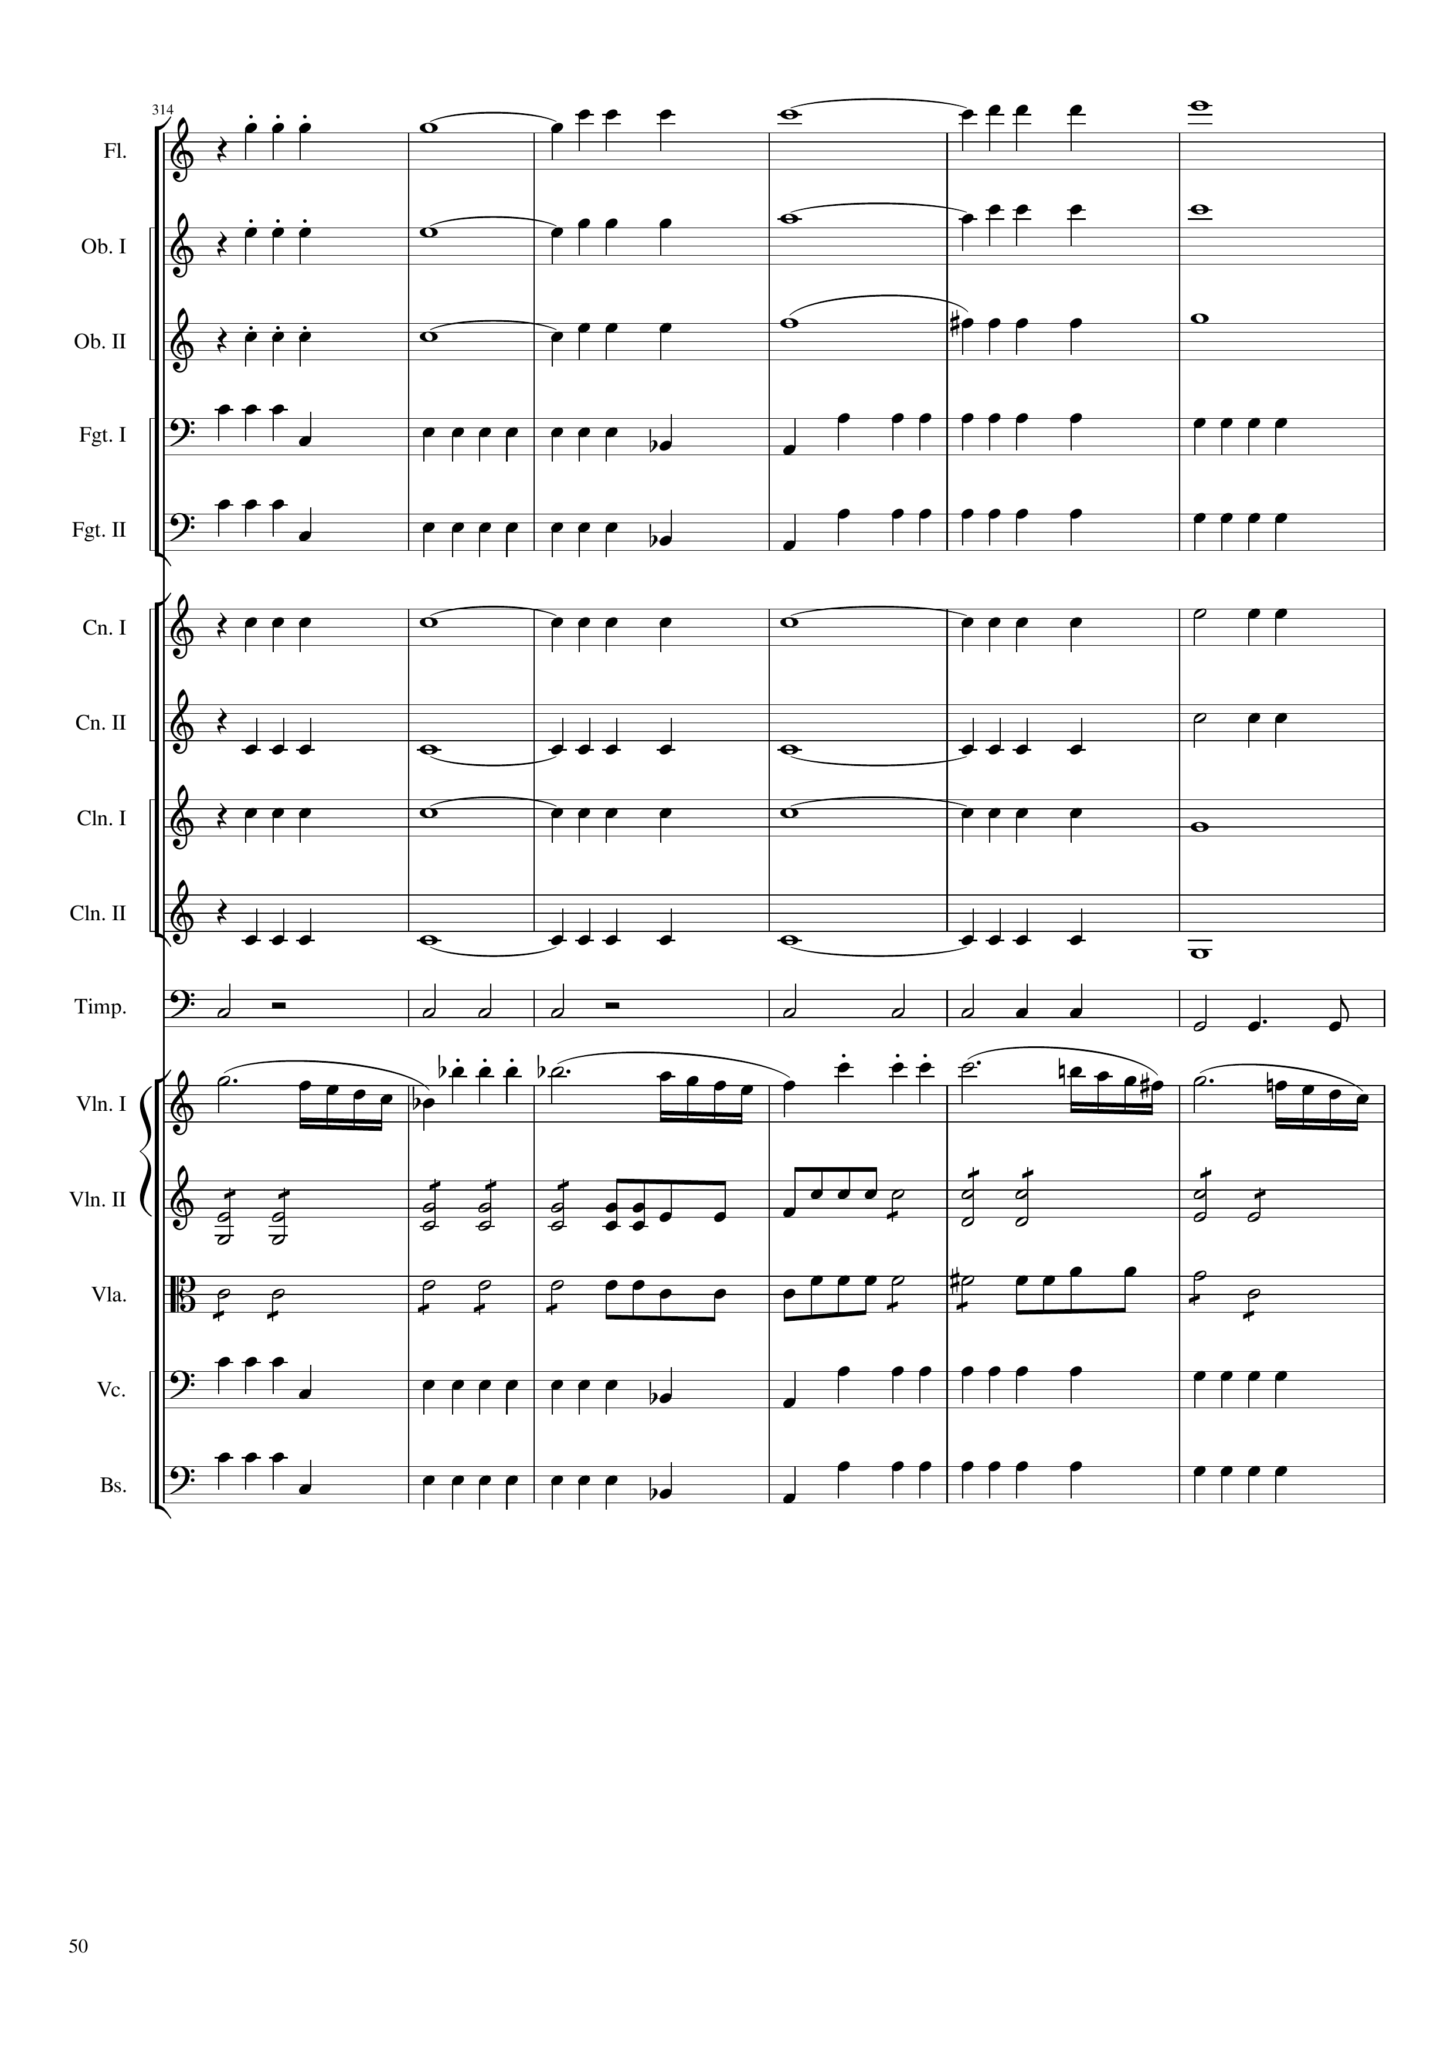
rhythm+harm
rhythm+harm
rhythm+harm
rhythm
rhythm
rhythm+harm
rhythm+harm
rhythm+harm
rhythm+harm
rhythm
mel
rhythm
rhythm
rhythm
rhythm
1880
1904

Slide 51

rhythm+harm
rhythm+harm
rhythm+harm
rhythm
mel
rhythm
mel
rhythm+harm
rhythm
rhythm+harm
rhythm
rhythm+harm
rhythm
rhythm+harm
rhythm
rhythm
mel
rhythm
rhythm
rhythm
rhythm
mel
rhythm
mel
1904
1928

Slide 52

rhythm+harm
mel
rhythm+harm
mel
rhythm+harm
mel
mel
mel
mel
harm
mel
rhythm
rhythm
rhythm
rhythm
rhythm
rhythm
rhythm
rhythm
rhythm
rhythm
rhythm
mel+rhythm
mel+rhythm
mel
rhythm
mel
rhythm
mel
rhythm
1928
1936
1952

Slide 53

mel
mel
mel
mel
mel
mel
rhythm
mel
rhythm
mel
mel
rhythm
mel
rhythm
rhythm+harm
rhythm
rhythm+harm
rhythm
rhythm
rhythm
rhythm+harm
mel
rhythm+harm
mel
rhythm
mel
rhythm
mel
rhythm
mel
1952
1960
1980

Slide 54

mel
harm
mel
harm
mel
mel
mel
mel
mel
mel
rhythm
rhythm+harm
rhythm
rhythm+harm
rhythm
rhythm+harm
rhythm
rhythm+harm
rhythm
rhythm
mel
rhythm
mel
rhythm
mel
mel
mel
mel
mel
mel
1980
2004
Notes:
39:20

Slide 55

harm
harm
mel
mel
harm
mel
mel
mel
rhythm+harm
rhythm+harm
rhythm+harm
rhythm+harm
rhythm
rhythm
mel
rhythm
mel+harm
mel
mel+harm
mel
rhythm
mel
rhythm
2004
2024
2032

Slide 56

mel
mel
mel
mel
mel
mel
mel
rhythm
rhythm
rhythm
rhythm
rhythm+harm
rhythm
rhythm+harm
rhythm
rhythm+harm
rhythm
mel
mel
mel+harm
mel
mel+harm
mel
rhythm
rhythm+harm
mel
rhythm
rhythm+harm
mel
2032
2052
2856
2848
Notes:
39:27

Slide 57

mel
mel+harm
mel
mel
mel
mel
rhythm
rhythm
rhythm
rhythm
rhythm
mel
mel+harm
mel
mel+harm
mel
mel+harm
mel
mel+harm
mel
2856
2896

Slide 58

mel+harm
mel+harm
mel+harm
mel+harm
mel+harm
mel+harm
mel+harm
mel+harm
mel
mel+harm
mel
mel+harm
mel+harm
2896
2928
mel+harm
mel+harm
mel+harm
mel
mel
mel+harm
mel+harm
mel
mel
mel
2928
2956

Slide 59

mel+harm
mel
mel+harm
mel+harm
mel
mel
mel+harm
rhythm
rhythm
rhythm
rhythm
rhythm
mel+harm
mel
mel+harm
mel
mel
mel
mel
mel
mel
mel
mel
mel+harm
2956
2980

Slide 60

mel
mel
mel
mel
mel+harm
mel+harm
mel
rhythm
rhythm
rhythm
rhythm
rhythm
mel
mel
mel
mel
mel+harm
mel+harm
mel
2980
3004

Slide 61

mel
mel+harm
mel
mel+harm
mel+harm
mel+harm
mel
mel
rhythm
rhythm
rhythm
rhythm
rhythm
mel
mel+harm
mel
mel+harm
mel
mel+harm
mel
mel
3004
3028

Slide 62

mel+harm
mel
mel+harm
mel
mel+harm
mel
mel
rhythm
mel
rhythm
rhythm
rhythm+harm
rhythm
rhythm+harm
rhythm
rhythm+harm
rhythm
rhythm+harm
rhythm
rhythm+harm
mel+harm
mel
mel
mel
mel
rhythm
mel
rhythm
mel
rhythm
3028
3052

Slide 63

mel
mel
mel
rhythm
mel
mel
rhythm
rhythm
mel
rhythm
rhythm
mel
rhythm
rhythm+harm
rhythm
rhythm+harm
rhythm
rhythm+harm
rhythm+harm
rhythm+harm
mel
mel
mel
mel
rhythm
mel
rhythm
rhythm
mel
rhythm
rhythm
mel
rhythm
3052
3072

Slide 64

mel
rhythm
harm
rhythm
mel
rhythm
mel
rhythm
mel
rhythm
rhythm
rhythm
rhythm
rhythm
mel
rhythm
mel
mel
mel
rhythm
mel
rhythm
mel
rhythm
mel
3072
3092

Slide 65

rhythm+harm
rhythm+harm
rhythm+harm
rhythm+harm
rhythm+harm
rhythm+harm
rhythm
rhythm+harm
rhythm
rhythm+harm
rhythm
rhythm+harm
rhythm
rhythm+harm
rhythm
mel
rhythm+harm
rhythm+harm
rhythm+harm
rhythm+harm
rhythm+harm
3092
3120

